Slide 1
Existing Building Electrification:
City of Sacramento
Ashley N. DePew
Kesh Nayebi
Daniel Simpson

Slide 2
Where to Begin?
Notes:
Client Tasks: ID priorities and key considerations | Scope and Frame the project| Review current research and best practices | Develop Recommendations

Slide 3
Scope & Deliverables
Report | Included | Excluded
Electrification Best Practices | X
Policy Landscape | X
Barriers | X
Municipal Building Analysis | X
Recommendations | X
Electrification Strategy |  | X

Slide 4
Methodology
01
02
03
04
Literature Review
Industry & Government
EnergyCap, Internal Assessments
Sustainable Communities
Resource Priorities Map
Notes:
1 Academic publications, media sources, 2 Reports & databases: CEC, CPUC, EIA, EPA, and others
3 Sacramento building characteristics and energy usage 4 DAC Mapping

Slide 5
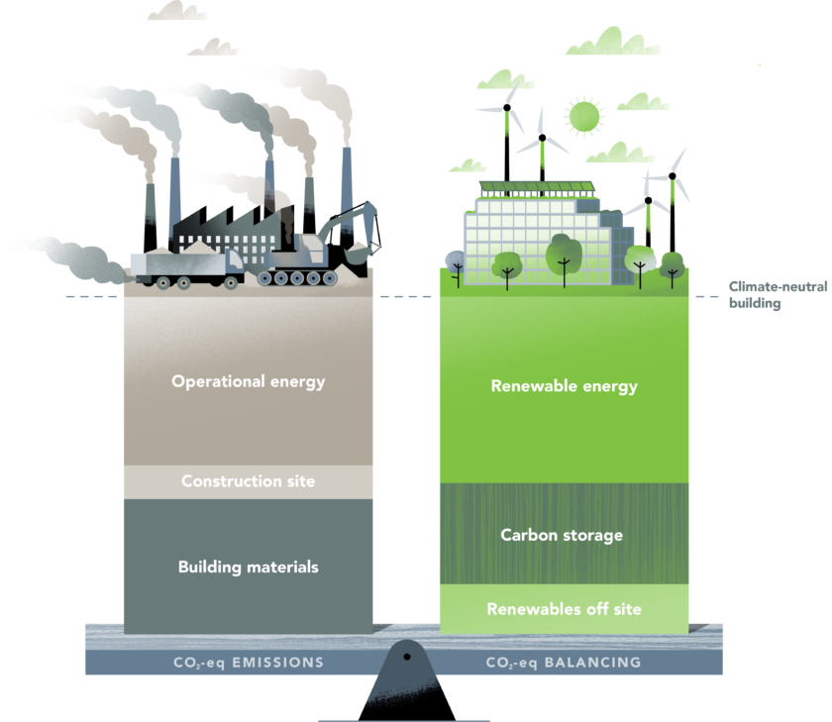
Benefits to Electrification
Greenhouse Gas Emissions
when combined with a green grid
Health & Safety
Indoor air quality improvements; fire, explosion, leak safety
Cost of Fuel
SMUD has a longstanding record of low electricity rates

Slide 6
Policy Landscape
AB 3232
Building stock emissions 40% less than 1990 levels by 2030
Carbon Neutrality - 2045
Goal, but no state mandate for electrification as a means of decarbonization
Gas Bans & Reach Codes
44 communities to date

Slide 7
Barriers to Electrification
Infrastructure Capacity
Occupant Demand
Electrical panel sizing, transformers & secondary grid network
Customer education
Lack of Skilled & Willing Labor Force
Initial Capital Investment
Unfamiliar technology, unwillingness to switch to default electric installs, logistics across different trades
Costs of equipment, labor, infrastructure upgrades

Slide 8
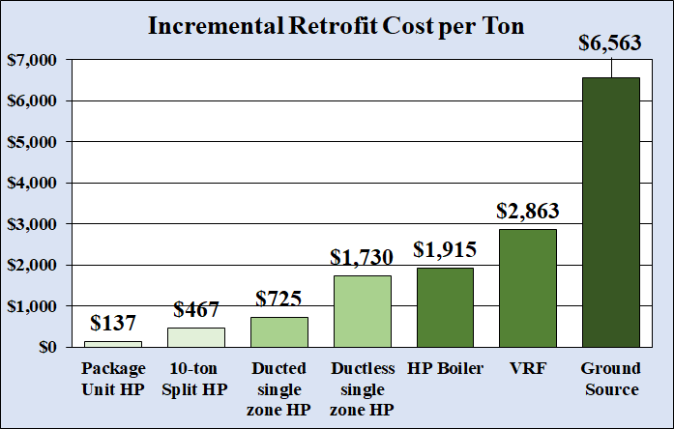
Best Practices
Commercial Electrification Retrofit: Space Heating
Best Practice System Retrofit
Rooftop Gas-pack Unit: HP Package Unit
Furnace: HP Package System
Individual Space Heater: Single Zone HP
Boiler w/ Ducted Air System: HP Boiler & Larger VAV Coils
Boiler w/ Radiant heat:
VRF & Piping & Dedicated Outdoor Air System
Incremental Cost: System cost above Standard Equipment Replacement
Notes:
Ton is a unit of power. It is defined as the power required to melt or freeze 2000 pounds of ice per day. Approximately equal to 12,000 BTU/h.

Slide 9
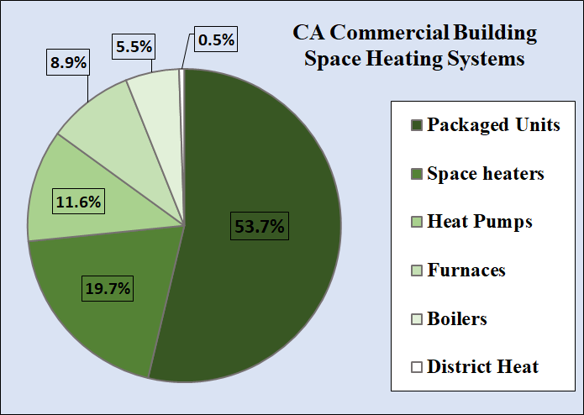
California Space Heating Retrofit Landscape
Data: Commercial Building Energy Consumption Survey: 2012 (EIA 2016)
Notes:
Fortunately the

Slide 10
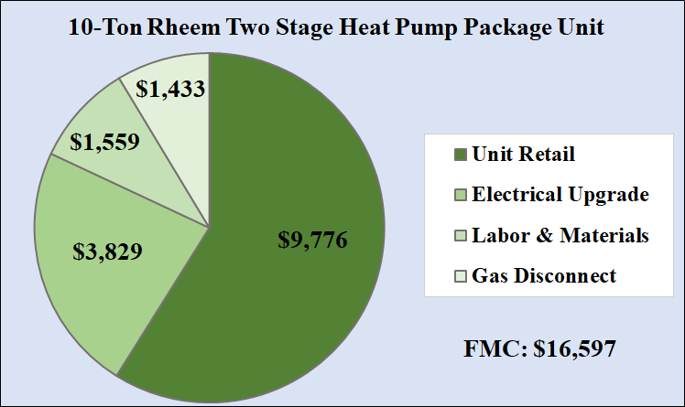
Full Measure Cost: Example
Full Measure Retrofit Costs
Unit: Retail Cost
Electrical Upgrades: Circuit 20A to 80A
Labor & Materials: Installation & Infrastructural changes
Gas Disconnection: Whole Building PG&E Disconnect

Slide 11
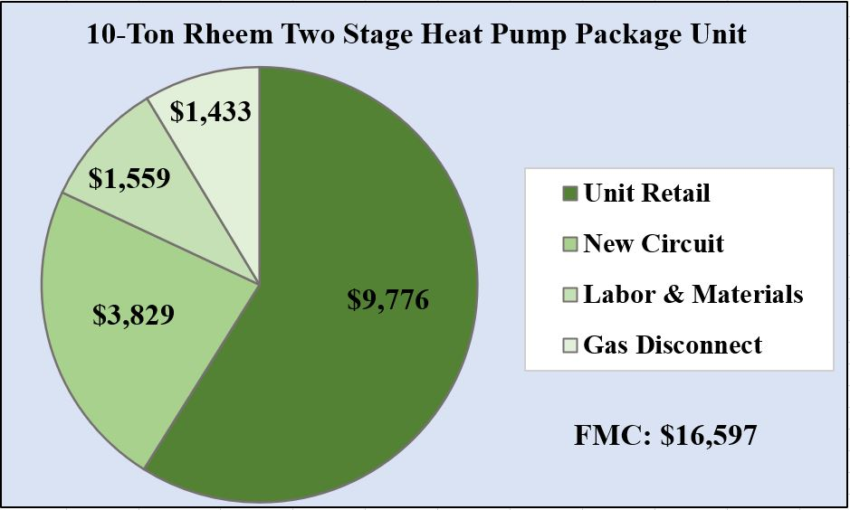
Cost Assessment Methodology
Accelerated Replacement Costs (ARC) ARC: Cost of replacement ahead of end of life. FMC: Full Measure Cost IMC: Incremental Measure Cost D: CPUC-adopted discount rate (7.6%) RUL: Remaining Useful Life (Ex. 5 years)

Slide 12
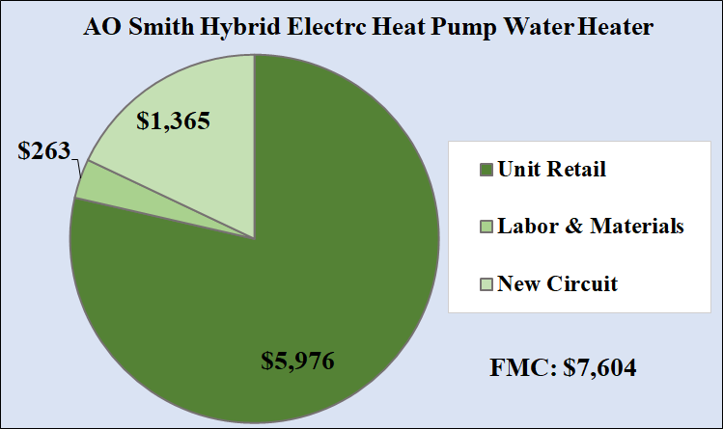
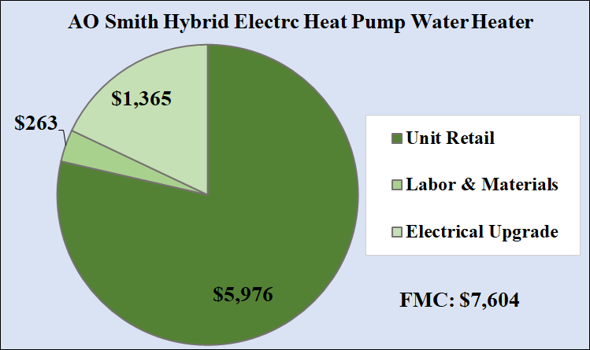
Commercial Electrification Retrofit: Domestic Hot Water
Best Practice Electrification
Heat Pump Water Heater: 49%-63% more Efficient than Resistance Electric
Full Measure Retrofit Costs
Unit: Retail Cost
Electrical Upgrade: 20A to 30A
Labor & Materials: Installation, Infrastructural Changes & Gas Line Cap
Incremental Cost: $700

Slide 13
Recommendations

Slide 14
Methods: Prioritizing Buildings
1
Client Account Prioritization
Sites that rely heavily on natural gas.
2
EV Chargers and Bike Program
Sites that will adopt EV and deploy EV supply equipment.
3
Building Type
Community facing Buildings.
4
Communities Analysis
Buildings located in low-income, disadvantaged communities.
Notes:
EV Blueprint grant

Slide 15
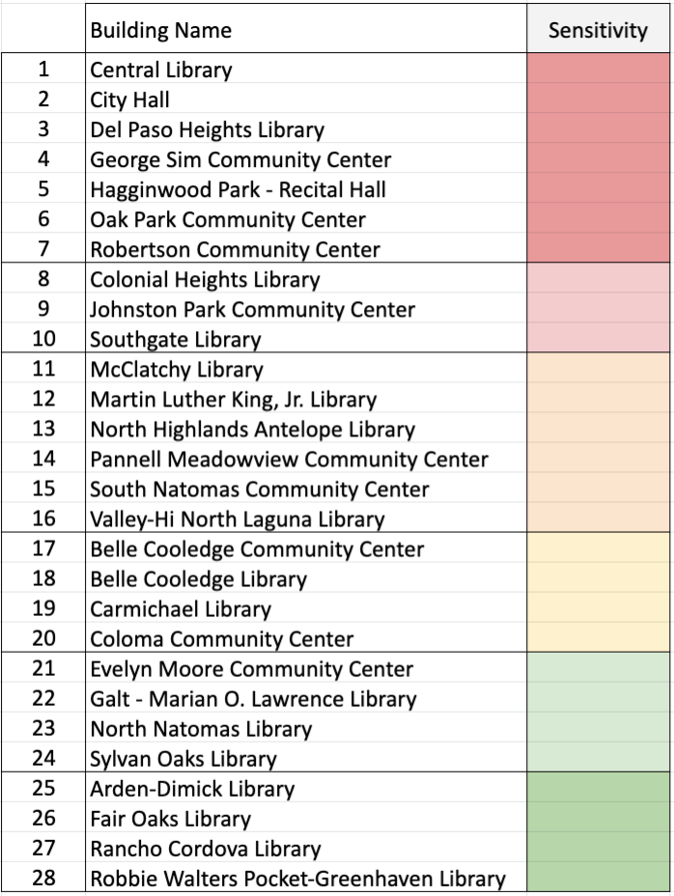
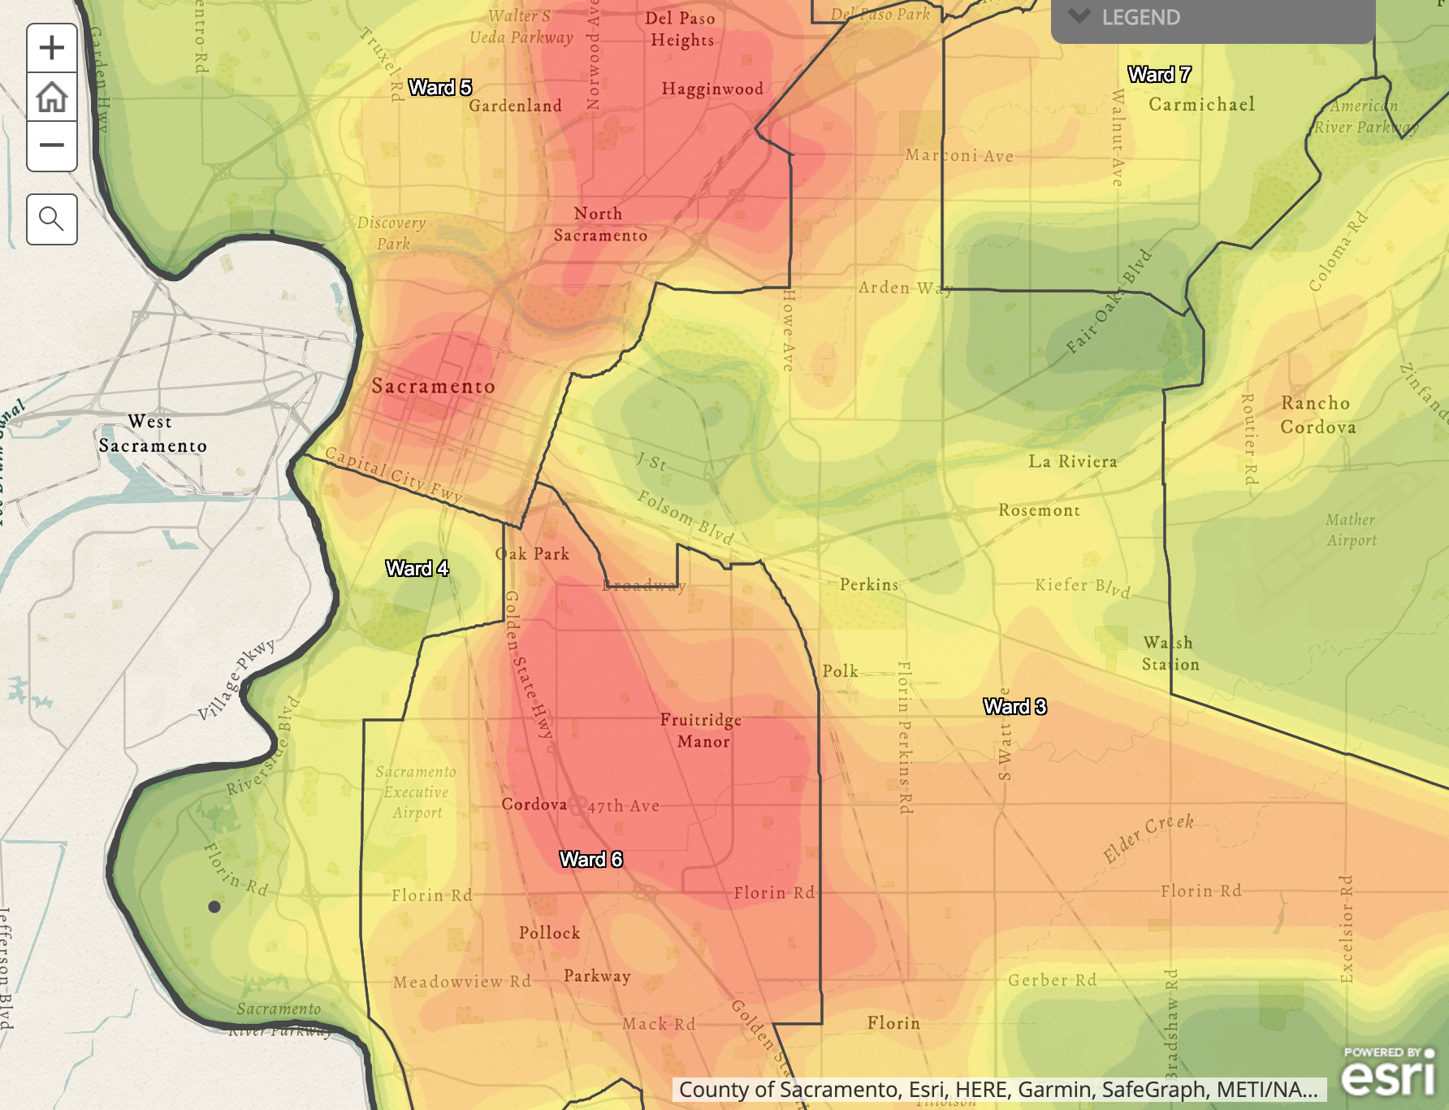
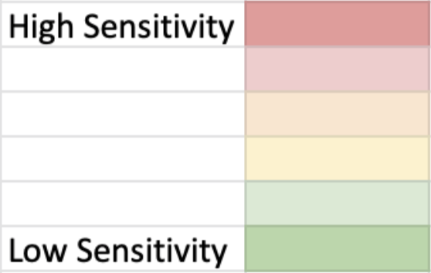
Communities Analysis
7
3
5
9
19
15
2
25
1
27
11
20
6
8
18
17
21
4
28
12
10
14

Slide 16
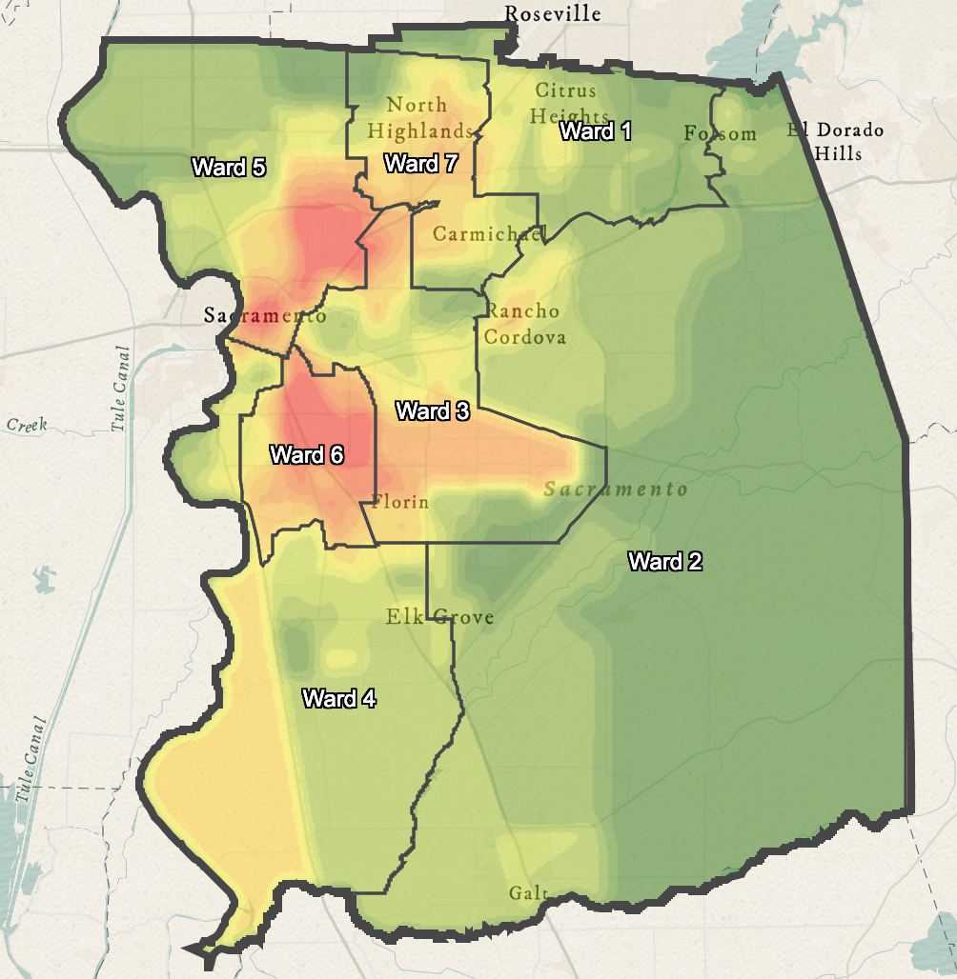
Communities Analysis Continued
13
24
23
26
16
22

Slide 17
Multiple Pathways to 25%
25%
25%
Buildings Approach
Emissions Approach
Buildings Undergoing Upgrades
Buildings with small easily replaced systems
Phasing by Use and Location
Replace one type system in all applicable buildings
Phasing by HVAC systems

Slide 18
Recommended First Steps
1
2
3
4
Plan for Emergency Replacement
Electrification Pilot
Preparation
Funding Sources
Retrofit design plans
Designate funding
City Budget
Identified SMUD Incentives
Biden Administration Efforts
Retrofit plans for replacement upon unexpected failure
Rooftop Package Units
Disadvantaged Communities

Slide 19
Thanks! Questions?
Ashley N. DePew
Kesh Nayebi
Daniel Simpson
andepew@ucdavis.edu
knayebi@ucdavis.edu
dhsimpson@ucdavis.edu

Slide 20
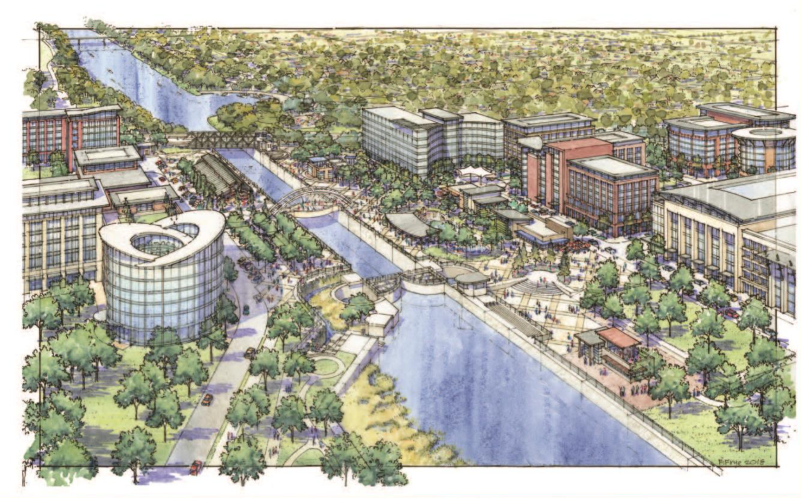
Resources
CEC (California Energy Commission). 2021. 2021 California Building Decarbonization Assessment. www.energy.ca.gov/data-reports/reports/building-decarbonization-assessment
Cunningham, Alejandra M., Ralston, Michelle V., Wu, Katie. 2018. Building Decarbonization Coalition Strategies and Approaches for Building Decarbonization. www.buildingdecarb.org/uploads/3/0/7/3/30734489/bdc_report_3_approaches_for_building_decarb.pdf.
Deason, Jeff et al. 2018. LBNL Report: Electrification of Buildings and Industry in the United States. Drivers, Barriers, Prospects, and Policy Approaches. http://eta-publications.lbl.gov/sites/default/files/electrification_of_buildings_and_industry_final_0.pdf.
Heinen, Steve, Pierluigi Mancarella, Ciara O’Dwyer, and Mark O’Malley. 2018. Heat Electrification The Latest Research in Europe. ieee power & energy magazine 16(June): 69–78.
Rocky Mountain Institute. 2019. Rocky Mountain Institute: The Impact of Fossil Fuels in Buildings: A Fact Base. https://rmi.org/insight/the-impact-of-fossil-fuels-in-buildings/.
SCEa (Southern California Edison). 2020. Workpaper SWWH027-01: Heat Pump Water Heater, Commercial – Fuel Substitution. San Francisco: CPUC. http://deeresources.net/workpapers
SCEb (Southern California Edison). 2020. Workpaper SWHC046-01: Heat Pump, Unitary Air Cooled HVAC, Commercial – Fuel Substitution. San Francisco: CPUC. http://deeresources.net/workpapers.
TRC. 2016. Palo Alto Electrification Final Report. (Online) www.cityofpaloalto.org/files/assets/public/development-services/advisory-groups/electrification-task-force/palo-alto-electrification-study-11162016.pdf
Wendee, Nicole. 2014. Science Selections Cooking Up Indoor Air Pollution. Environmental Health Perspectives 122(1): 2103

