Slide 1
Energy Investigator:
Making Energy Audits Beginner Friendly
Raymond Breault &
Meena Venkatraman
Client: Kiernan Salmon of the Energy Conservation Office
Notes:
RAYMOND
Add verb to title : e.g. making it easier to understand/more accessible etc (=problem defn)
USE AS INTRO/BACKGROUND SLIDE

Slide 2
Scope & Methodology
Energy Audit Research
Reviewed energy audit guides, other software tools and websites for conducting audits
Initial Website Review
Card-sorting with UX students
Used sections of website to inform audit process
1
2
Energy Audit
Performed at UC Davis’ Heitman Staff Learning Center
Deliverable: Energy audit report
App Feedback
Used app to input audit data
Deliverable: Screen recordings and document with feedback
Website Content
Deliverable: Document with proposed content for the “Writing Your Report” section
3
4
5
Notes:
M
Mention only using the app to input things afterwards
(scope of work + methodology) -> make sure to call it this, probably still ok to do

Slide 3
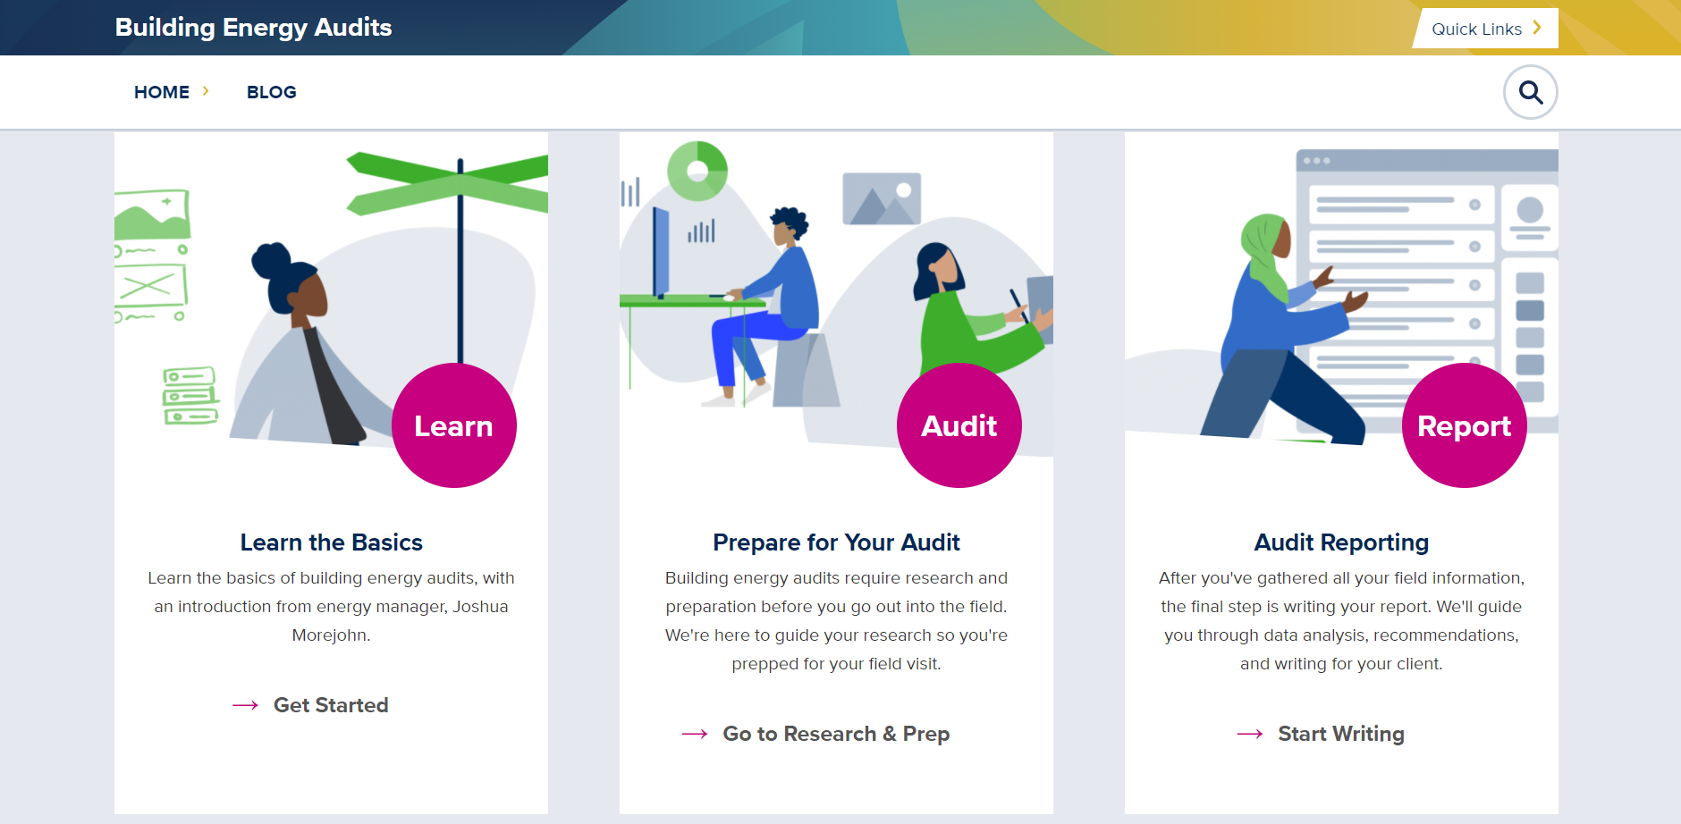
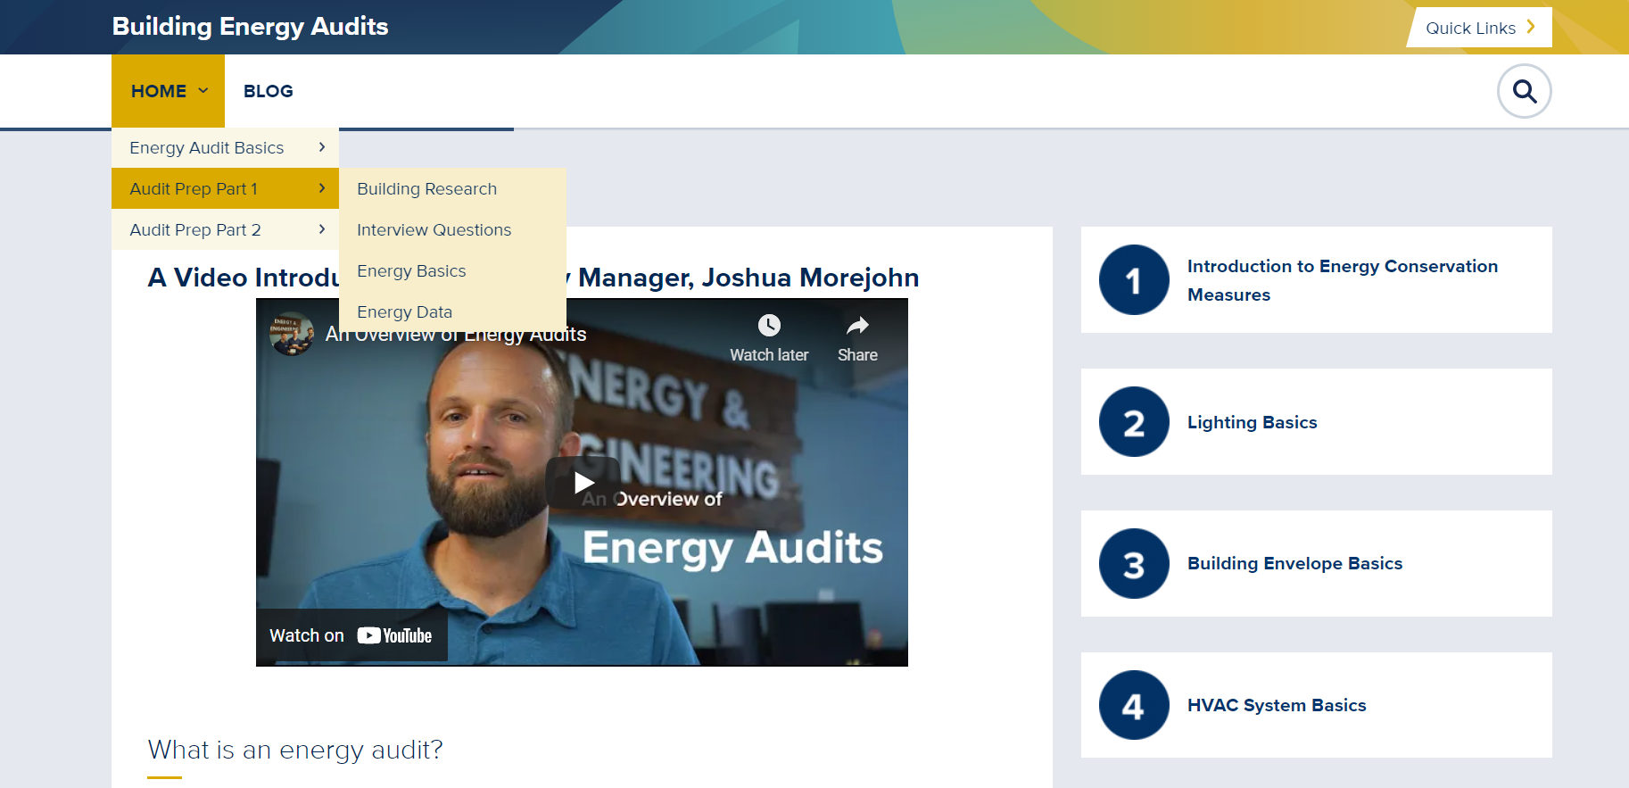
Results & Discussion
Website Recommendations
Step by Step Assistance
Address how to handle data
Include miscellaneous loads section
Notes:
RAYMOND

Slide 4
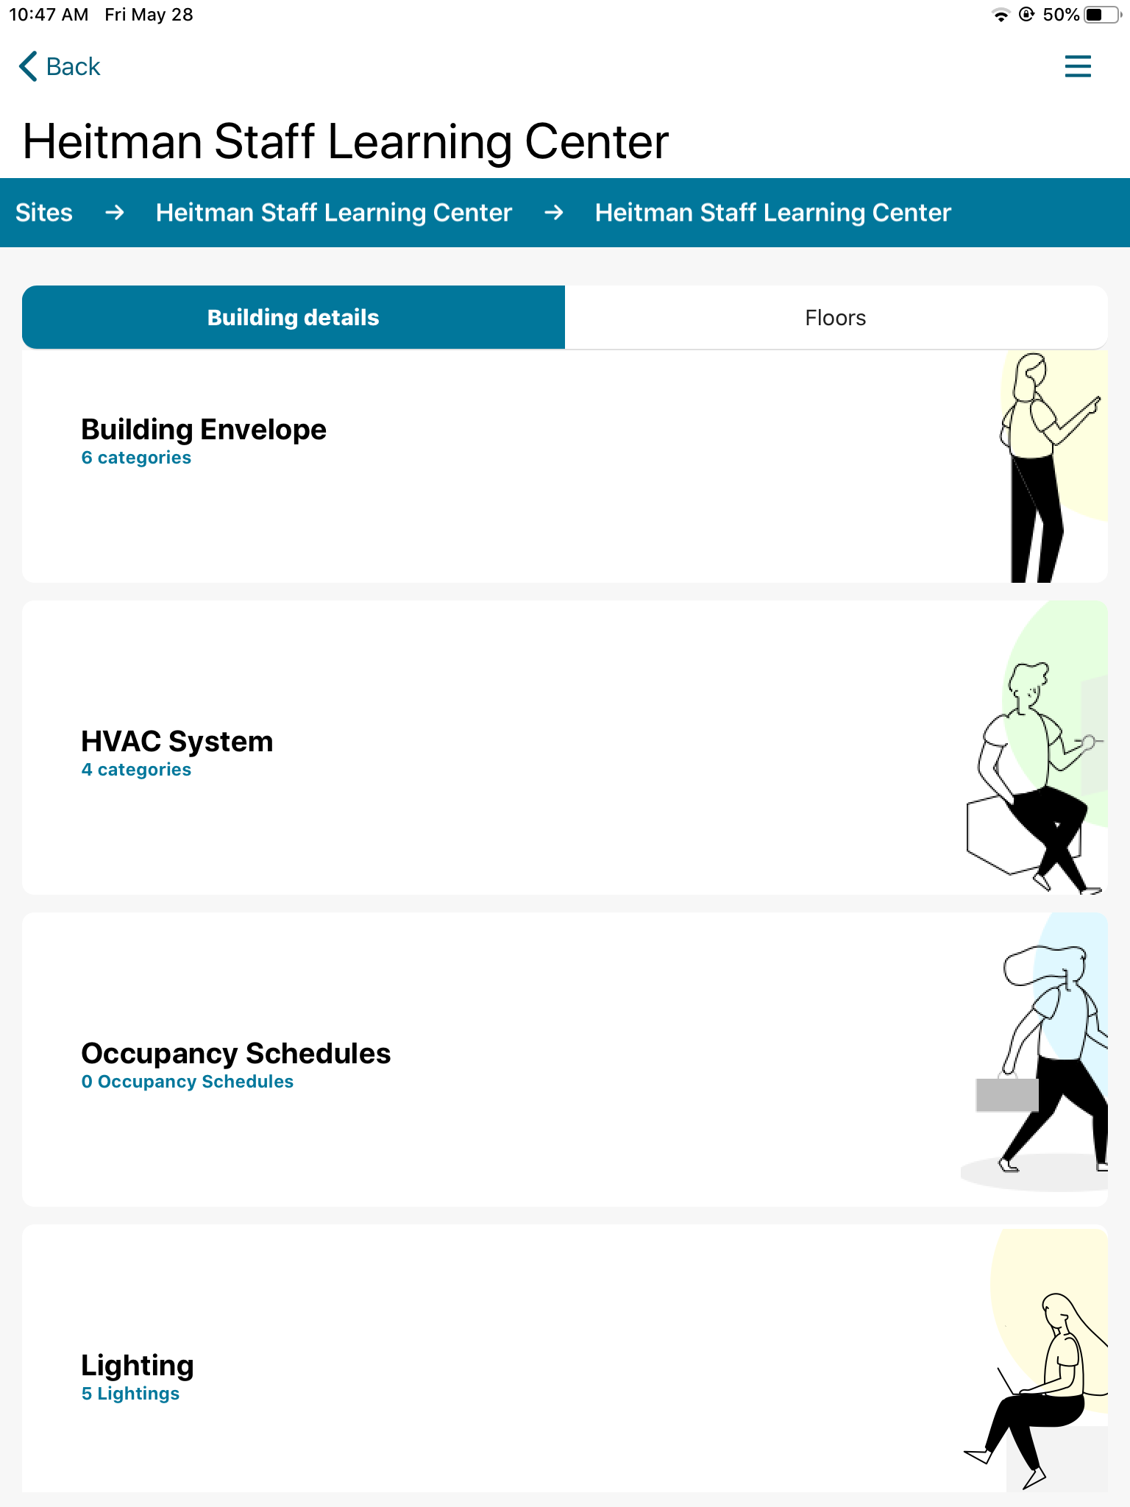
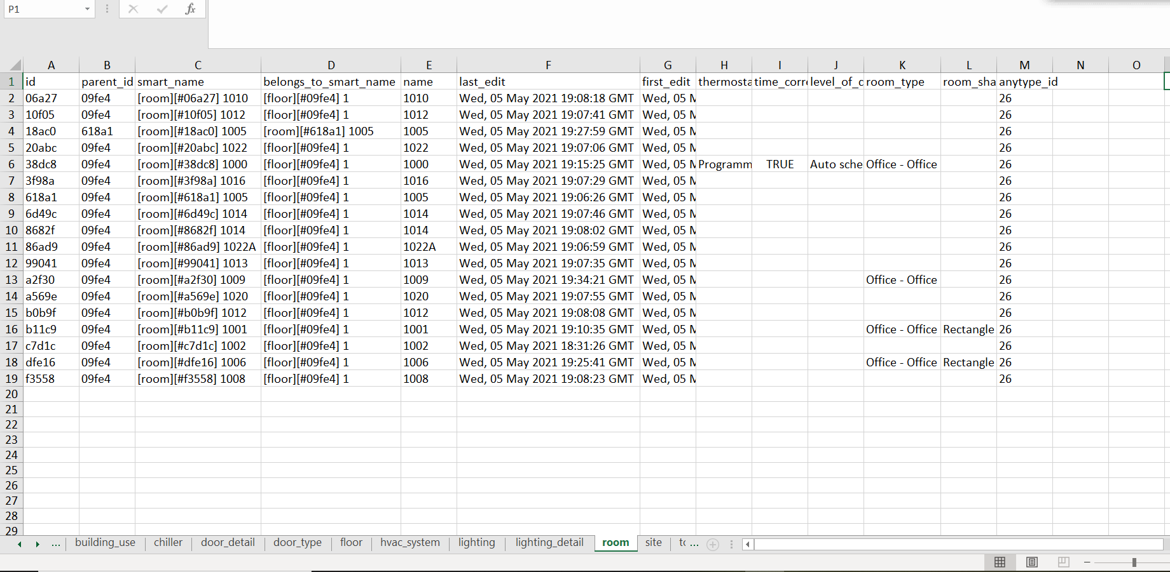
Results & Discussion
App Recommendations
Add section for miscellaneous loads
Reformat output spreadsheet
Feedback on app usability
Notes:
M

Slide 5
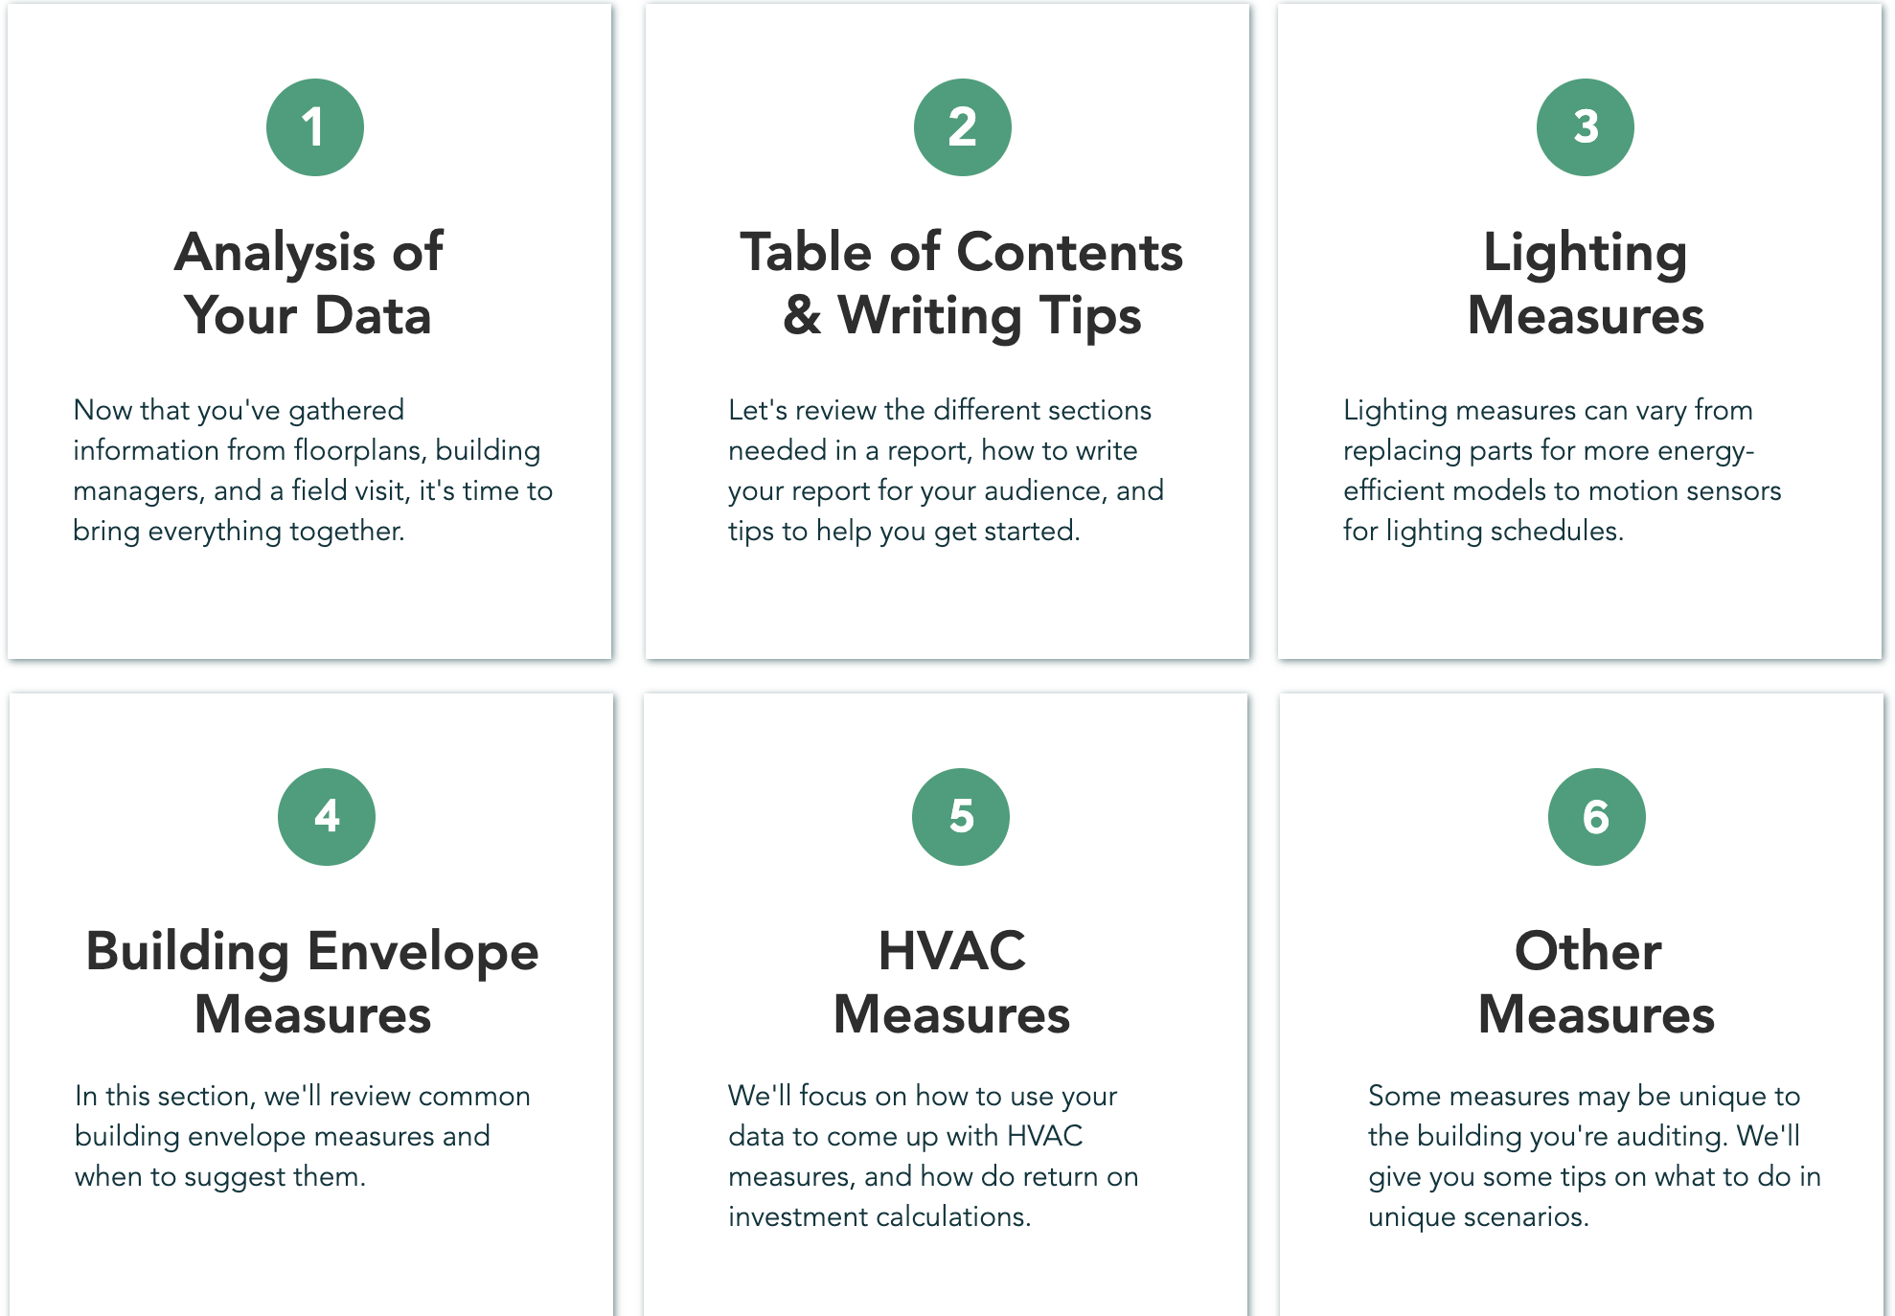
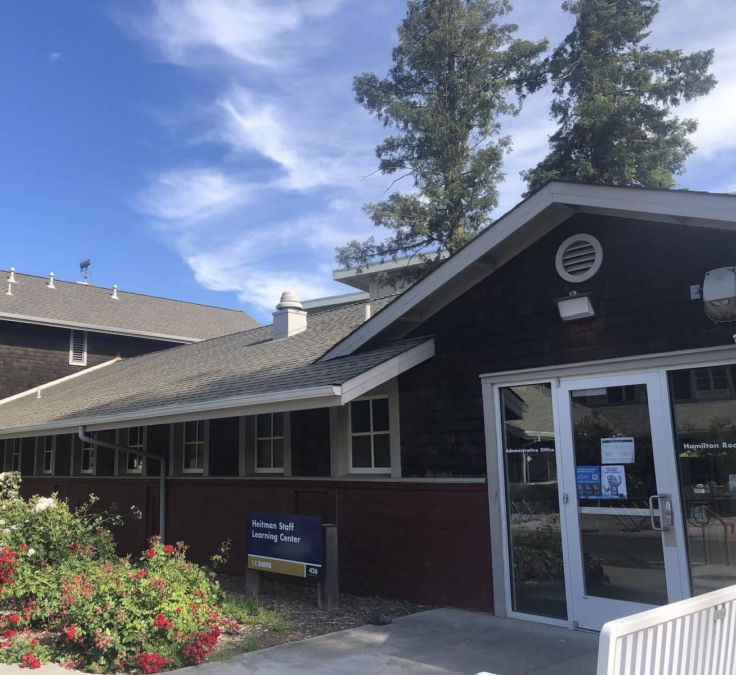
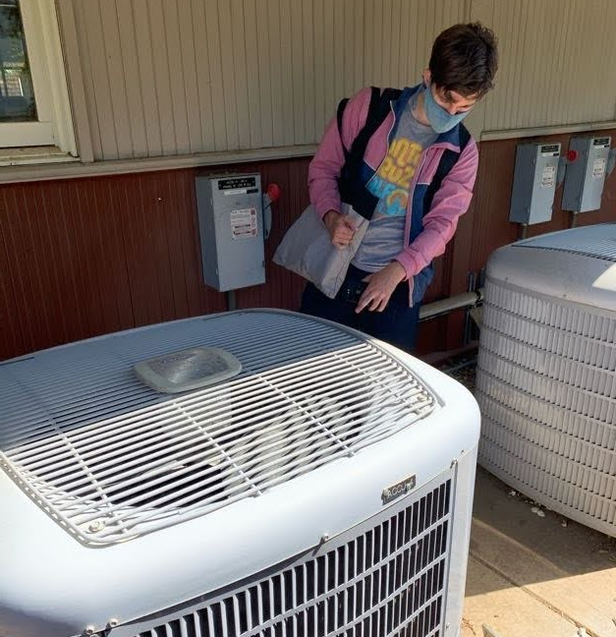
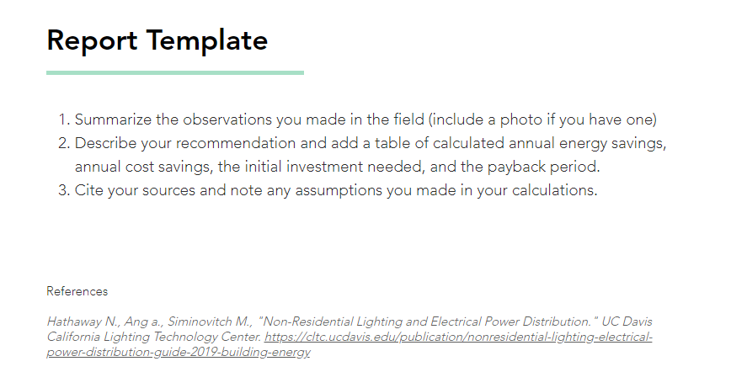
Results & Discussion
“Writing Your Report” section
Example templates
How to fill in missing data
How to find replacement equipment
Notes:
RAYMOND
Half those links don’t even work currently, maybe site isn’t finished

Slide 6
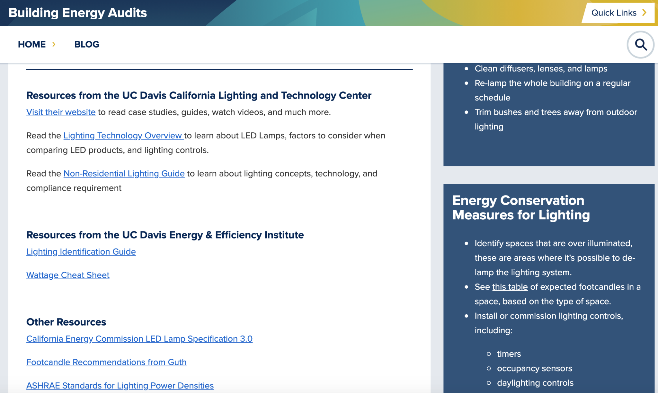
Recommendations & Conclusions
Recommendations
Have energy audit experts review our website content
Have a group of students ONLY use the website to conduct the audit
Start collecting feedback from non-students
Conclusions
High potential
Needs to guide through every step
Notes:
MEENA
Maybe raymond for conclusions

Slide 7
Thank You

Slide 8
Questions?

Slide 9
References
M. Baechler, "A Guide to Energy Audits," ed. Washington: Pacific Northwest National Laboratory, 2011.
R. Matulka. "#AskEnergySaver: Home Energy Audits." US Department of Energy. https://www.energy.gov/articles/askenergysaver-home-energy-audits (accessed April 20, 2021).
https://energyfeedback.sf.ucdavis.edu/
https://energyfeedback.wixsite.com/audits-101/floors-rooms
https://energyfeedback.sf.ucdavis.edu/building-energy-audit-basics/lighting-introduction

