Slide 1
Managing Resources: Feasibility Studies
Meg Slattery & Abby Edwards

Slide 2
Feasibility Studies Course
Objectives:
Students provide a valuable consulting experience for a real client
Students develop creative and innovative thinking skills
Students employ the design process to solve a problem

Slide 3
Framework: Four Lenses of Sustainability
Technical
Environmental
Economic
Social

Slide 4
4 Lenses of Sustainability:
Project Considerations
Technical
Environmental
Economic
Social
Performance
Available Materials
Capacity Requirements
Local Pollutants
GHG Emissions
Water/Resource Use
Cost/Benefit Analysis
Business Model
Return on Investment
Key Stakeholders
Community Ownership
Gender Equity

Slide 5
Feasibility Studies Course Outline
Introductory project briefs and project selection
Project framing A: Initial project statement and 4 lens broad overview
Project Framing B: Research and 4 lens analysis
Project Framing C: 4 lens Specification of Analytical Tools, Objective functions, and Target Values
In Depth Research: Sector Paper
Presentation
Review
Final Presentation
Final Report

Slide 6
Course Organization

Slide 7
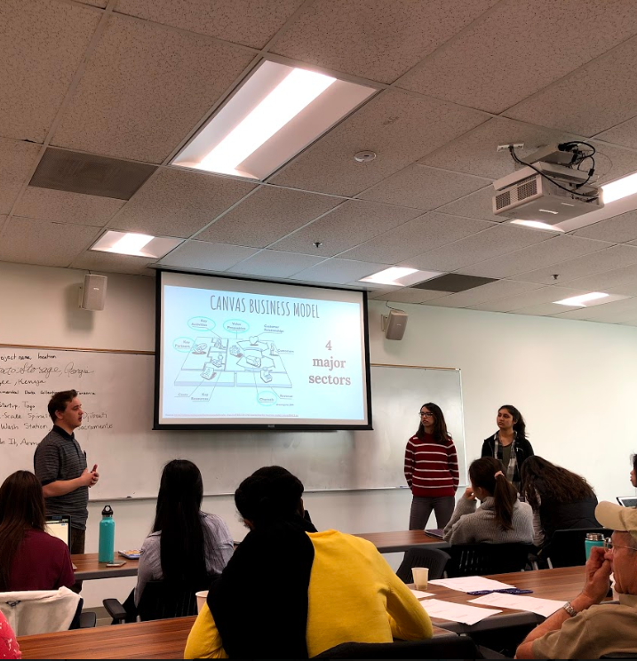
Analytical Tools
Stakeholder analysis
SWOT Analysis
Canvas Business Model
Economic analysis
Policy ID
Decision Matrix

Slide 8
Case study: Mongolia Poultry Farm
Client: Organic Protein LLC
Location: Dornod Province, Mongolia
Project Statement: “Evaluate the feasibility of a poultry farm start-up in the Dornod Province of Mongolia and evaluate funding opportunities.”
Notes:
Abby talks about how they selected the project, and the team for this
I talk about why I wanted to work on it

Slide 9
Methodology
Canvas-Business model
Large poultry farm business
Stakeholder Analysis
S.W.OT. Analysis
Policy Analysis
Financial Opportunities
Funding research

Slide 10
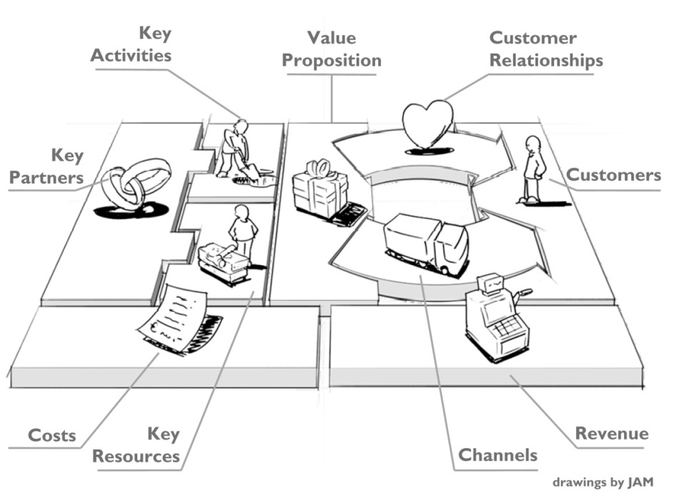
Osterwalder’s Canvas Business Model
Customers Offer Infrastructure Financial Viability

Slide 11
SWOT Analysis
Organic Protein LLC
Capital Market LLC
Strengths | Weaknesses
Have already established distribution routes 10 hours from UB - no contact with other birds (no diseases) | Financial resources 10 hours away from UB - transportation is difficult, increase the cost to get feed and deliver the product
Opportunities | Threats
More trust for local products Don’t have to pay the import taxes, pay lower domestic taxes | Lack of veterinary connections Potential pushback from the importers because taking their business
Strengths | Weaknesses
Financially sustainable Cheaper price because not actually farming the chickens | Stigma that China’s quality is much worse, because they choose the cheapest option Imported from china - takes 3 or 4 days to get to UB
Opportunities | Threats
Economic crisis in Mongolia Very few suppliers 2-3 importers, 1 major operation in Mongolia | Have to pay a import tax Higher risk of transportation problems
Notes:
The amount of research involved in creating this SWOT
How it relates to Canvas

Slide 12
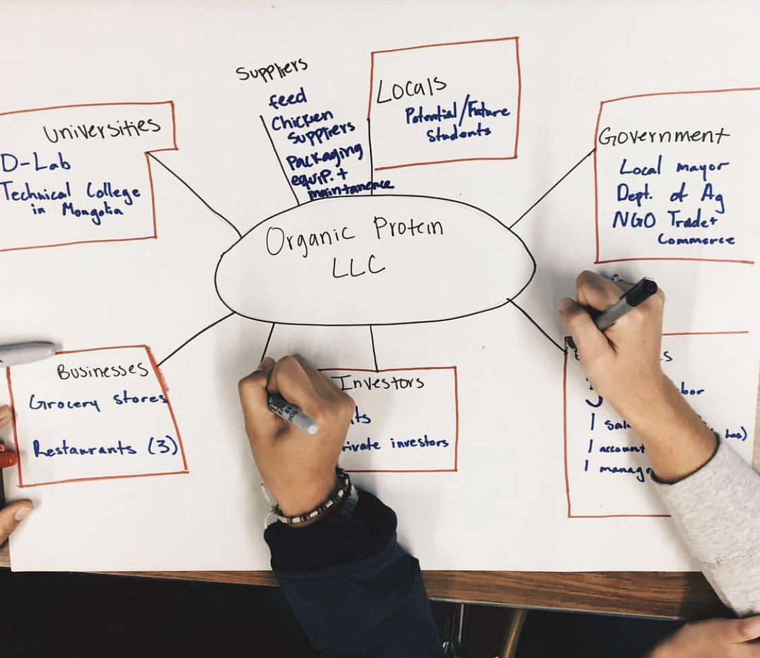
Stakeholder Analysis
Notes:
Key Partners

Slide 13
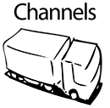
Store Owners
Meat
Stores
Restaurant Owners
Restaurants
Meat
Government
Economy boost
Consumers
Equipment/Services
Money
Organic Protein LLC (indirectly from consumers)
Students
Education
Organic Protein LLC
Health Groups
Healthier Lifestyle
Consuming from Restaurants and Stores
Notes:
Relationships she has and how she plans to maintain relationships

Slide 14
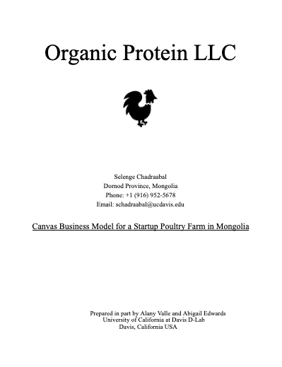
Results:
Framework for Business Model Canvas
Used for investors and funding opportunities
Informed recommendations
Notes:
We used both the Business Model Canvas and the discovery/research from the business model to make informed recommendations to our client

Slide 15
Case study: Crop-Wash Station
Client: International Rescue Committee
Location: Sacramento, CA, USA
Project Statement: “Evaluate alternative methods to recycle water from a crop wash station while promoting food safety at the New Roots farm in West Sacramento.”
Notes:
Abby talks about how they selected the project, and the team for this
I talk about why I wanted to work on it

Slide 16
Methodology
Research
Develop design criteria
Select five alternatives
Process diagrams + SWOT analysis
Decision matrix
Notes:
Meg

Slide 17
Research Methodology
Site Visits
Sector Papers
Food safety
Sediment Removal
UV Purification
Water quality testing
Prior Art
Notes:
Rujuta

Slide 18
Four-Lens Design Criteria
Ease of use
Compatible with existing infrastructure
Minimize Cost
Added value
Provides learning opportunity
Minimal upkeep
Operation & maintenance
Reduce water use
Safety (low risk of cross-contamination)
Uses UV purifier
Upfront
Pressure/energy requirements?
Technical
Economic
Social

Slide 19
Results: Decision Matrix
Option | Safety |  | Ease of use |  | Cost to Implement |  | Learning Opportunity |  | Value added |  | Ease of installation |  | Total
Dispose directly* | 5 | 5 | 5 | 3 | 5 | 4 | 0 | 3 | 0 | 3 | 5 | 3 | 75
Crop wash | 3 | 5 | 3 | 3 | 2 | 4 | 5 | 3 | 5 | 3 | 2 | 3 | 68
Drip Irrigation* | 4 | 5 | 3 | 3 | 2 | 4 | 3 | 3 | 5 | 3 | 1 | 3 | 64
Furrow Irrigation* | 4 | 5 | 3 | 3 | 3 | 4 | 4 | 3 | 4 | 3 | 3 | 3 | 74
Rain garden* | 5 | 5 | 5 | 3 | 4 | 4 | 3 | 3 | 2 | 3 | 4 | 3 | 83
Hand wash | 3 | 5 | 3 | 3 | 3 | 4 | 5 | 3 | 4 | 3 | 3 | 3 | 72
Notes:
Lilly
Safety (How safe is the final water?): 5=highest safety
Ease of use (How easy is it to operate? Is it passively operated? How many steps are required?): 5=easiest to use
Cost: 5=low cost
Learning Opportunity: 5=high potential for educational component
Value added (How much value does the outcome provide?): 5=high value for the farm

Slide 20
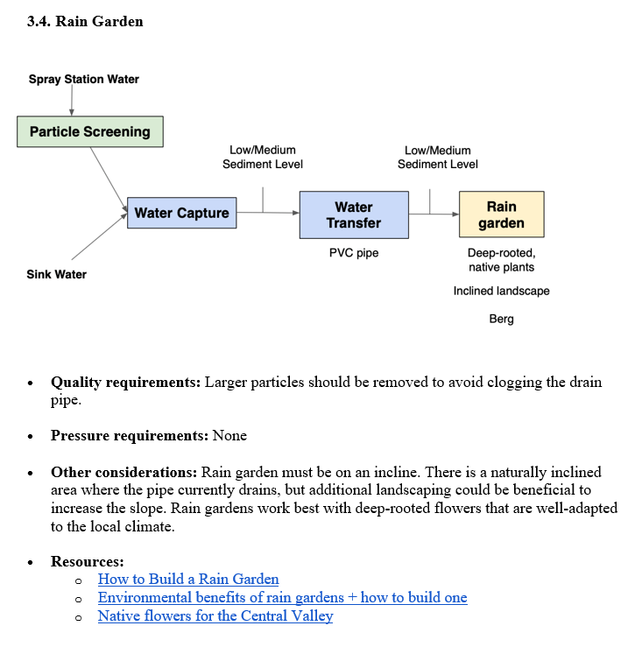
Results
Client was able to make an informed decision and had resources to implement solution

Slide 21
Questions?
Thank you for your time!

