Slide 1
Project Based Learning
Meg Slattery & Abby Edwards

Slide 2
Agenda
What is Project Based Learning?
Benefits of Project Based Learning
Course Logistics
Global Examples
Formulating a Project Idea
Notes:
In this presentation

Slide 3
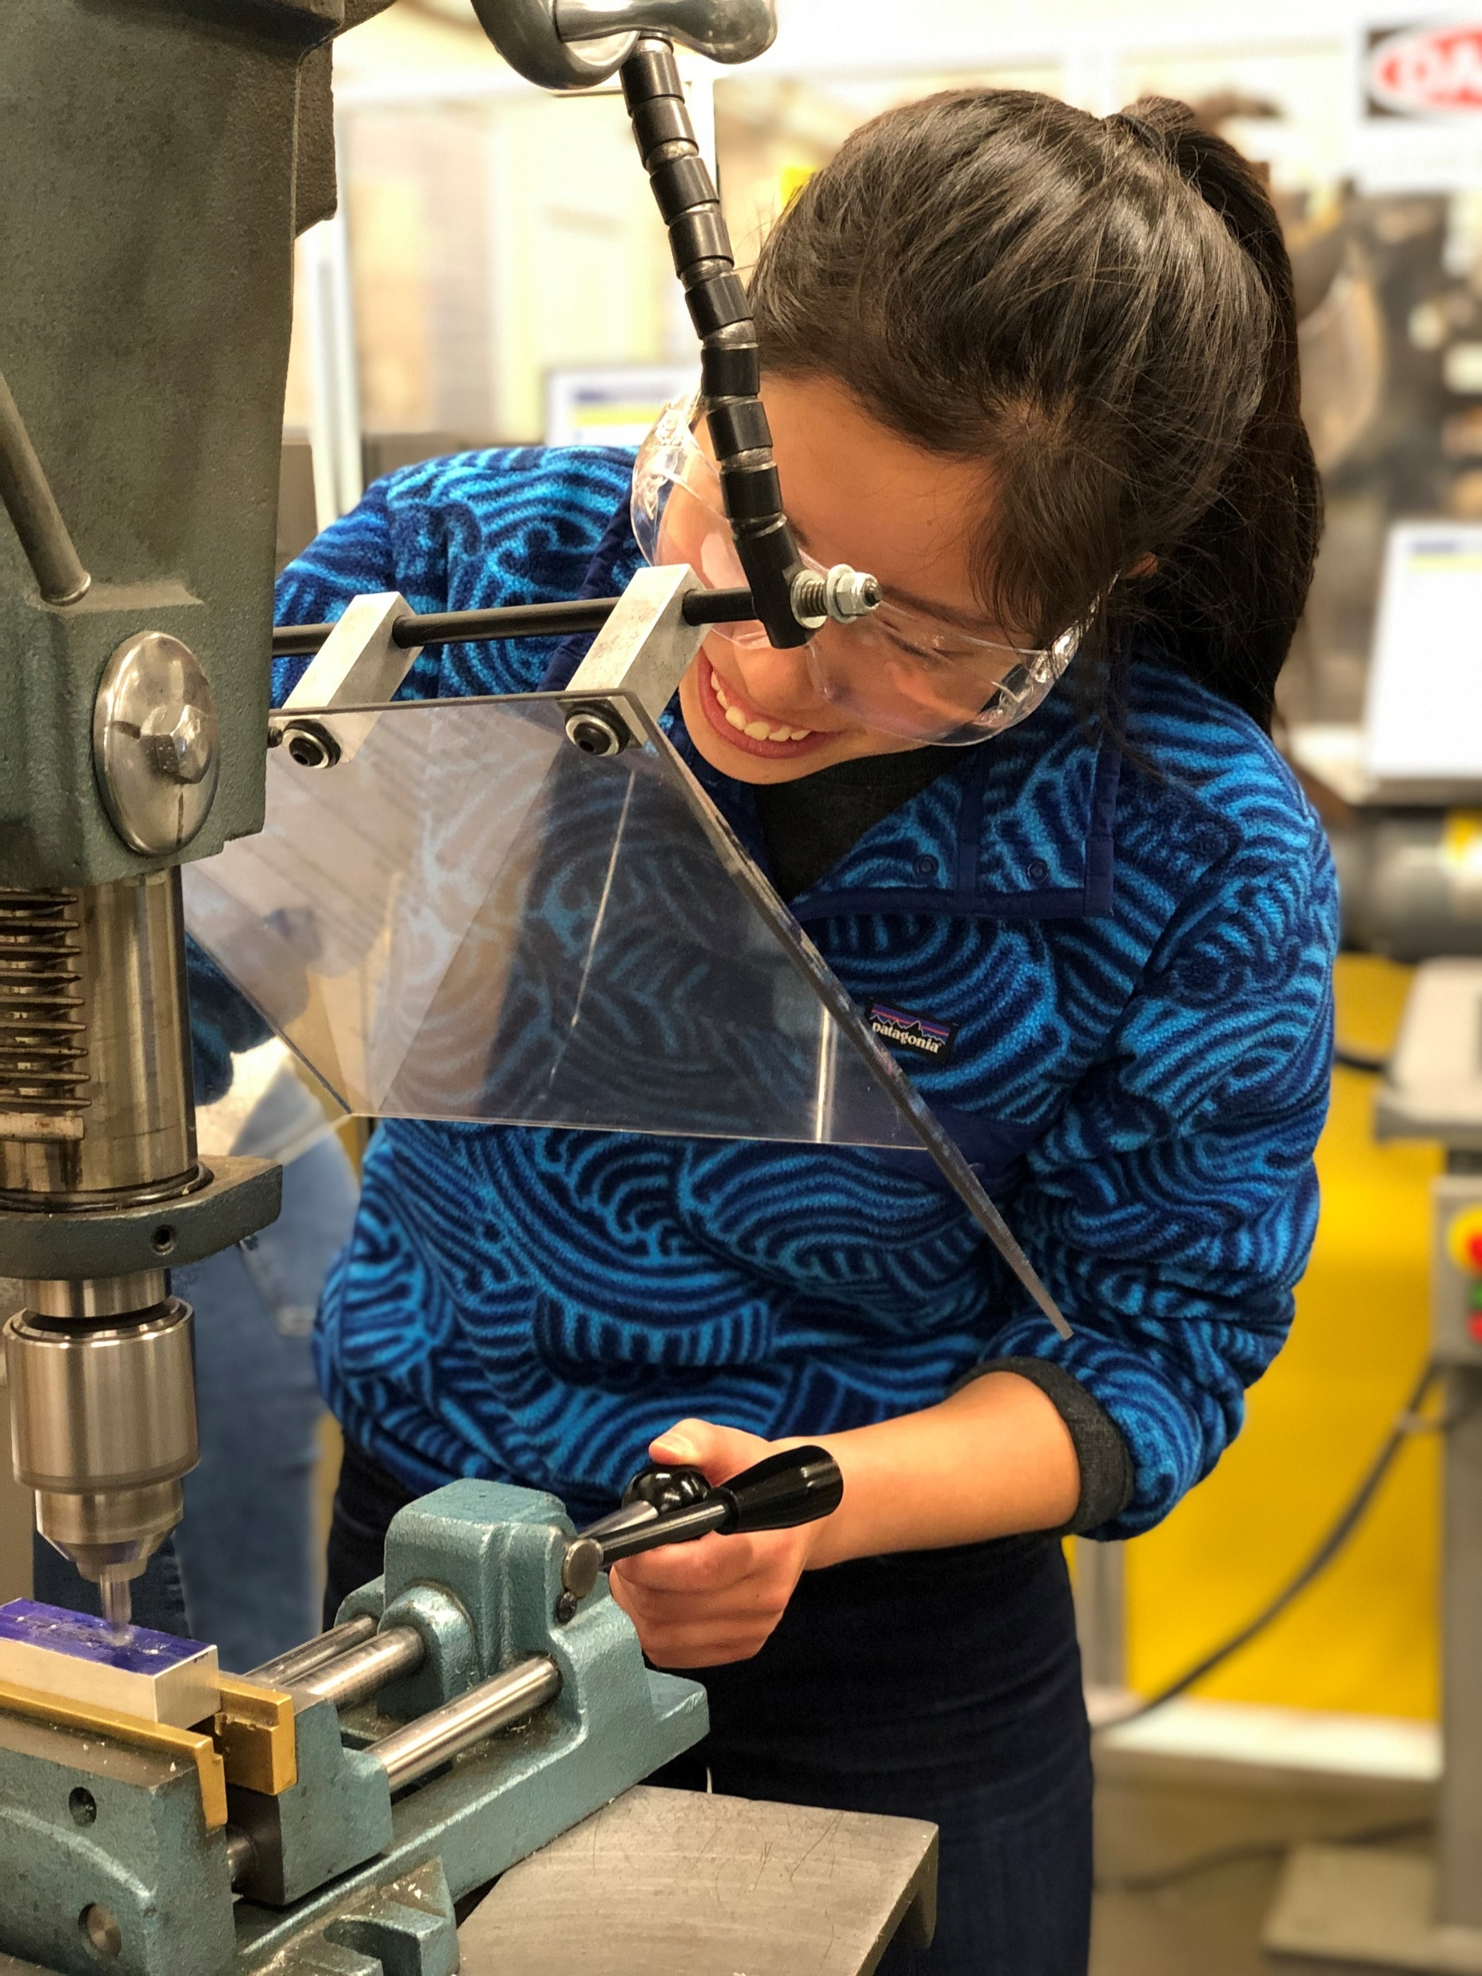
What is Project-Based Learning?
“Project-based learning is a dynamic classroom approach in which students actively explore real-world problems and challenges and acquire a deeper knowledge.”
“It’s not rocket science, you can do it too.”
Notes:
Examples of PBL at different levels
Goal is to apply what you’re learning to a real situation
Interactive
How many people have learned something in a classroom that you forgot once the class ended?

Slide 4
Benefits of Project-Based Learning
Develop creative confidence
Engage with local and/or international community
Turn ideas into action
Acquire professional skills and experience
Notes:
Talk about Peter
Talk about IRC and Humphrey and Mandela fellows – engaging with local

Slide 5
Benefits of project-based learning
Learning that occurs in the context of problem solving is more likely to be retained and applied (Boaler, 1998b; Bransford, Sherwood, Hasselbring, Kinzer, & Williams, 1990)
Increased classroom attendance (ELOB, 1999a)

Slide 6
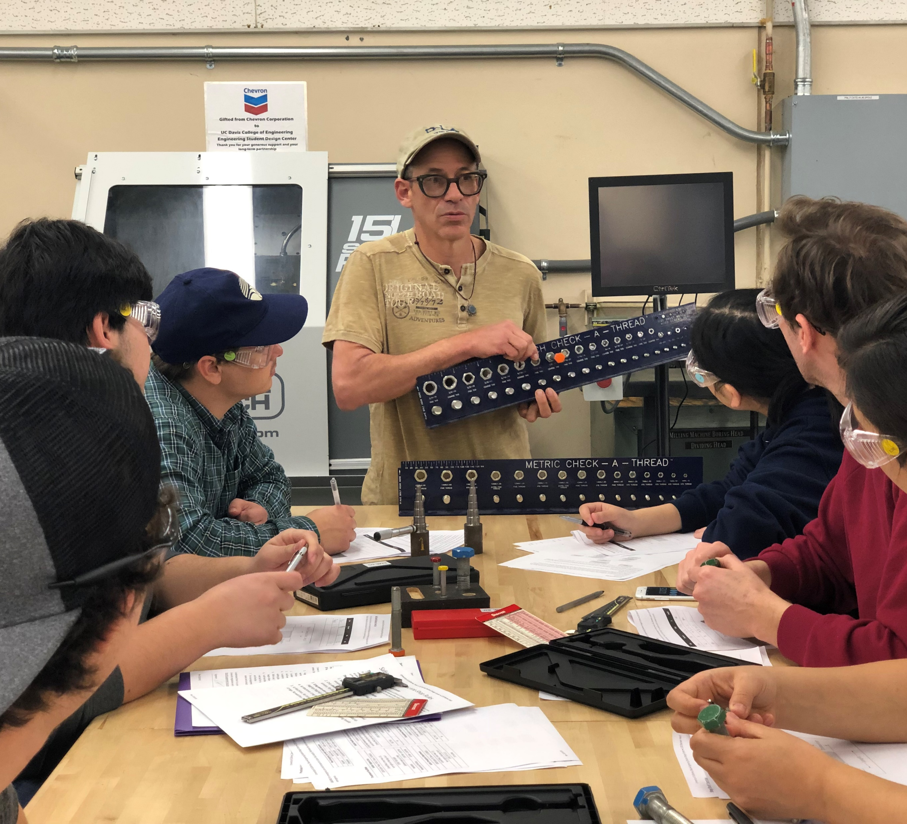
Course Logistics
How do you set up a project-based course?

Slide 7
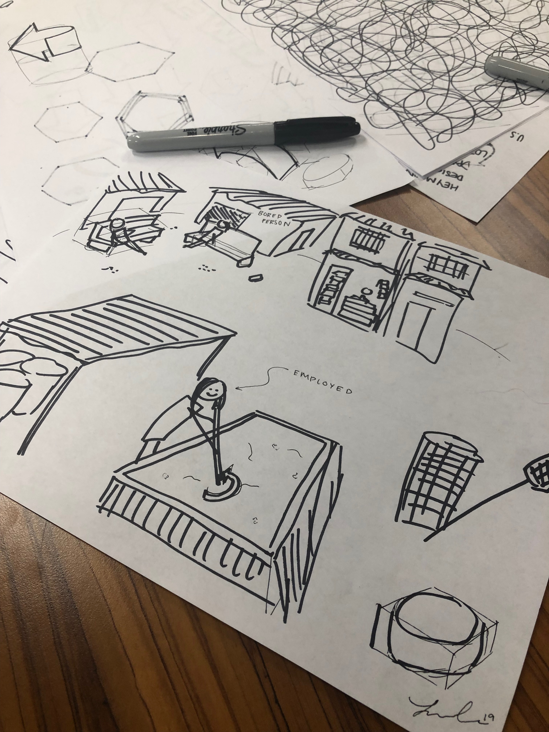
Course organization
Incorporate time for group work and research
Guest speakers
Course is structured around deliverables
Use case studies
Notes:
Group work time during class is super important!!!

Slide 8
Finding and Selecting Projects
Process
Criteria
Reach out to prospective clients, determine what they want
Look for potential for both client and college to gain from the experience
Client responsiveness and interest
Project compatibility with the course
Resource availability
Notes:
Client:
Do they email back quickly or do they wait a long time before responding?
Are they willing to work with students?
Do they understand what they may or may not get out of the course?
Resources:
Student skillset
Institution resources → building materials, financial support, etc.

Slide 9
Selecting Groups: Deliverable #1
Present the projects to students
Deliverable #1: Students to research projects and rank their top 3 choices, and list qualifications
Students print and turn in the assignment (one page!) to the next meeting
Instructors match students with projects

Slide 10
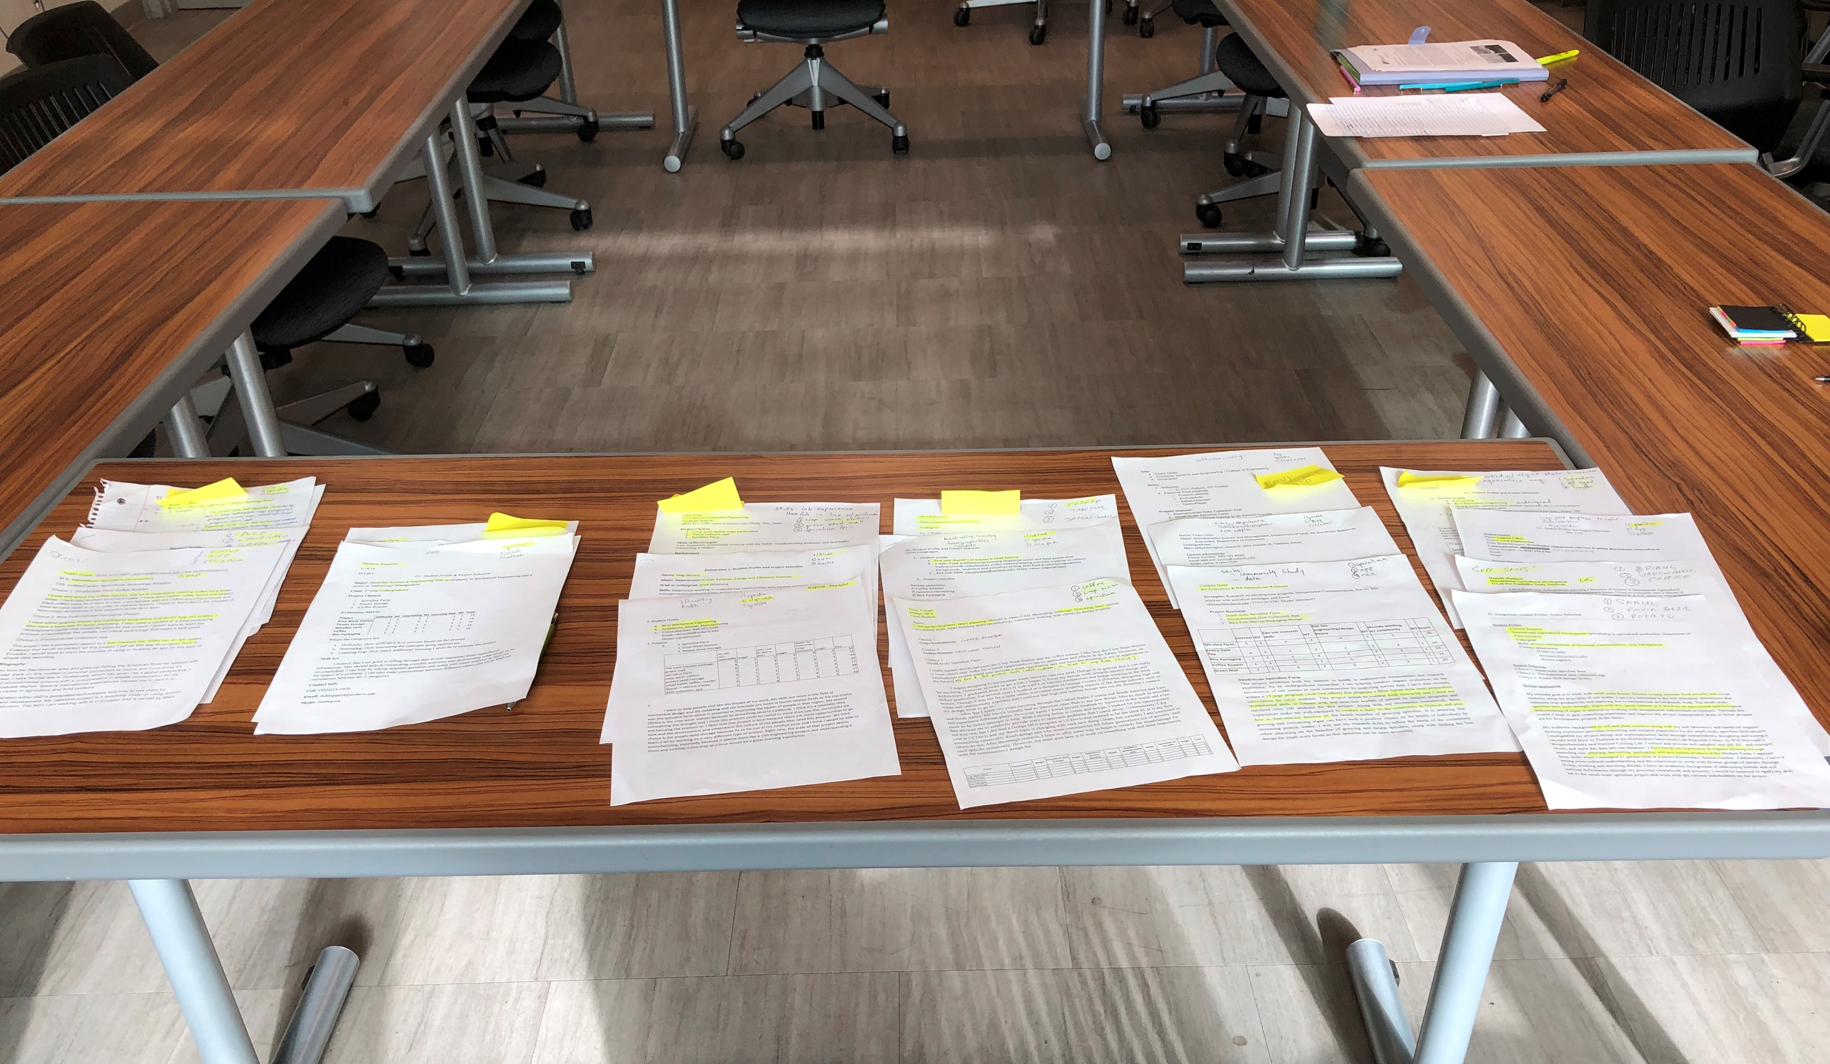
Selecting Groups: Process
Groups of 3-4
Things to consider:
Put students in one of their top three projects
Students from different disciplines
Level of experience in the project field
Notes:
We have found that groups of three work best but if you must, groups of four work as well
You want them to feel like they have had agency in their choosing and have them work on a project they are interested in
Real life is interdisciplinary, and projects do better with different perspectives
Connect students with clients

Slide 11
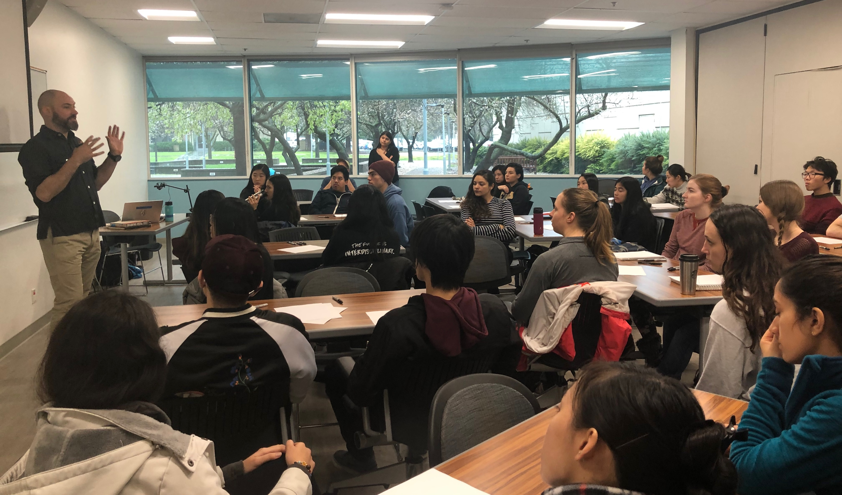
Possible Challenges
Student group dynamics
Student interest levels
Unresponsive clients
Class space
Time
Notes:
As instructors, we facilitate the groups during group time to make sure that they are on track. We encourage students to resolve group conflicts on their own – this is real life, but we will intervene if necessary.
We include activities, labs, simulations and guest speakers to ensure that students are engaged, not every class period should be group work.
If clients are unresponsive, we attempt to contact them.
Class space – it is important to have a room that can be used for both lecture but also is conducive to group work
Students are busy – this is why it is essential to have group time in class, we have seen increased student value from the course with more time in the curriculum to work on their projects → usually have 1 hour of lecture and 1 hour of group time for each meeting

Slide 12
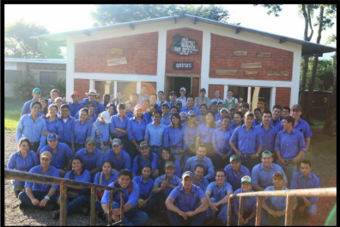
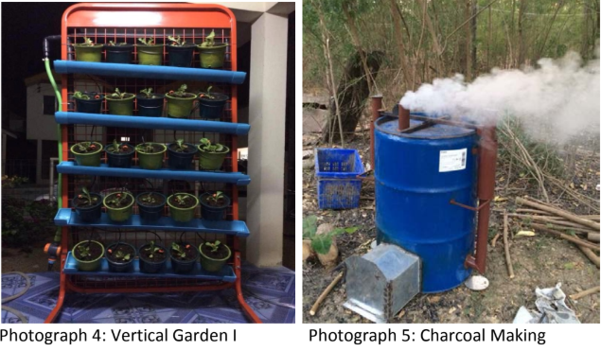
Global Examples
Zamorano University
Kasetsart University
Tegucigalpa, Honduras
July-August 2013
Bangkok, Thailand
November 2013-February 2014
Notes:
These were two universities that wanted to implement D-Lab Design, Build, Test classes because they wanted their students to learn more hands-on skills, so it’s slightly different than this case. Zamorano and Kasetsart are both agricultural universities. Projects: mainly came from faculty and personal connections, mentor/teacher role vs. external client
They consider this desirable while they establish their D-lab model
Added benefit of connecting resources and talent across departments
Ideal group size is three students per group

Slide 13
NORC Brainstorming Needs, Opportunities, Resources, Constraints
Using your community or sector of interest,
Brainstorm a list of 10 ideas for each category:
Need
Opportunity
Resource
Constraint
Technical
Environmental
Economic
Social

Slide 14
ACTIVITY: Create Project Ideas
TRANSFER
Transfer brainstormed NORC onto Cards
CONNECT
Draw connections between them
CREATE
Create project ideas (at least 3!)
SHARE
Discuss potential projects in pairs
How can you align the needs, opportunities, resources & constraints to create a potential project idea?
Notes:
Blue= 122660
Grey= E8E6E2

Slide 15
Research Time
Do some initial research to further inform your project
Write a preliminary description of each project idea
Technical
Environmental
Economic
Social

Slide 16
Brainstorming: What about YOU?

Slide 17
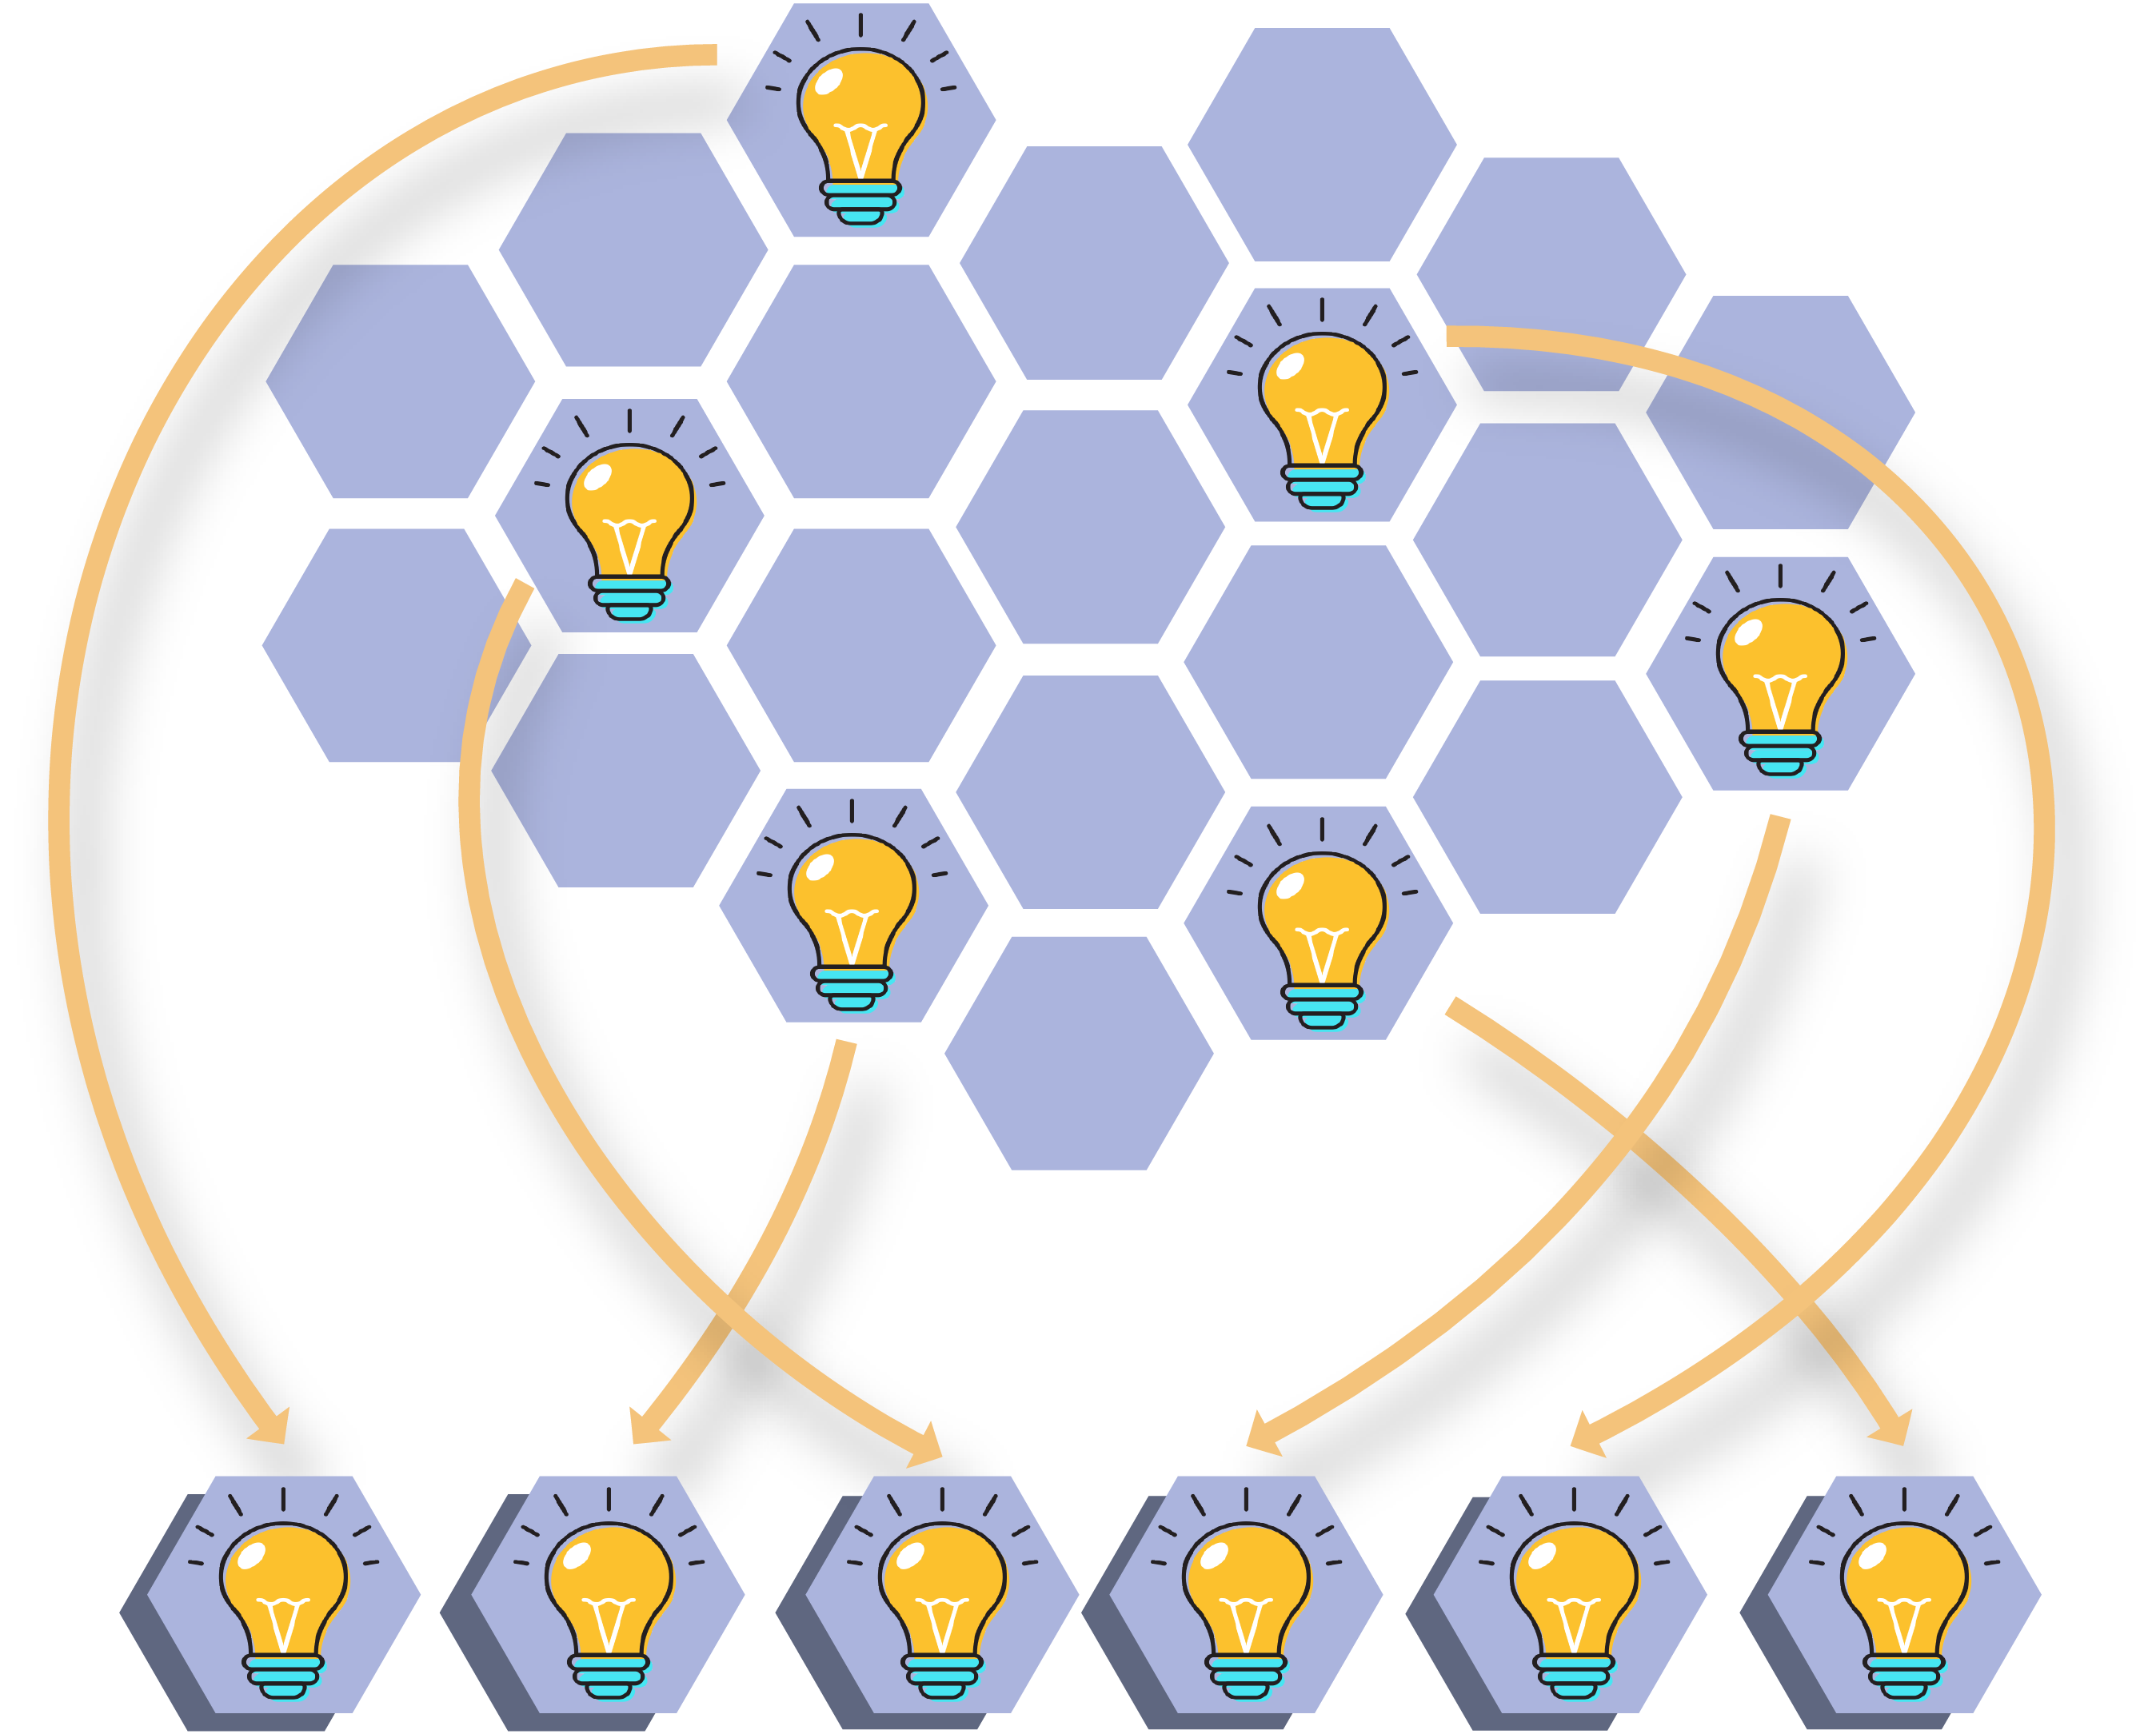
RANKING
Select your top 6-8 criteria.

Slide 18
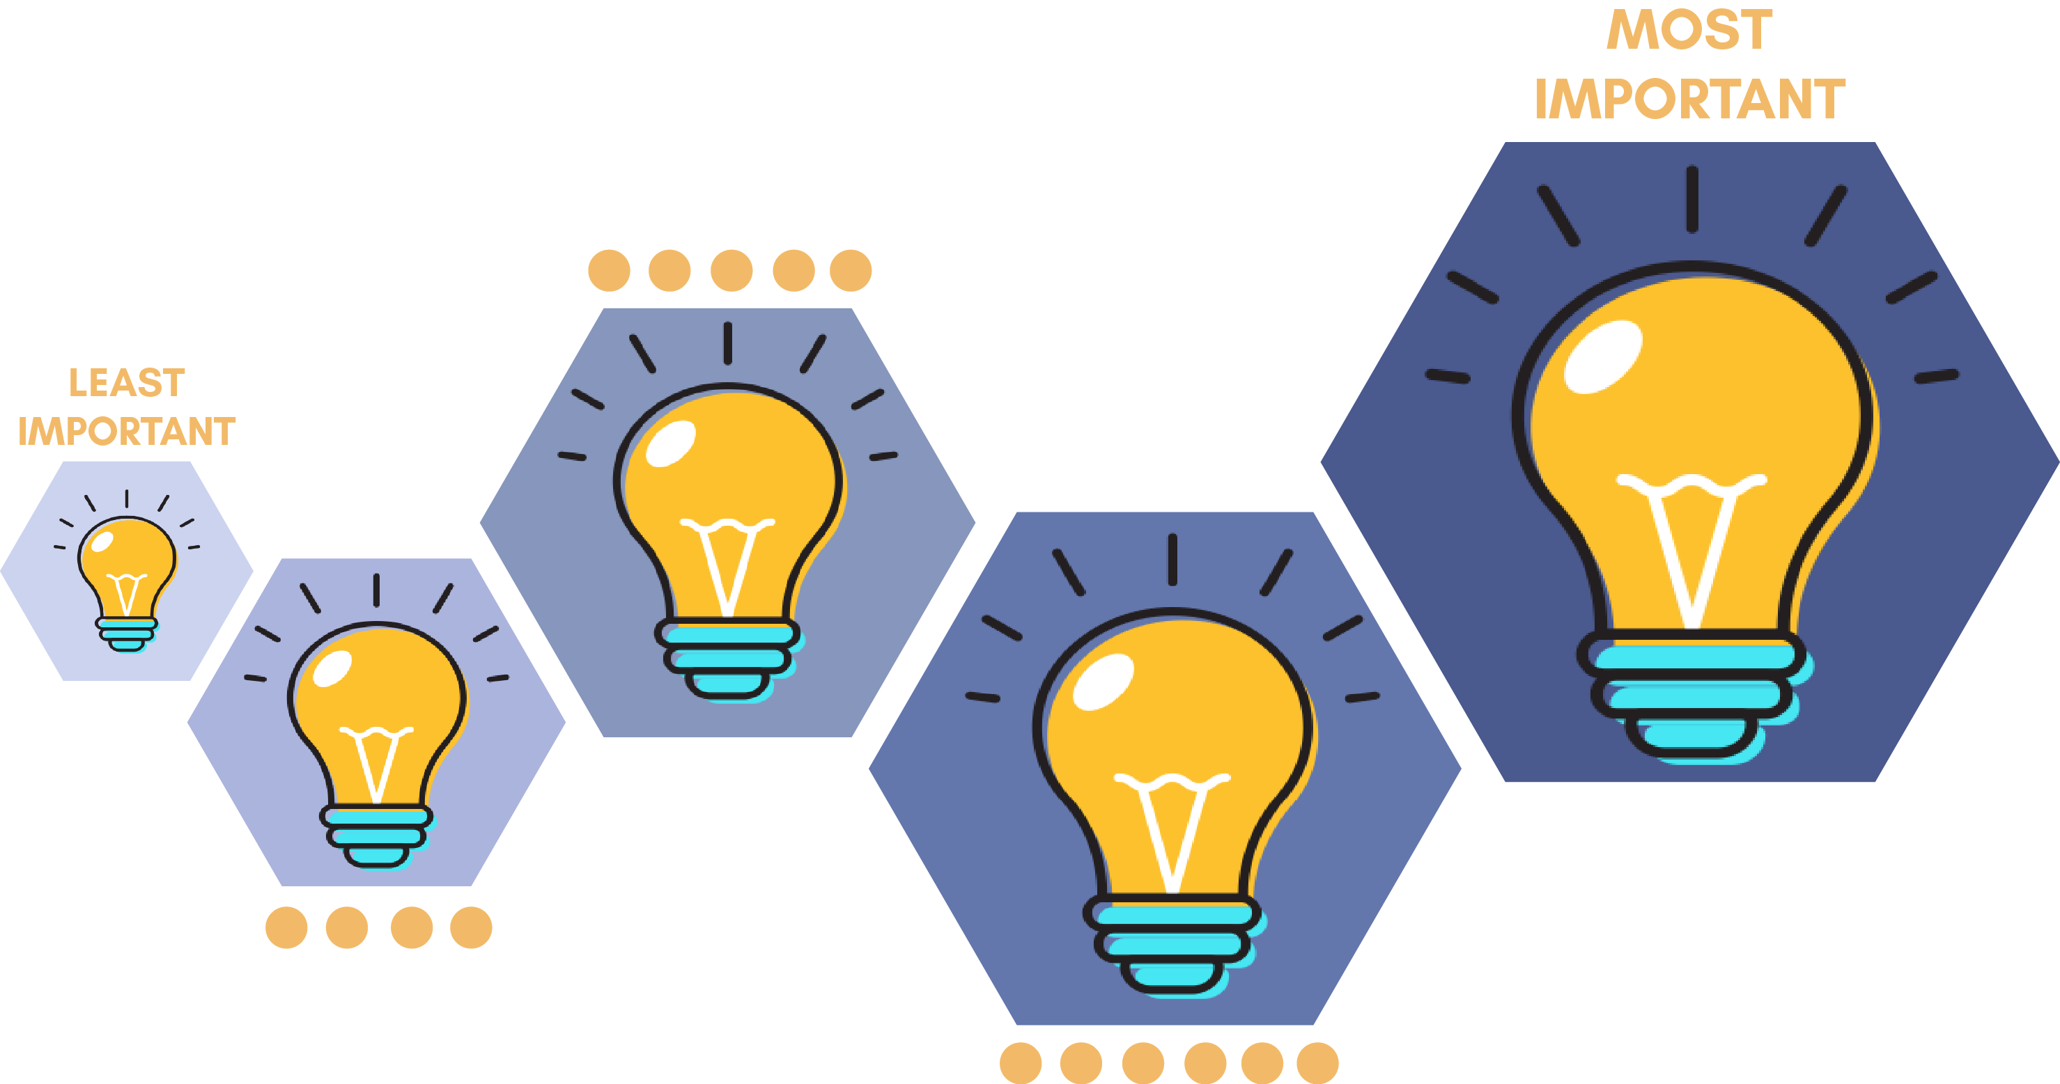
RANKING
Select your top 6-8 criteria.
Rank those criteria in order of importance

Slide 19
Decision Matrix
Use criteria from the previous exercise
How important is each criteria to you? Assign each one a weight
Score each project, calculate total
If it doesn’t feel right, re-evaluate your criteria!

Slide 20
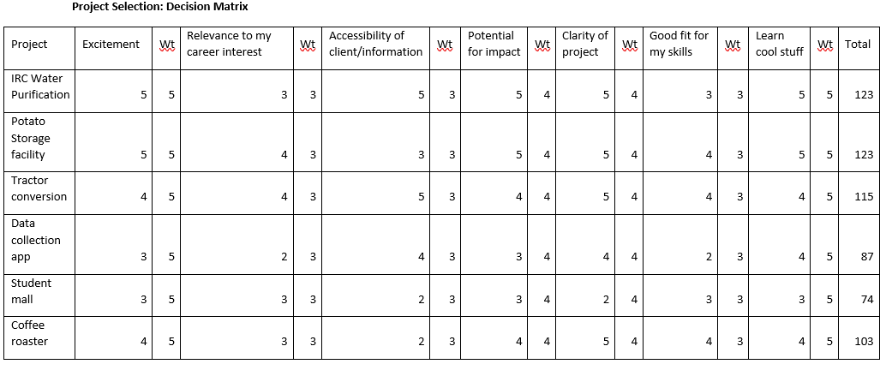
Project Selection Matrix: Example
Possible projects
Personal criteria
Total score

Slide 21
Questions?
Thank you for your time!

