Slide 1
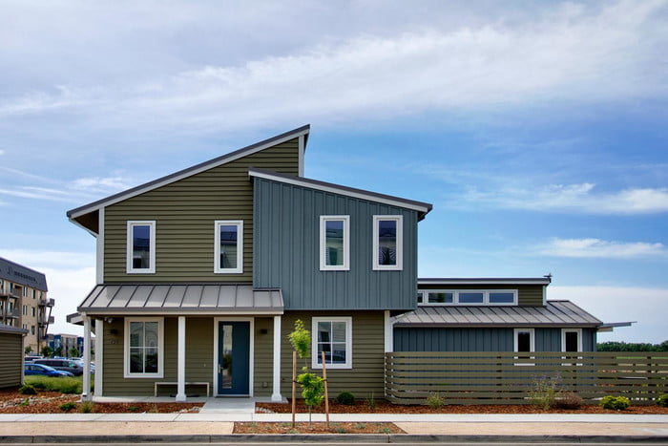
Low-Carbon Residence Roadmap Davis Resident Zero-Net Energy Network
Yasmin Afshar
Armando Gomez
Gandhar Pandit
Spring 2020
Notes:
Hello everybody, we are the Low-Carbon Residence Roadmap team, integrated by Yasmin, Gandhar, and myself, Armando. And we will share with you today the outcome of our project.

Slide 2
Outline
Problem Statement
Objectives and scope
Methodology
Literature review
ZNE Interview Templates
ZNE Roadmaps
Future of the project
References
Notes:
In this presentation we will talk about:
A brief summary of the description of our project, including the final objective and scope agreed with our client
Our methodology as we move through the slides
Our two deliverables, which are the Zero Net Energy interview templates and roadmaps we designed for Davis residents
And finally, our view of the future steps of this project

Slide 3
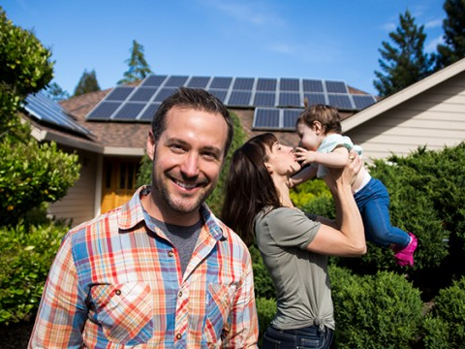
Problem Statement
Non-Zero Net Energy Homeowners to Zero Net Energy Homeowners
Notes:
Briefly talking about our project, we were given the following scenario:
Many homeowners in Davis, California are interested in converting their homes to Zero Net Energy, but do not have an easy guideline to do so.
Our client, Cool Davis, which is a non-profit organization that promotes sustainable living, asked us to develop a roadmap that would indicate the recommended step by step actions homeowners should take to convert to ZNE, based the input of their particular home.

Slide 4
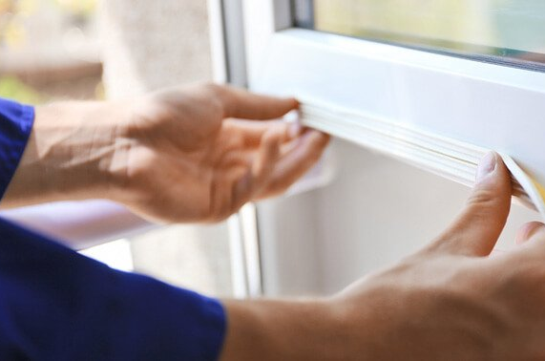
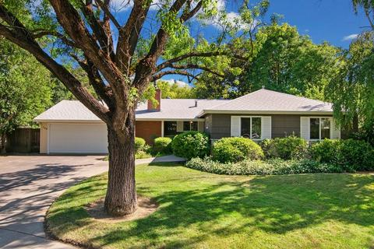
Objective & Scope of our Study
Objective
To identify, compile, and prioritize the changes Davis homeowners should implement to convert their home to Zero Net Energy through a roadmap diagram.
Scope
The project focuses on single-family households owned and lived in by Davis, California residents.
Notes:
With the previous said, we defined our objective as: To identify, compile, and prioritize the changes Davis homeowners should implement to convert their home to Zero Net Energy through a roadmap diagram.
And our scope limited to single-family households owned and lived in by Davis, California residents.

Slide 5
Methodology
Stage I
Literature Review
Stage II
Interview Templates and Audience Analysis
Stage III
Roadmaps
Stage IV
Future Directions
Notes:
We will now talk about our methodology as we move through our slides, starting by our Literature Review stage.

Slide 6
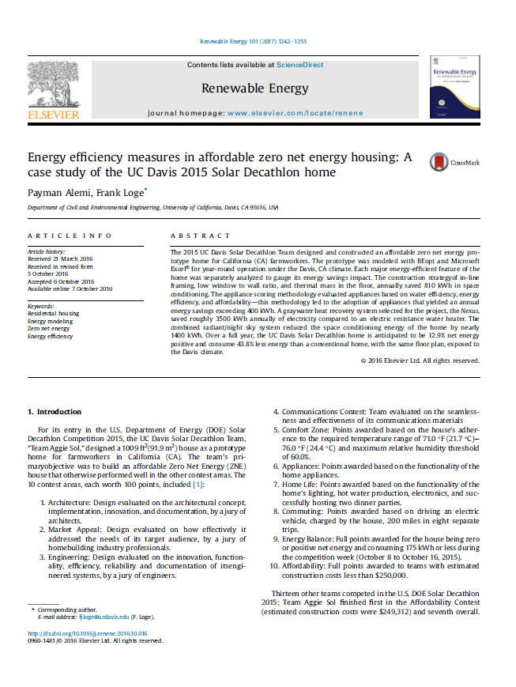
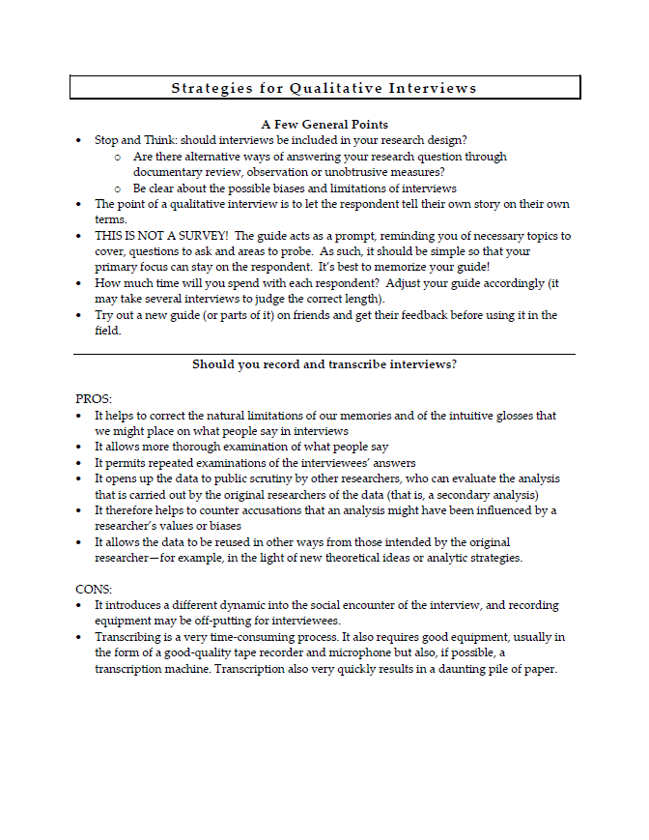
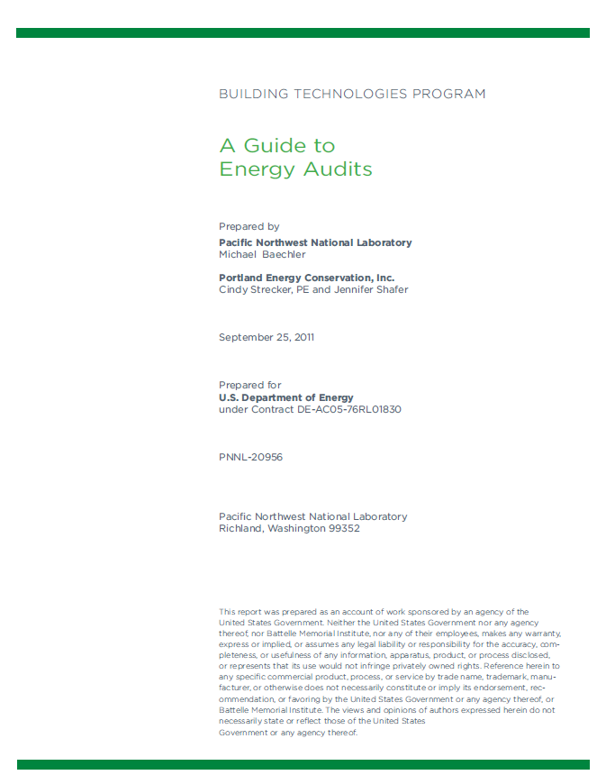
Literature Review
ZNE Home Research
Interview Strategies
Energy Audit Guide
Notes:
In this stage, we identified key information that would help us gain an understanding of Zero Net Energy Homes, and what aspects to consider when converting to them.
Here we show our most representative papers, which are about ZNE Home Research, Interview Strategies, which we used since the project involves contact with Davis residents, and finally Energy Audit guides.

Slide 7
Methodology
Stage I
Literature Review
Stage II
Interview Templates and Audience Analysis
Stage III
Roadmaps
Stage IV
Future Directions
Notes:
In the next stage, we developed our interview templates.

Slide 8
City of Davis Profile, 2018
Quick Facts:
Population Dynamics:
69784 Students 56%
Residential land uses 62.5%
Low density residence:
48%
Owner-occupied housing unit rate, 43.8%
Rental Housing unit share: 56%
Heating systems by natural gas: 65.4%

Slide 9
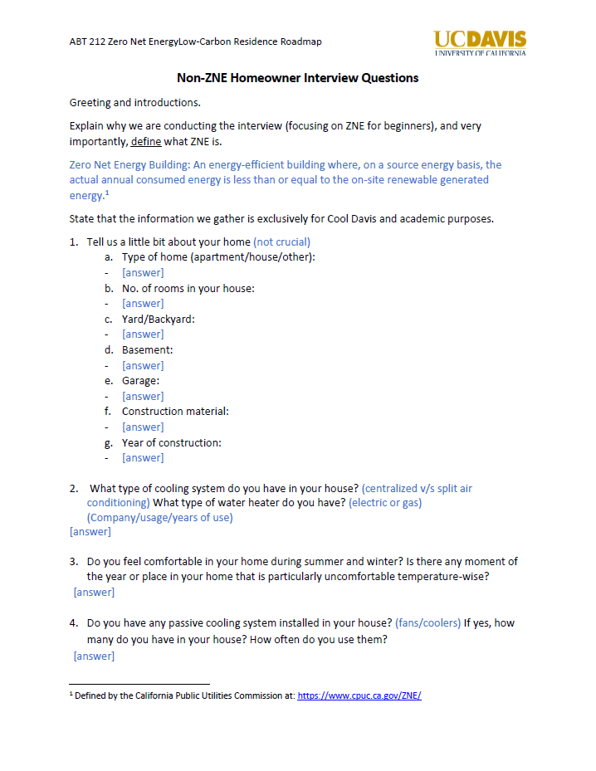
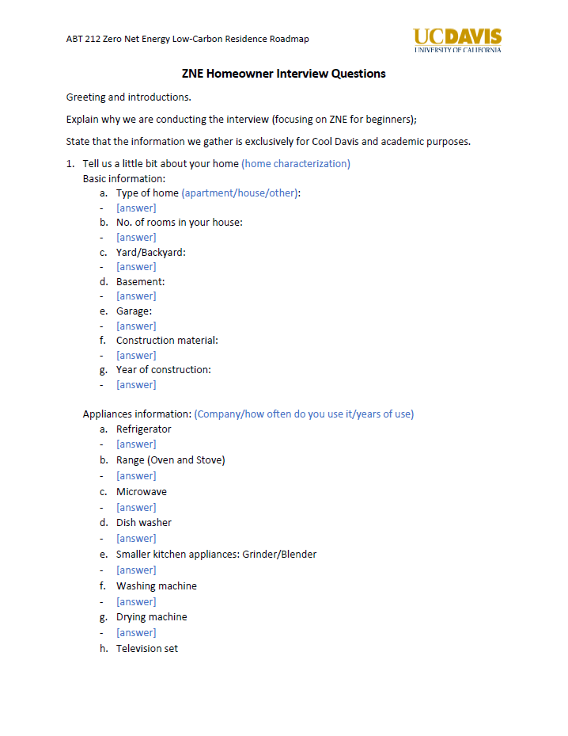
Interview templates
Purposes:
To help a non-ZNE homeowner to characterize his home to precede an energy audit.
To identify and document the characteristics of a ZNE home, and the expertise of its homeowner
Identify and document new elements needed for the roadmap as a direct input from the interviews.
Notes:
We developed two interview templates, one for non-ZNE homes and on for ZNE homes.
The templates have three purposes:
To help a non-ZNE homeowner to characterize his home to precede an energy audit.
To identify and document the characteristics of a ZNE home, and the expertise of its homeowner.
But most importantly,
To identify and document new elements needed for the roadmap as a direct input from the interviews.

Slide 10
Interview templates
Common Points
Non-ZNE Homeowners
ZNE Homeowners
Home Characterization
Home Appliances
HVAC Systems
Lighting
Motivation to become ZNE
Perceived thermal comfort
Perceived toughest challenges
Self-searched resources and guidelines (if applicable)
First steps taken and guidelines used
Estimated energy and emissions savings
Home and lifestyle overall change
Expertise and advice
Notes:
The key information that we will obtain through interviewing Davis homeowners with our templates is shown in this slide.
Firstly, both templates ask questions to characterize the home, such as its dimensions and year of construction; followed by questions about their home appliances, HVAC systems, and lighting.
Next, the templates asked particular questions depending on the type of home.
For Non-ZNE homes, the distinguishing questions are
Motivation to become ZNE
Perceived thermal comfort
Perceived toughest challenges
Self-searched resources and guidelines (if applicable)
For ZNE homes:
The first steps taken, and guidelines used
Estimated energy and emissions savings
Home and lifestyle overall change
And very importantly, their expertise and advice they would give to non-ZNE homeowners
As a reminder, all this information is relevant to our overall objective, which the development of a ZNE roadmap, which we will now talk about in the next stage.

Slide 11
Methodology
Stage I
Literature Review
Stage II
Interview Templates and Audience Analysis
Stage III
Roadmaps
Stage IV
Future Directions
Notes:
(pause slightly)

Slide 12
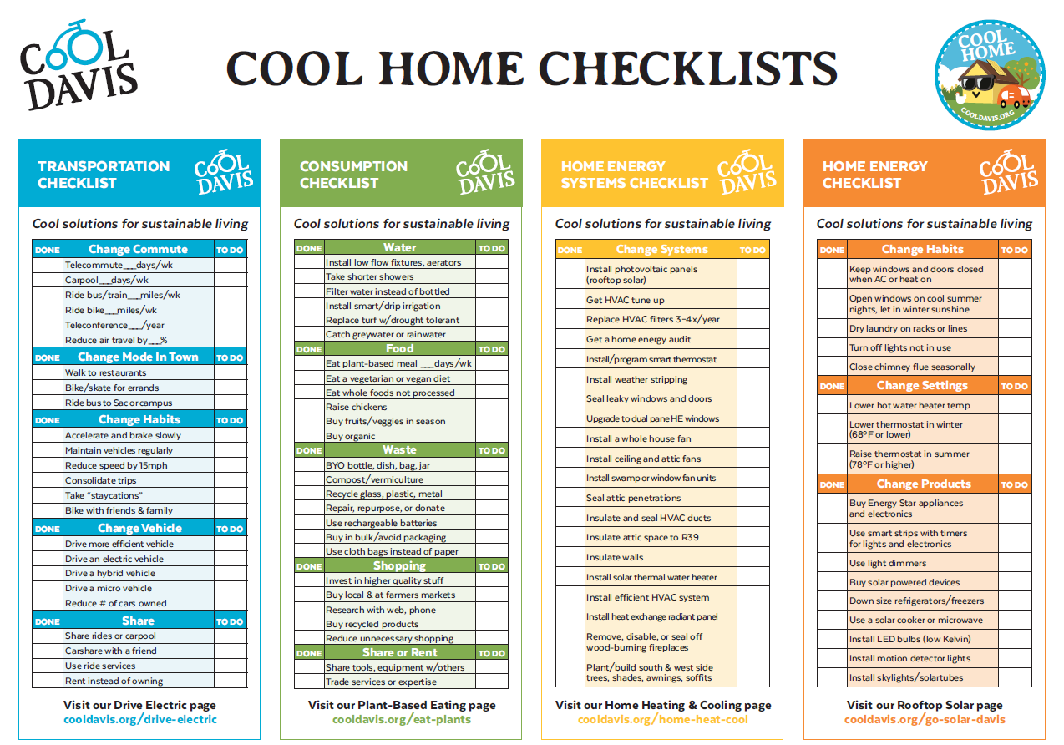
Client’s preexisting resources
Notes:
Apart from our literature review, the key design of our roadmap came from our client’s preexisting resources. Particularly this Home Checklist they had already developed that addresses the changes homes need to make to become ZNE.
As you can see in the figure, it is divided by four categories:
Transportation
Consumption
Home Energy Systems
And Home Energy

Slide 13
Audience Analysis: Who are roadmap focus groups?

Slide 14
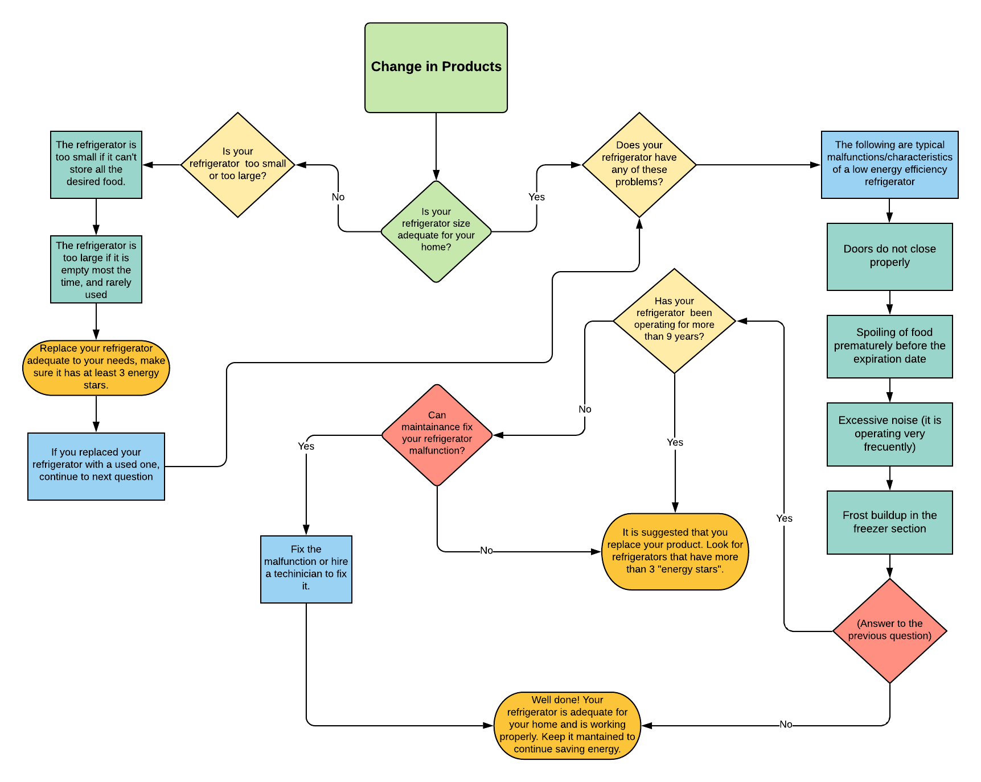
Conversion to a roadmap
Notes:
For our project, only the categories related to Home Energy were within our scope.
As you can see, both checklists cover 4 main topics. Naming them in order of complexity to implement, we have:
Change in Habits and Change in Settings, which involve no cost and immediate changes
Change in Products, which involves transitioning home appliances to energy star certified products, and lighting to high efficiency bulbs such as LED
And finally, change in Systems, which involves more sophisticated changes, such as insulation reinstallation, HVAC system tune ups, and the possibility of installing solar panels.
With the help of our client’s preexisting resources and our literature review, we were able to design various roadmaps, prioritized by the categories just mentioned, and addressing each item of the checklist.

Slide 15
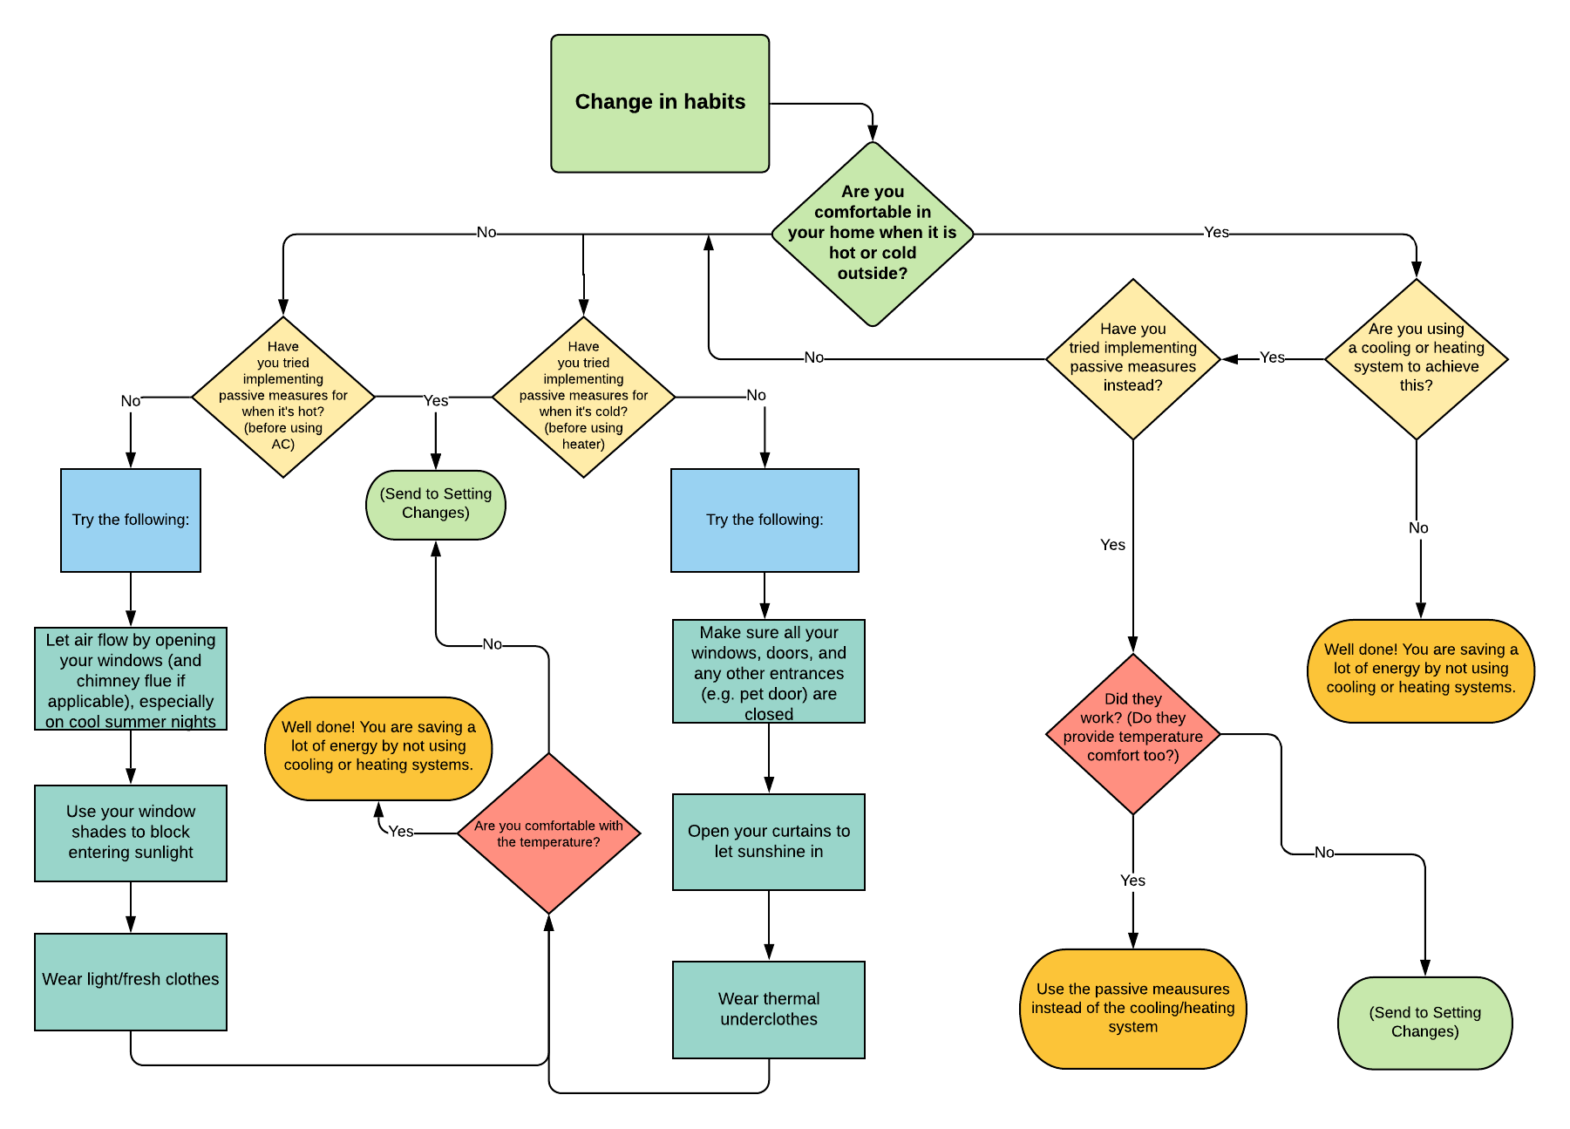
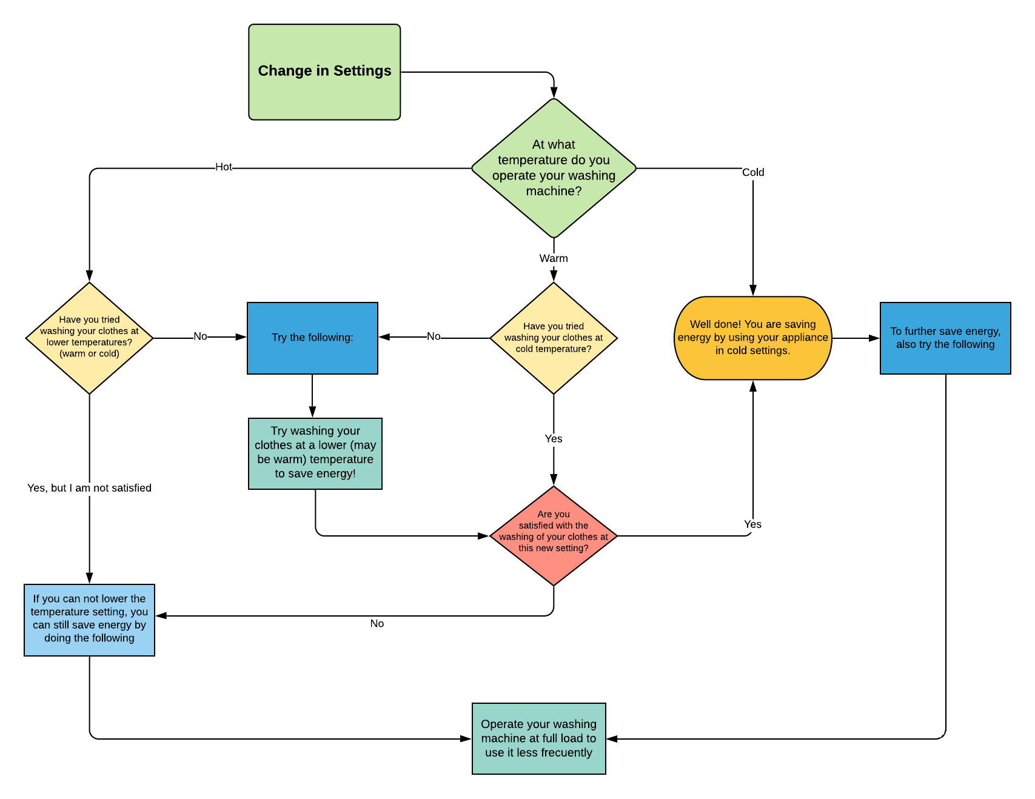
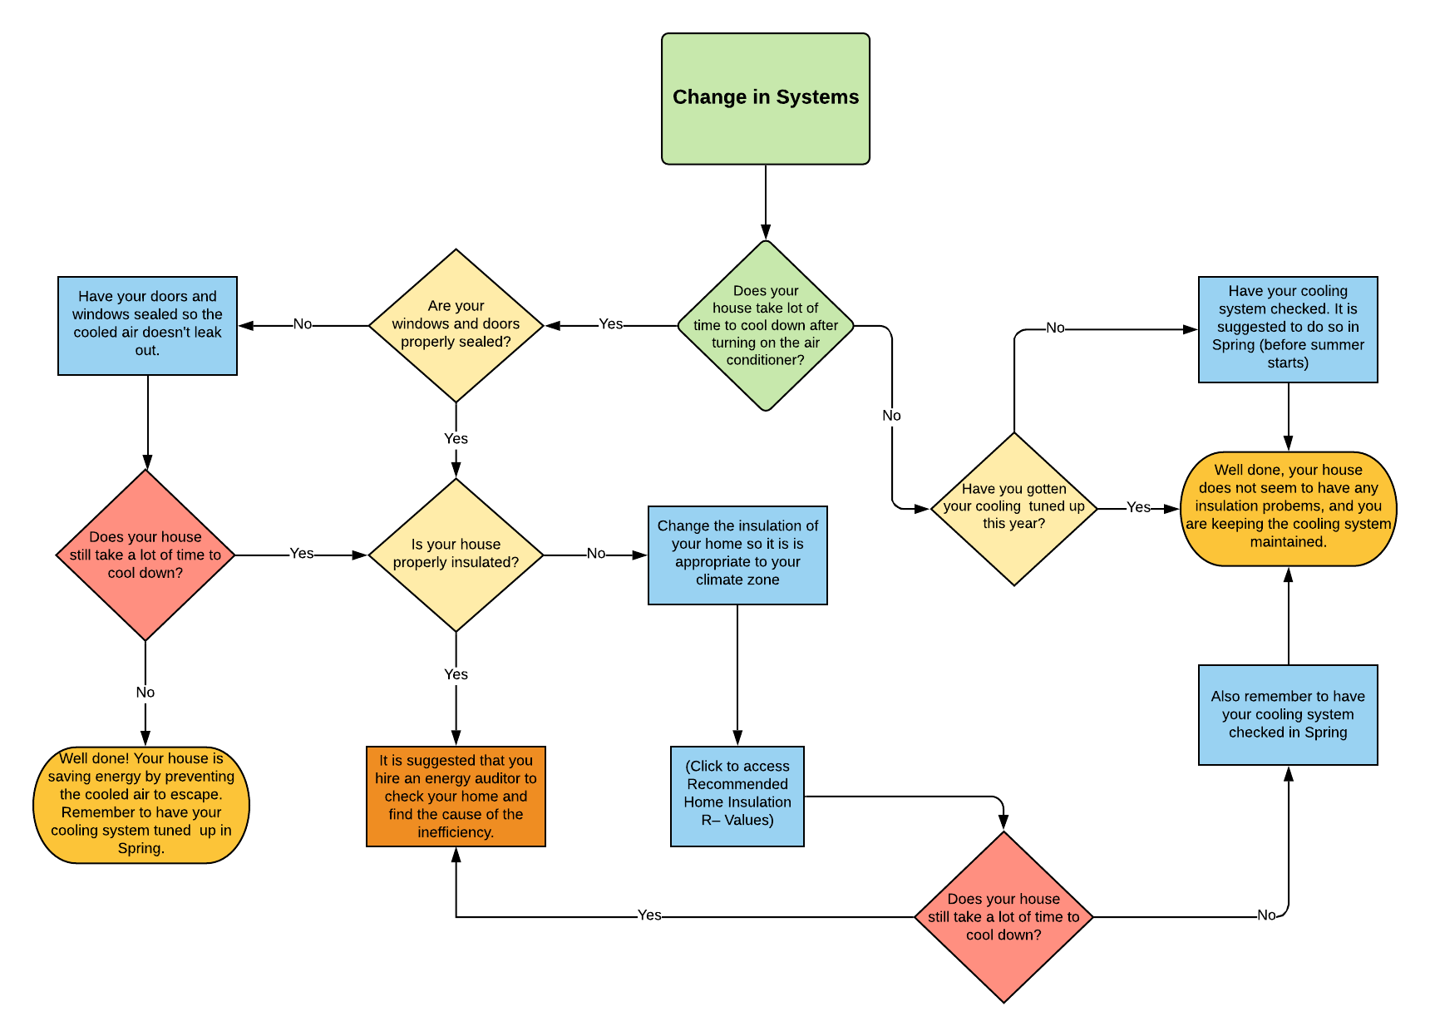
Roadmap samples by category
Notes:
As I mentioned, we have various singular roadmaps that together build the whole roadmap, so we will only show you one example in our next slide.

Slide 16
Roadmap sample
Notes:
This roadmap belongs to the change in products category.
The roadmap here is evaluating a home appliance of the user, in this case, a refrigerator.
Depending on the answers of the user, the roadmap will first evaluate if the size of refrigerator is appropriate to the home, since too large refrigerators consume unnecessary energy.
Next, the roadmap will evaluate if there are any current malfunctions with the refrigerator. The malfunctions we chose are key indicators of an inefficient refrigerator. The roadmap will also consider the life expectancy of the refrigerator.
Finally, before recommending the purchase of an energy start product, the roadmap will ask the user if the refrigerator can be fixed.
This is the structure we have implemented in all our roadmaps, so it can cover any particular situation as possible.

Slide 17
Methodology
Stage I
Literature Review
Stage II
Interview Templates
Stage III
Roadmaps
Stage IV
Future Directions
Notes:
Finally, we move to our last stage, the Future Directions of the project.

Slide 18
Future steps of the project
Step I
Define and identify a representative sample of non-ZNE and ZNE homeowners in Davis
Step II
Conduct the interviews
Step III
Use the previous step as feedback to improve the road maps
Step IV
Develop the roadmap into an online tool and test it with the non-ZNE homeowners
Notes:
Our Project covered the development of the interview templates and the first design of the ZNE Roadmap. The nexts steps for this project involve putting these deliverables to the test and making the necessary adjustments until the roadmap is ready to be worked as a final versión.
By priority, the next steps we recommend are:
First, to define and identify a representative sample of non-ZNE and ZNE homeowners in Davis
Followed by conducting the interviews to the selected homeowners
Then, use the information gained in the interviews to improve and adjust the roadmap.
Finally, to develop the roadmap into an online tool, and put it to the test before making available to the residents of Davis.

Slide 19
Thank you!
Notes:
This is all we have to share with you about our project, thank you for your attention.

Slide 20
References
Alemi, P., & Loge, F. (2017). Energy efficiency measures in affordable zero net energy housing: A case study of the UC Davis 2015 Solar Decathlon home. Renewable Energy, 101, 1242–1255. https://doi.org/10.1016/j.renene.2016.10.016
Harvard Department of Sociology. (2017). Strategies for Qualitative Interviews. Harvard University, 1–4. http://sociology.fas.harvard.edu/files/sociology/files/interview_strategies.pdf
Baechler, M., & Strecker, C. (2011). A Guide to Energy Audits. U.S. Department of Energy, 46. https://doi.org/10.2172/1034990
City of Davis. Interactive Maps available at: http://maps.cityofdavis.org/davis/

