Slide 1
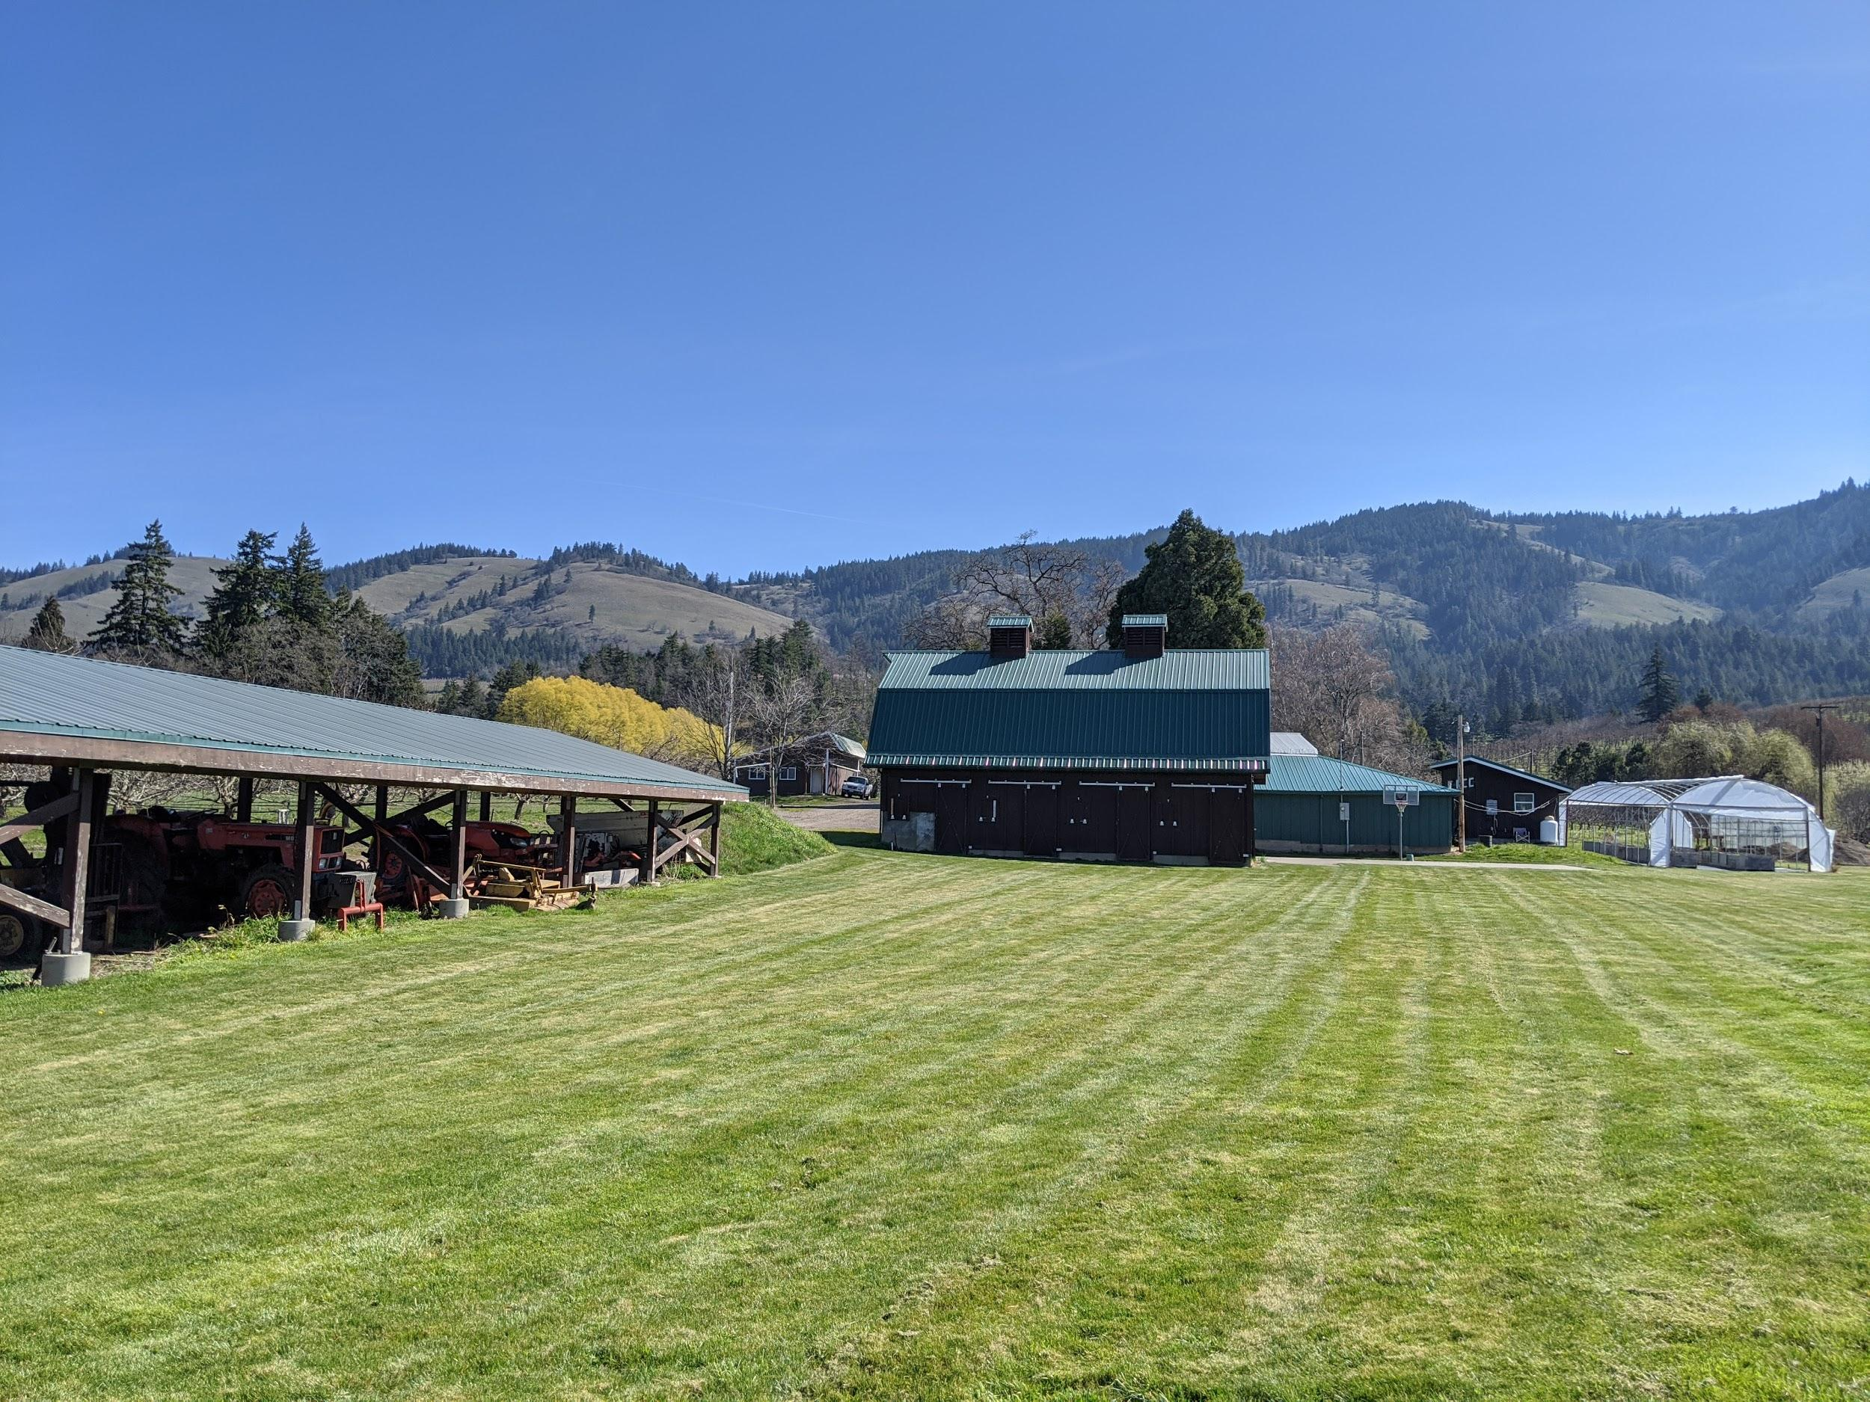
Thrane Homestead Microgrid
Alex Cagle | Greg Miller | Miheer Shah
Designing an islandable, 100% renewable microgrid for a self-sufficient homestead demonstration project in Hood River, OR
Notes:
Alex
Project Goal/background
Client Priorities
No fossil fuels / sustainability
Self-sufficiency/independence from grid
Educational demonstration
Return on investment

Slide 2
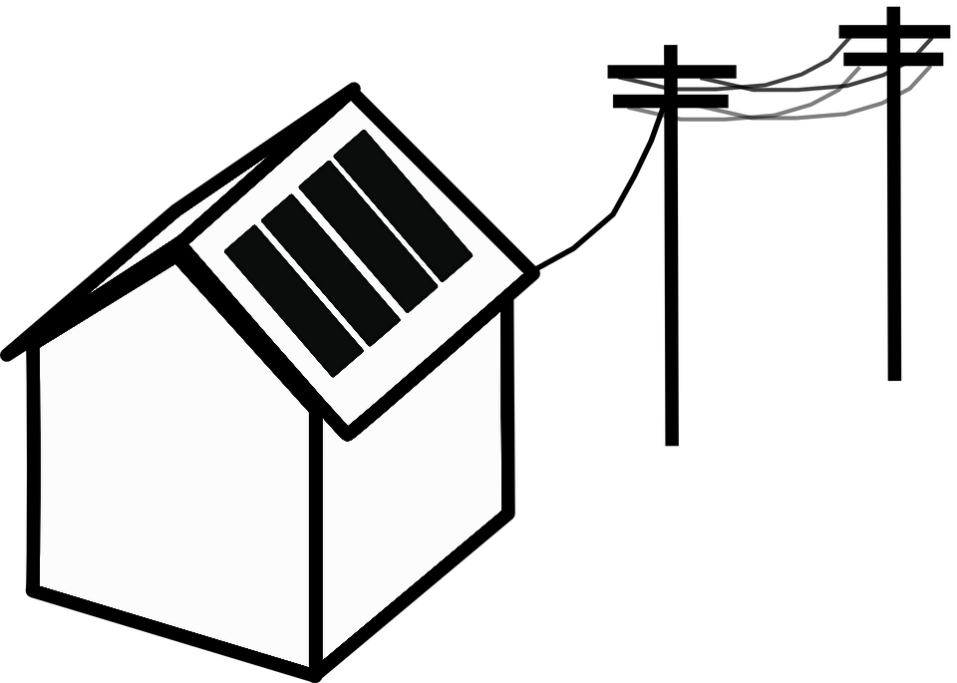
Scope of Work
Renewable Resource Assessment
Energy Audit & Efficiency Recommendations Smart Load and Electrification Recommendations
Energy Balance & Economic Analysis
Microgrid Architecture & Design
Phased Implementation Recommendations
Notes:
Miheer
To achieve this goal, we began by first evaluating its technical feasibility.
This involved assessing the potential of the available renewable resources to provide fossil fuel free energy,
and investigating the energy consumption and demand profile of the property in order to identify the most impactful recommendations for increasing energy conservation and sustainability.
Armed with more detailed energy supply and demand data, we analyzed the opportunities for matching the loads with renewables.
The next step involves studying the economic feasibility of several load balancing alternatives.
The combined technoeconomic analysis then informs a best case choice for sizing and designing the microgrid.
This would be synthesized into a final deliverable to our client with recommendations on how to implement the design in phases.

Slide 3
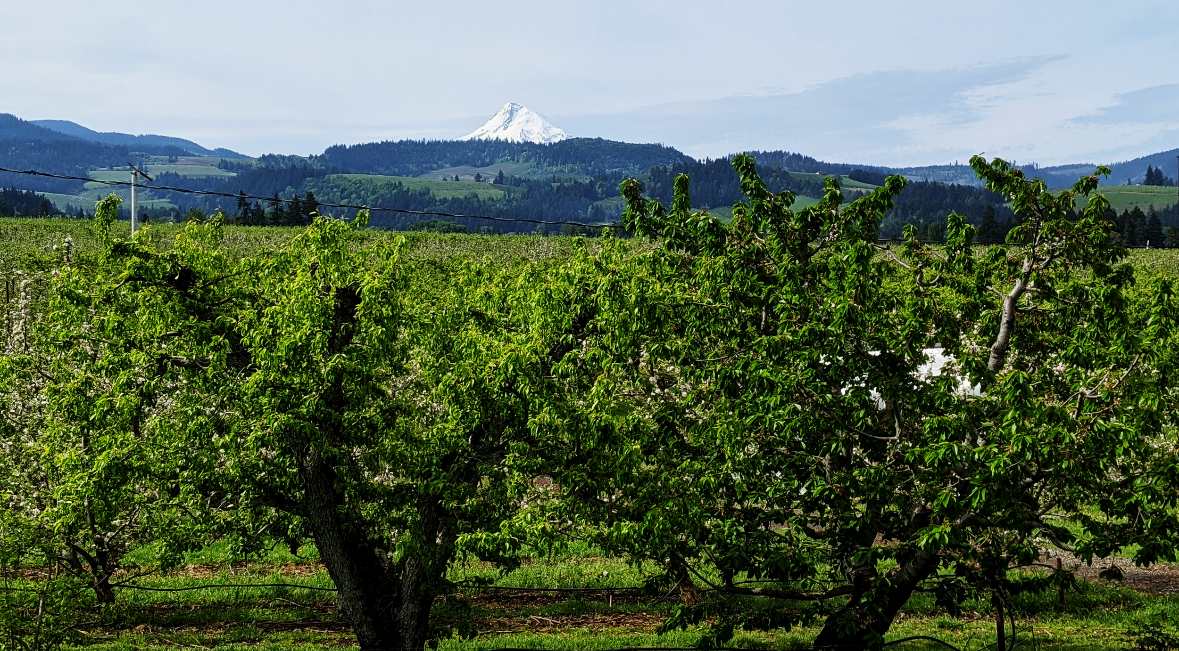
Methodology & Approach
Resource Assessment
Solar: PV Watts modeling
Wind: Local airport wind speed data
Hydro: Engineering potential calculations
Energy Audit
Kill-a-Watt
FLIR camera
Home energy monitor
Energy Balance & Economic Analysis
Case Studies (load profiles, components)
Excel Analysis
HOMER Grid
Microgrid Design
Interviews with experts
Microgrid circuit mapping
Local PV zoning requirements
Notes:
Miheer
How have we addressed the components in the scope of work?
We evaluated the potential of solar, wind and conduit hydropower resources using solar irradiation, wind speed and water pressure data most representative of the homestead’s location.
This resource data was than converted into energy output using NREL models and literature based engineering calculations.
The load profiles were determined using billing data and by conducting an energy audit of the property using various tools such as kill-a-watt meter and home energy monitors.
Energy supply and demand matching analysis was done using Excel,
and economic modeling is being conducted using HOMER Grid which enables optimization of design and economics of hybrid energy systems such as the on

Slide 4
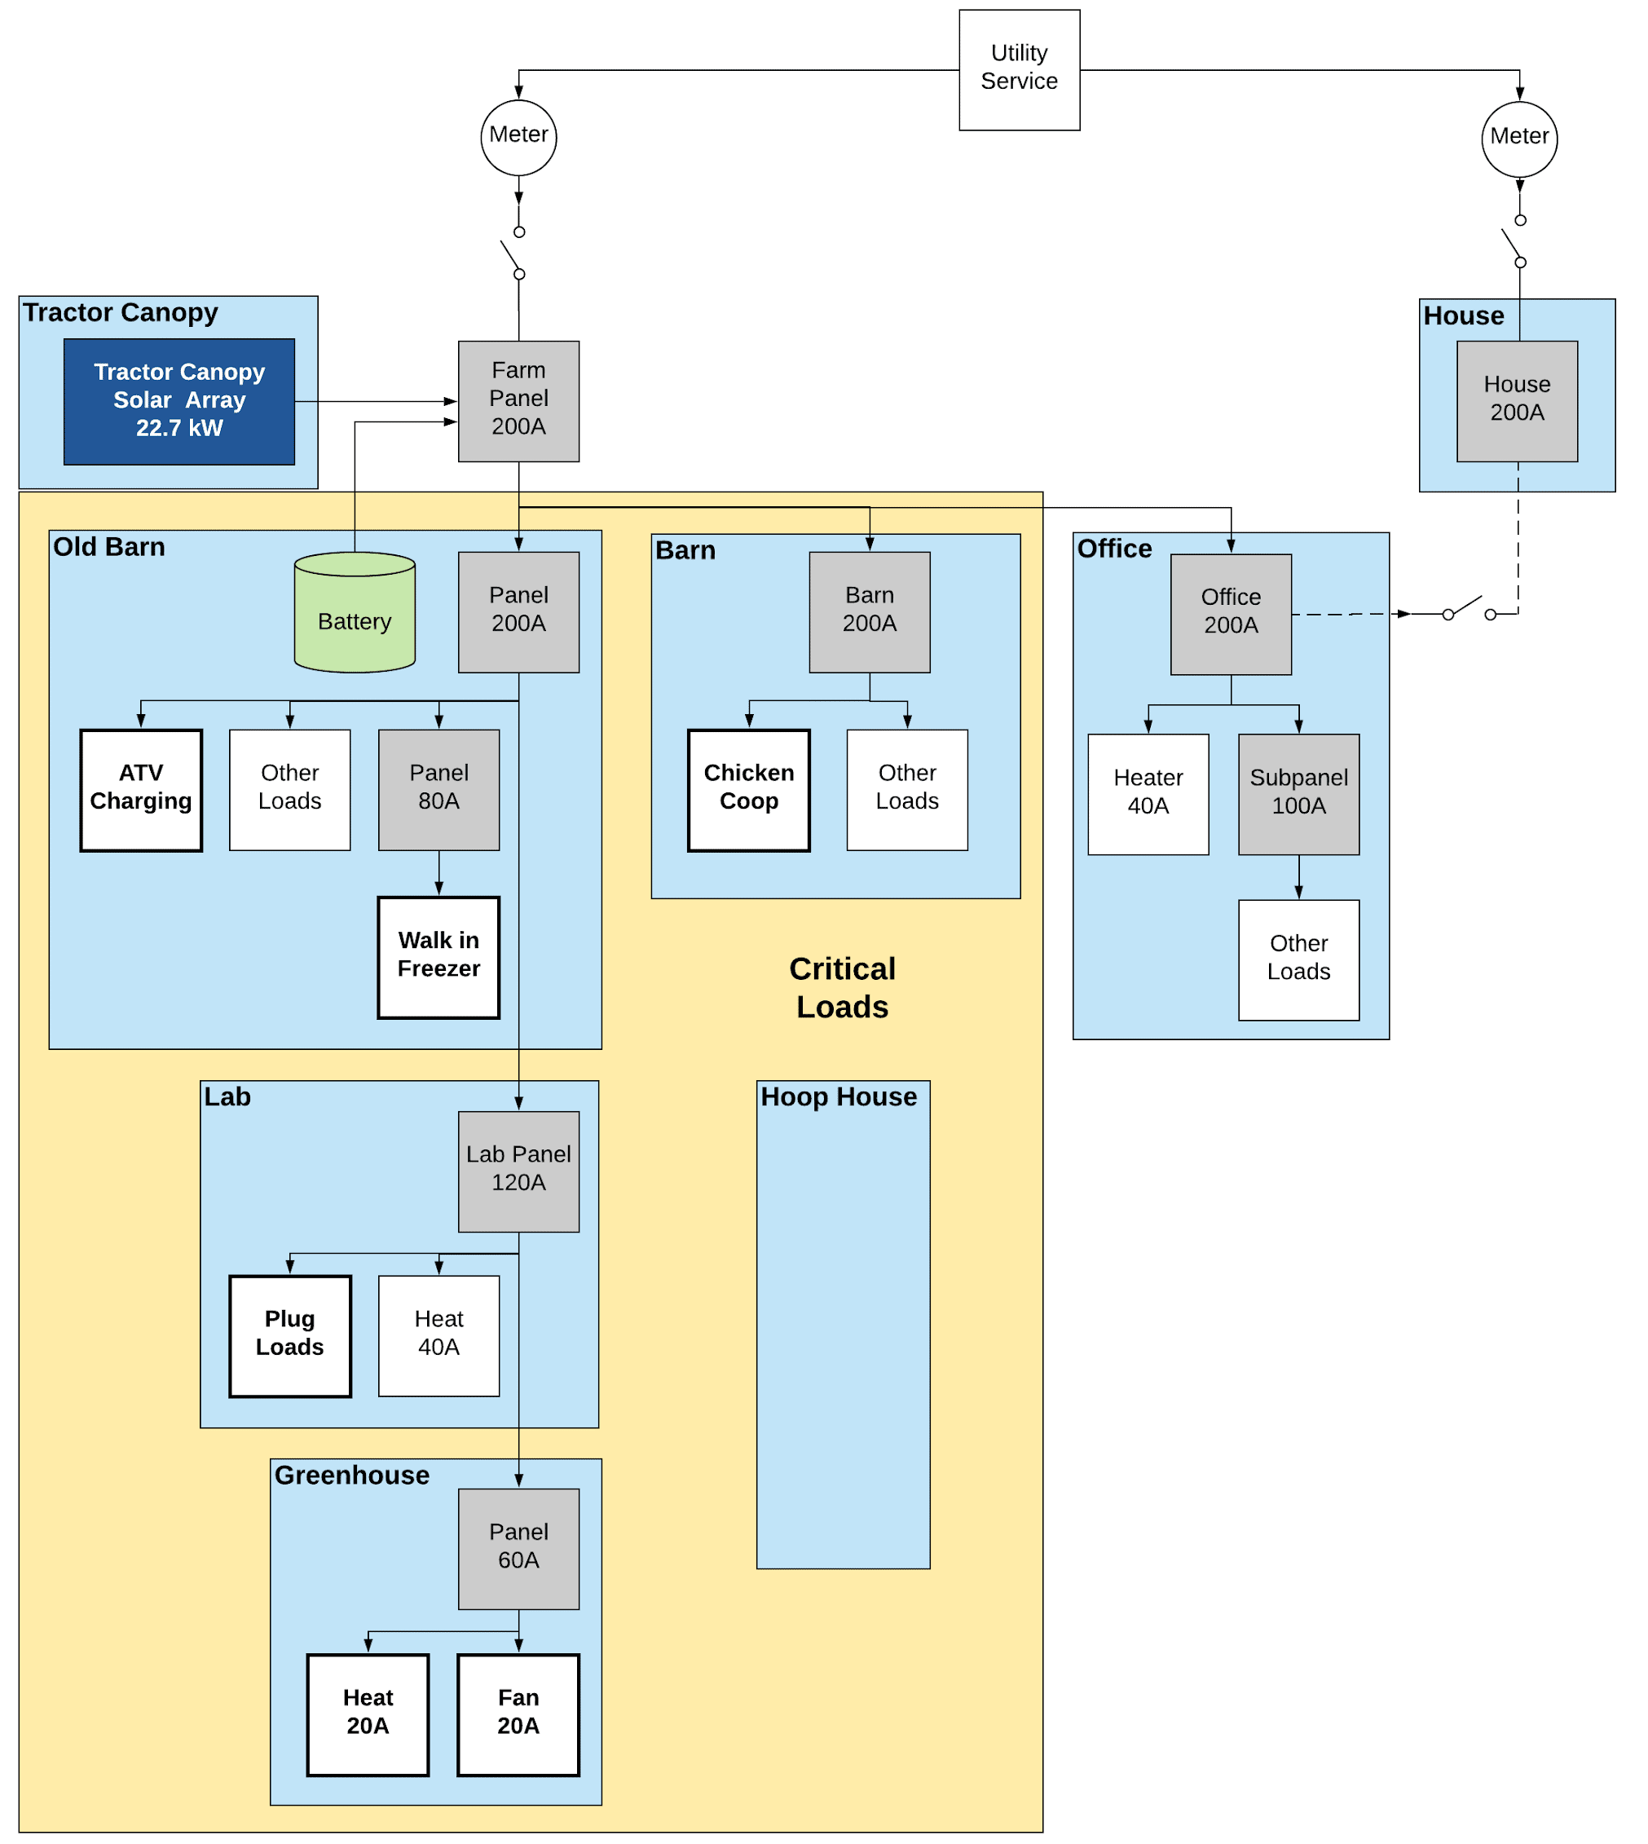
Microgrid Architecture
Components
22.7kW Sunpower X-series high-efficiency rooftop solar array
6.8kW / 13kWh Sunpower Equinox battery
Viking Cold thermal storage
Operational Hierarchy
Power homestead loads
Charge batteries
Power house
Export to Grid
Notes:
Greg

Slide 5
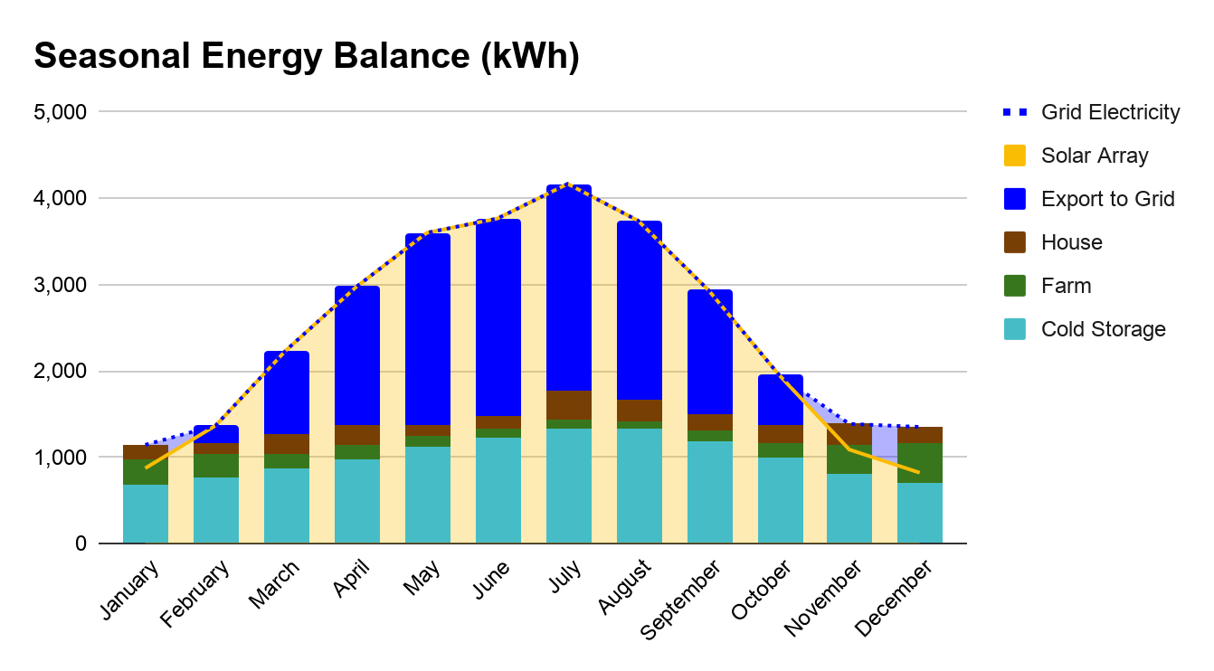
Notes:
Greg
Main Results: Homestead could be off-grid for 8-9 months of year, will rely on grid electricity in winter, but would still have about 24 hours of backup power even in winter.
Sources of Uncertainty: Magnitude of cold storage energy consumption
Additional/Follow-on work: Applying learned historical microgrid performance to better identify critical circuits to power year round; add certainty in estimates through use of HOMER Grid

Slide 6
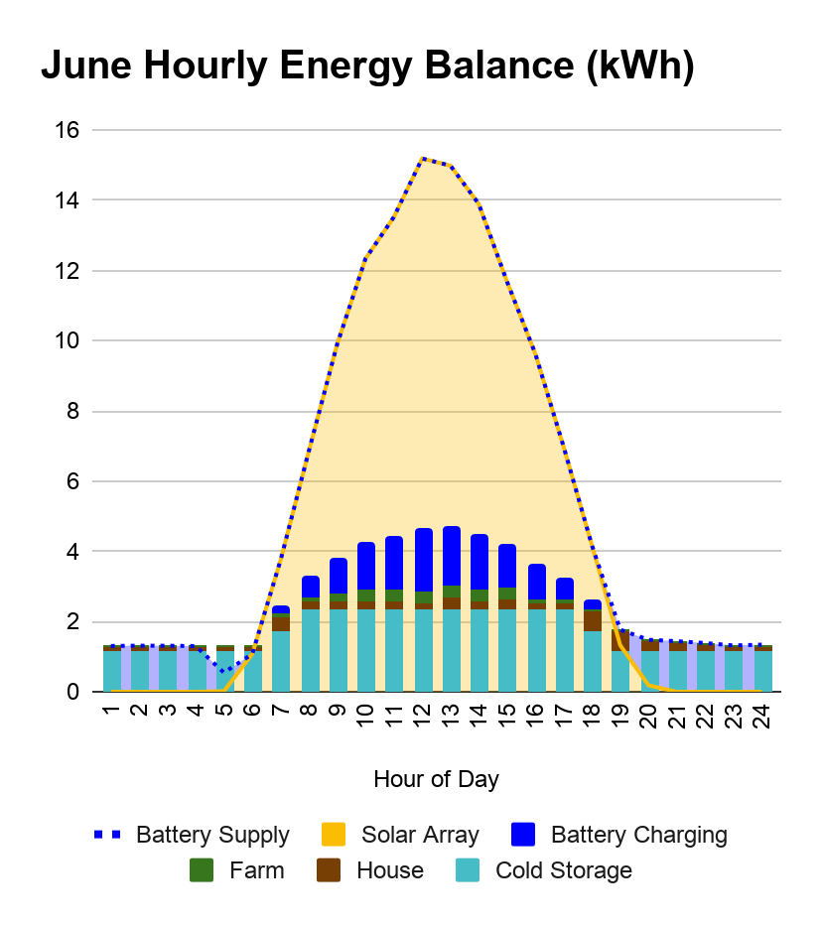
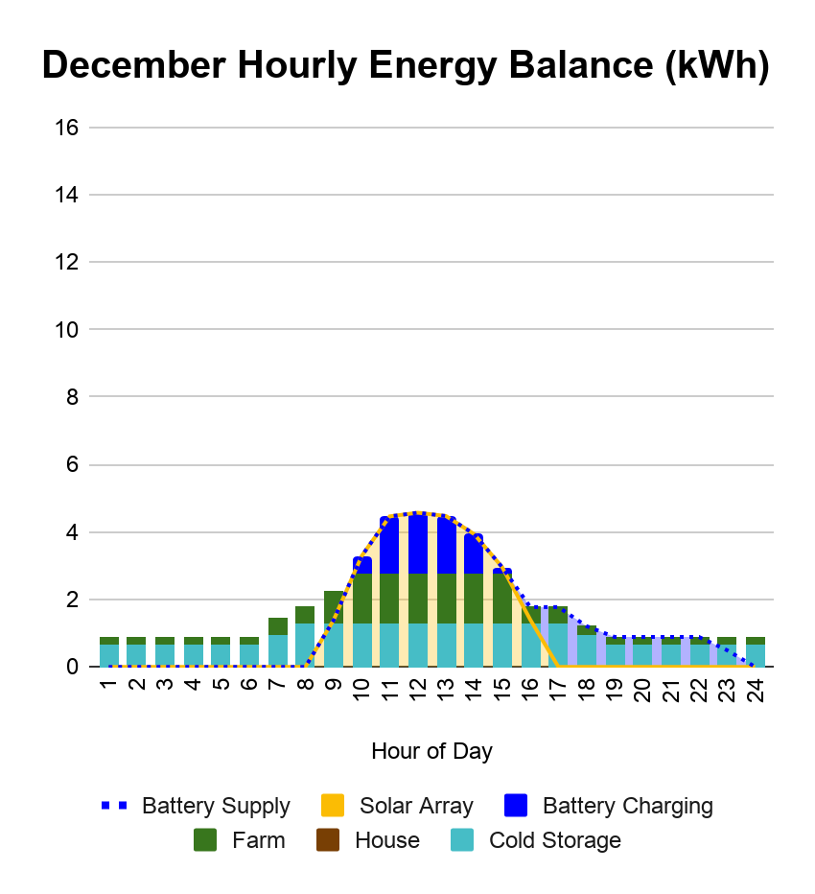
Notes:
Greg
Main Results: Need to align loads as much as possible with solar profile: using cold storage as thermal battery
Sources of Uncertainty: Lack of hourly energy consumption data -> had to rely on synthetic data
Additional/Follow-on work: Incorporate learned grid behavior and load performances

Slide 7
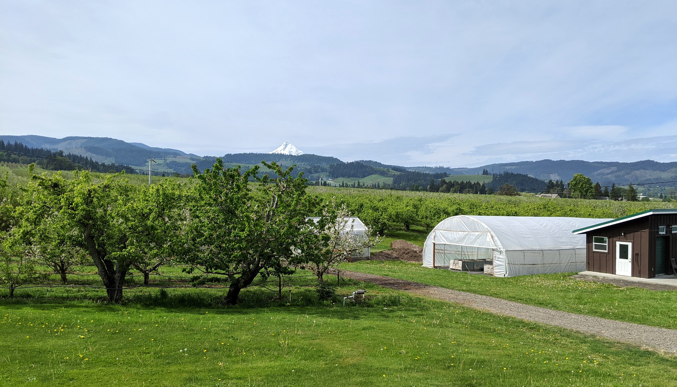
Recommendations
Phase I: Create the Foundation for a Microgrid
Purchase and install all solar PV, storage, and controls
Utilize the Investment Tax Credit (ITC) while it remains above 20%
Begin collecting comprehensive energy usage on the homestead
Phase II: Optimize Microgrid Operations
Integrate new electric loads to the Homestead Microgrid
Electric farm vehicles
Electric water heater
Optimize microgrid system to power new loads accordingly
Notes:
Alex
Suite of options within each phase
PV sizing
additional loads etc
Initial HOMER Findings:
17.5 cents/kWh-24 cents/kwh depending on sizing

