Slide 1
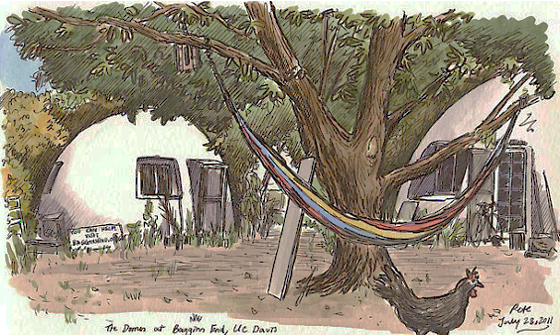
Domes 2.0: Beyond the Back-40
Maria Kanwal (PhD EGG)
Isaac Trejo (B.S. LDA)
Siobhan Rubsam (M.S. IAD)

Slide 2
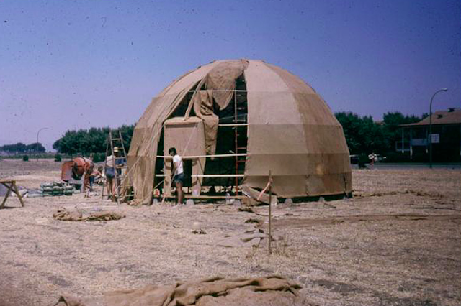
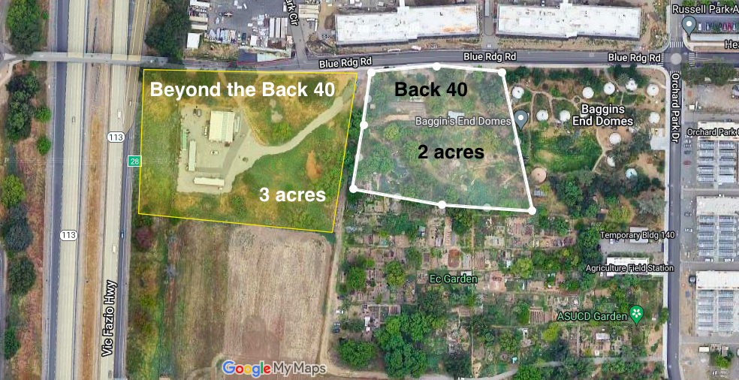
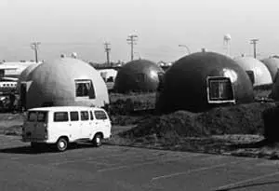
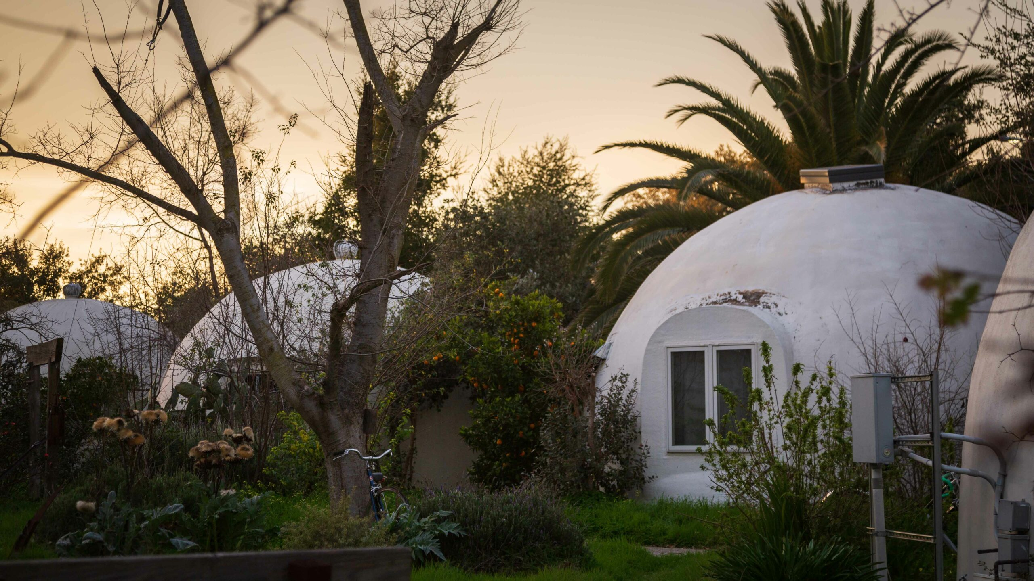
Building on a 50-year vision
Notes:
The Domes have inspired people since their founding 50 years ago, and the SCHA and SLLC would like
to build upon this vision on a larger scale to make the Domes experience accessible to more students. 60 students.
two potential sites to work with

Slide 3
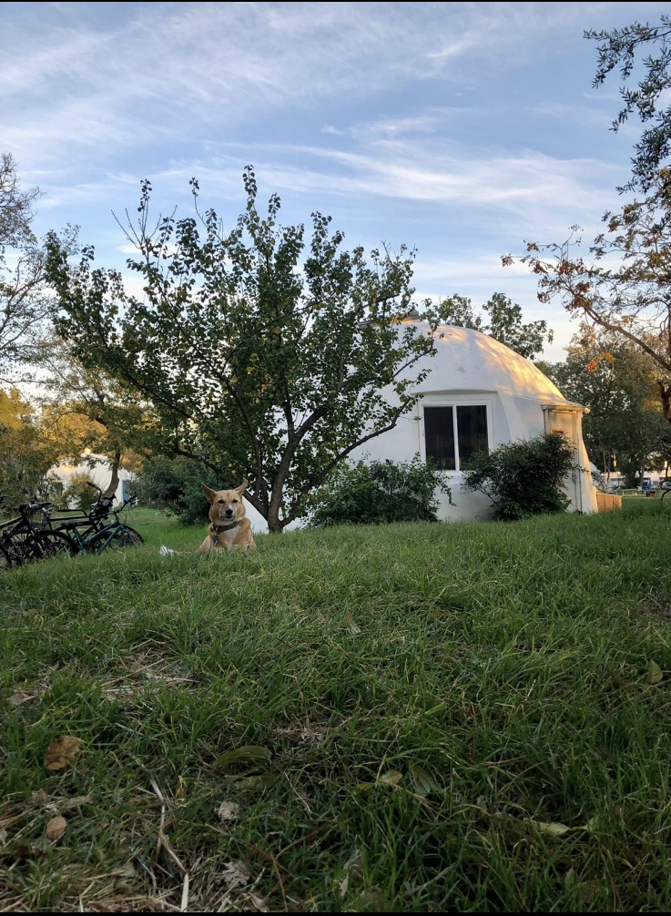
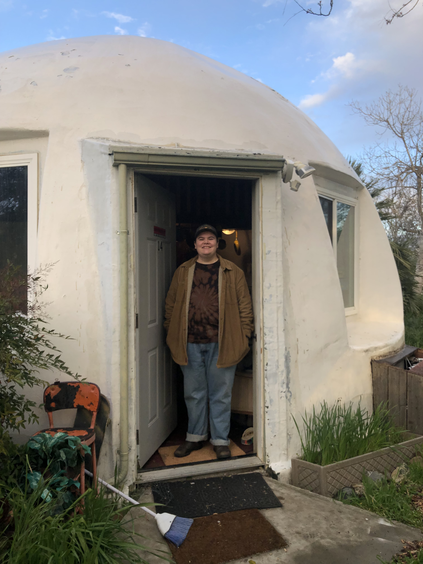
What did we do?
Determined project values.
Looked at prior art.
Evaluated sites.
Designed layouts.
Evaluated layouts.
Recommendations and next steps.

Slide 4
What values are important to our clients and stakeholders?
Clients
Domies
ADA Accessible
Energy efficient structures
Higher density than Domes
Private green space
Layout enforces visibility
Net-zero energy production
Quirky, unique architecture
Integration into natural environment
Can be replicated
Low rise buildings
Diverse community members
Small building footprint
Affordable
Self-governance
Wastewater conservation
Notes:
Focus group discussions with current domies, conversations with clients, and a values survey sent to our clients and a few past Domies.
-
Clients (Ryan Galt and Leslie Geathers) and Domies: ADA accessible, higher density than Domes, and a layout that enforces neighbor visibility.
Clients: passive energy efficiency and wastewater conservation, as well as net zero energy, replicability
Domies: private green space and quirky architecture

Slide 5
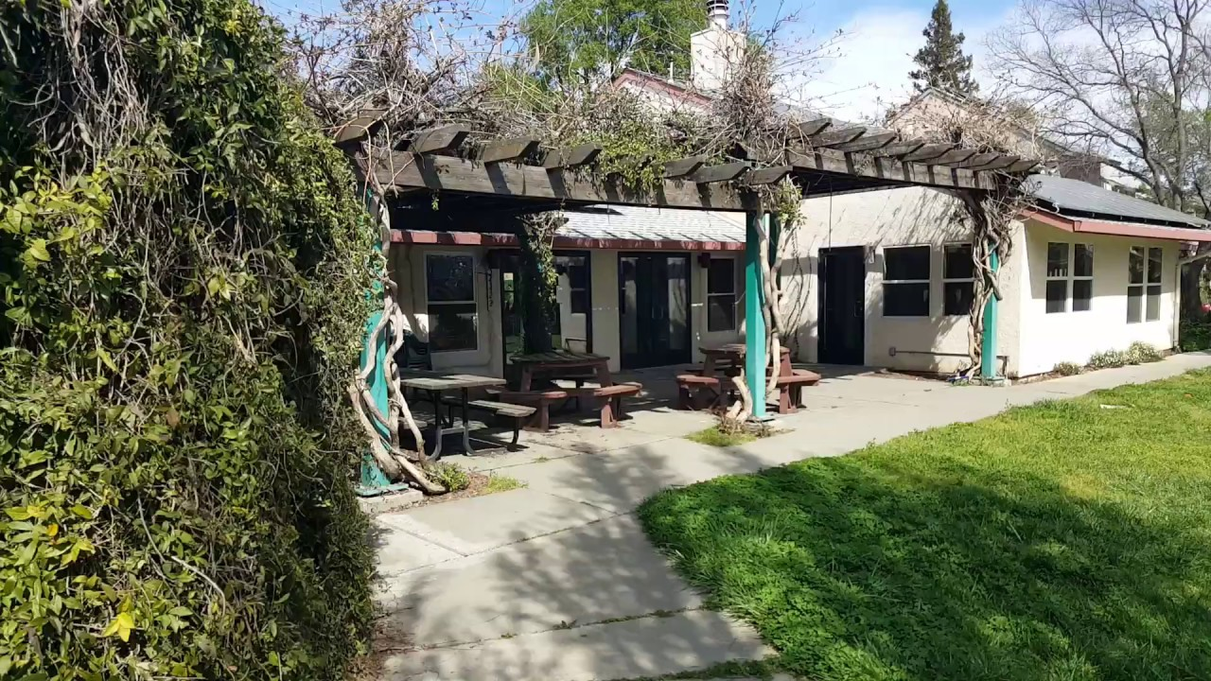
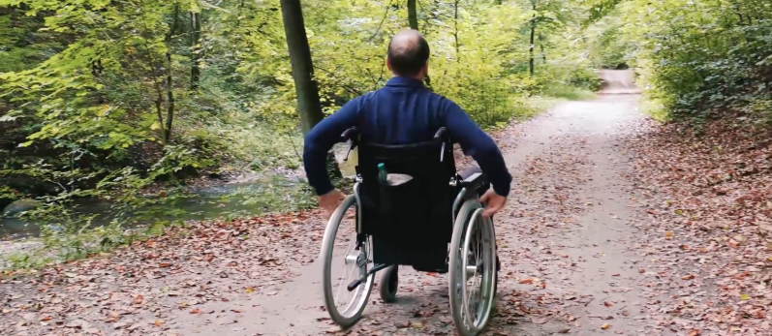
Diversity, Equity, and Inclusion: The Heart of Domes 2.0
Diversity: A greater effort to attract racial and cultural diversity.
Equity: The community will be more affordable than average Davis housing.
Inclusion: Consensus and self-governance so everyone is heard.
Notes:
Diversity:
The very model of cooperative living is anti-capitalist and should in theory attract a diverse range of people who are not benefitting from the current systems.
Equity: The new community will be more affordable than an average Davis rental.
Inclusion: Community decision-making will be modeled so all members feel they are a valued and integral member, regardless of their seniority.
2 DEI components of our project will be:
2 ADA units
Shared community building
(The entire community will be built to include people of all ability levels–including ADA pathways reaching each unit (so ADA community members are not limited to only ADA units but can visit neighbors), and 2 downstairs units entirely retrofitted for ADA accessibility. ADA parking spaces will most likely be in the new Orchard Park parking lot, which is directly to the north of our proposed ‘Beyond the Back 40’ site.)

Slide 6
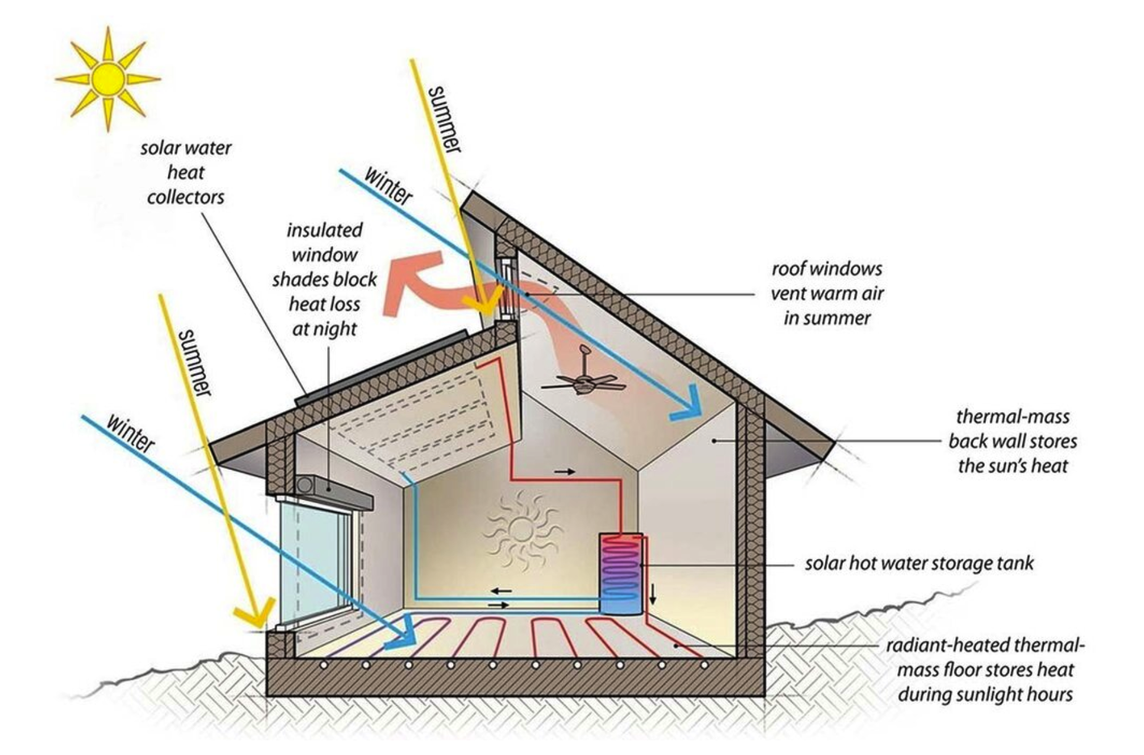
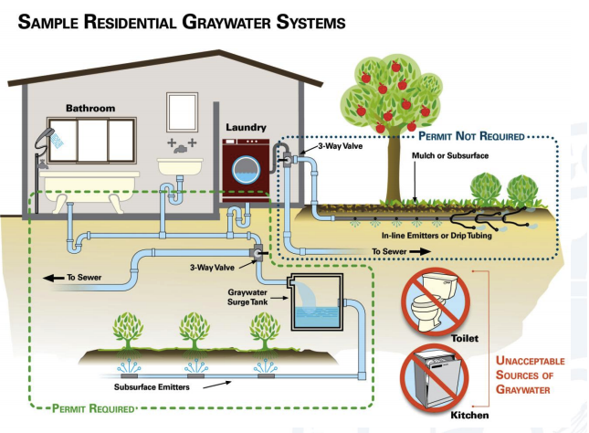
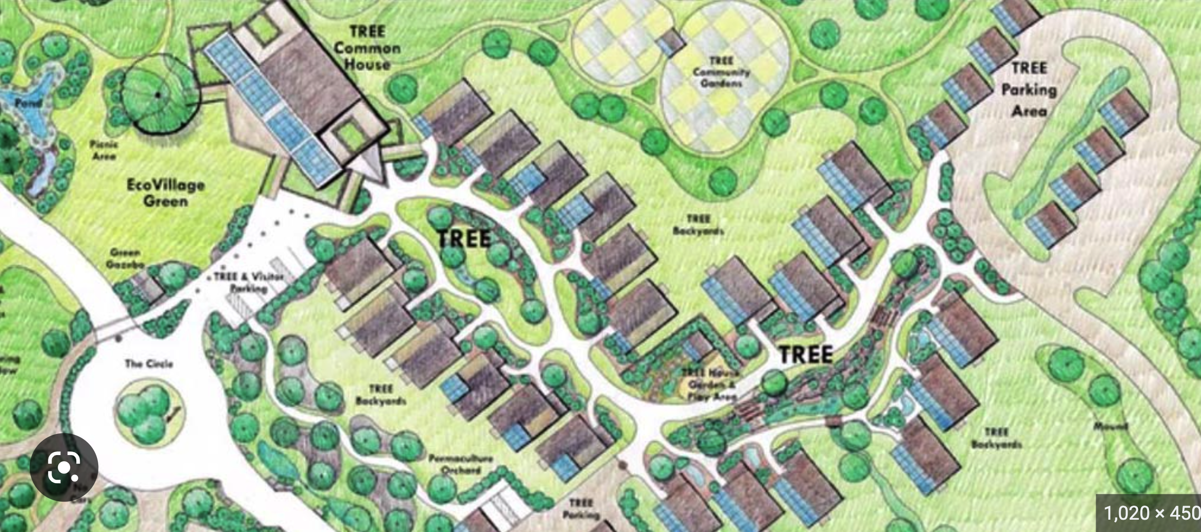
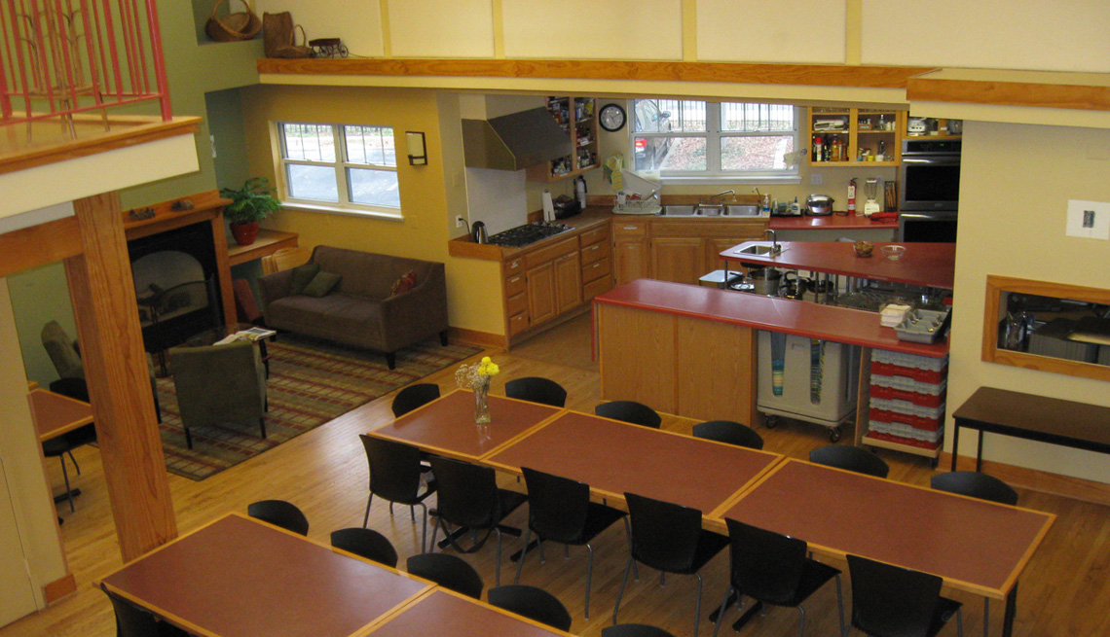
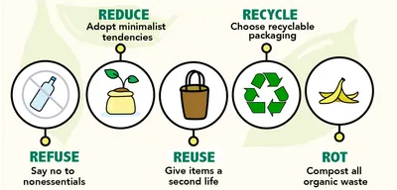
Ecovillages: Best Practices
Renewable Energy
Low resource use
Land preservation
Visibility enforced by design
Shared community space
Zero waste
https://www.ecologyartisans.com/blog/san-diego-graywater-rebates
https://psci.princeton.edu/tips/2020/7/20/passive-solar-design-retrofits
https://www.aarp.org/livable-communities/housing/info-2016/questions-answers-about-cohousing.html
https://keepmassbeautiful.org/what-we-do/waste-reduction-recycling/zero-waste-in-massachusetts.html
https://world-habitat.org/world-habitat-awards/winners-and-finalists/ecovillage-at-ithaca/
Notes:
We identified some best practices across ecovillages, such as
The use of renwable energy like rooftop solar
Low resources use, which can be accomplished using energy efficiency measures like passive solar design, skylighting, high thermal insulation, natural shading. Additionally rainwater and greywater harvesting can decrease the water consumption.
Land preservation
Visibility enforced by design to promote community interaction
Passive solar design: This approach utilizes the sun's energy to heat and light the building naturally. By orienting the building to maximize solar gain and incorporating features like large windows, thermal mass, and shading, the building can remain warm in the winter and cool in the summer. Research shows that including passive solar options increases the cost of a new build by between 0% and 3%. On a home costing $250,000 to build, that means at most $7,500 extra. That's quite a lot of money, but the returns on that extra investment can be astronomical.
Insulation: Proper insulation in walls, floors, and roofs can significantly reduce heat loss and gain, making the building more energy efficient
High-performance windows: Windows with double or triple glazing, low-e coatings, and gas fills can reduce heat loss and improve thermal performance.
Air sealing: Proper sealing of air leaks in walls, roofs, windows, and doors can prevent drafts and heat loss, improving overall energy efficiency.
Efficient HVAC systems: High-efficiency heating, ventilation, and air conditioning (HVAC) systems can significantly reduce energy consumption and operating costs.
Energy-efficient lighting: LED lighting can use up to 75% less energy than traditional incandescent bulbs, making them an ideal choice for energy-efficient homes.
Shading: Installing shades or blinds on skylights can block direct sunlight and reduce solar gain. Automated shading systems that can adjust based on the sun's position are especially effective.
Glazing: Choosing skylights with low-emissivity (low-e) coatings or tinted glass can reduce solar heat gain.
Orientation: Placing skylights on the north side of a roof or using a slope that faces away from the sun's path can minimize solar gain.
Ventilation: Incorporating operable skylights that can be opened to allow for natural ventilation can help reduce the need for air conditioning.
Thermal insulation: Insulating around skylights and ensuring they are installed properly can help reduce heat transfer.
It is important to note that skylights can also provide natural light, which can help reduce the need for artificial lighting and provide health benefits to occupants. Therefore, it is important to balance the benefits of skylights with the potential for solar gain and implement design strategies to minimize their impact on energy efficiency.
Energy-efficient appliances: Appliances with Energy Star certification can use up to 50% less energy than non-certified models, reducing overall energy consumption.
Renewable energy: Installing solar panels, wind turbines, or other renewable energy systems can generate clean energy on-site, reducing the need for fossil fuels.
By incorporating these energy efficiency measures into the design of sustainable housing, it is possible to achieve energy savings of 30-50% or more.

Slide 7
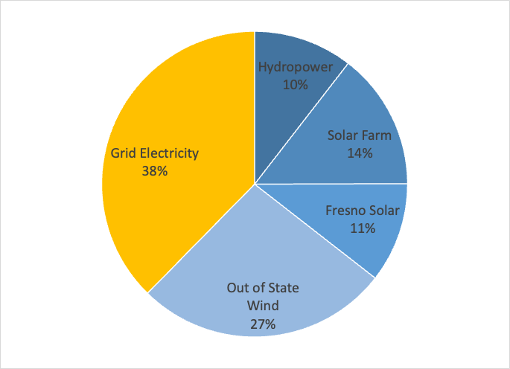
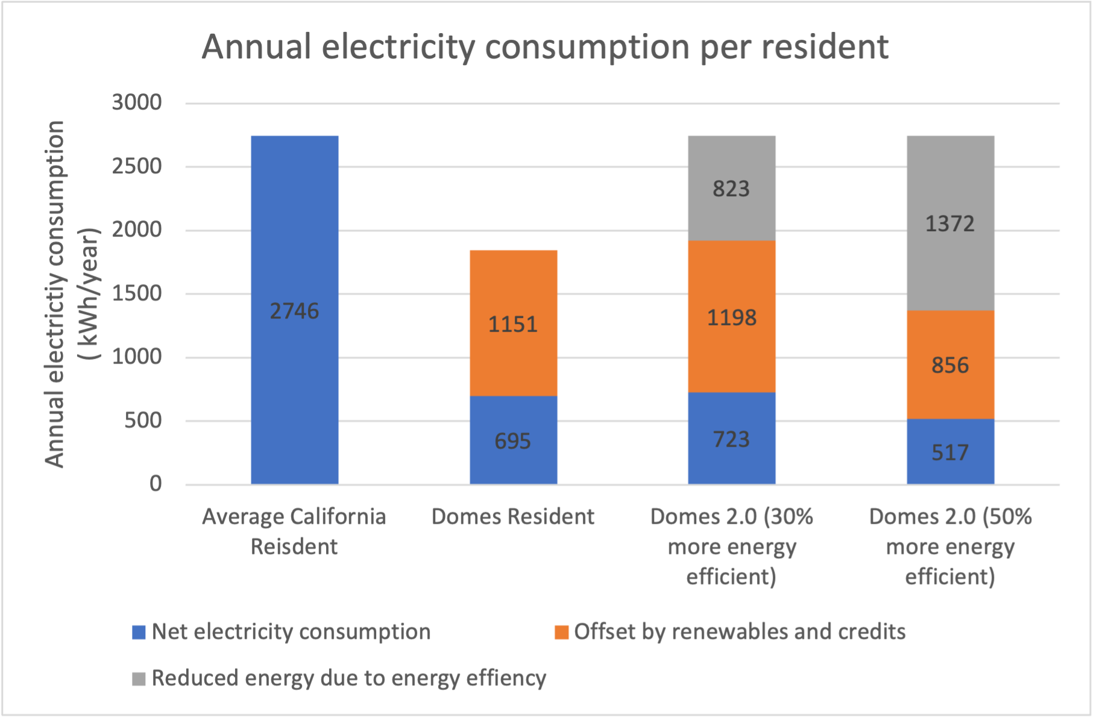
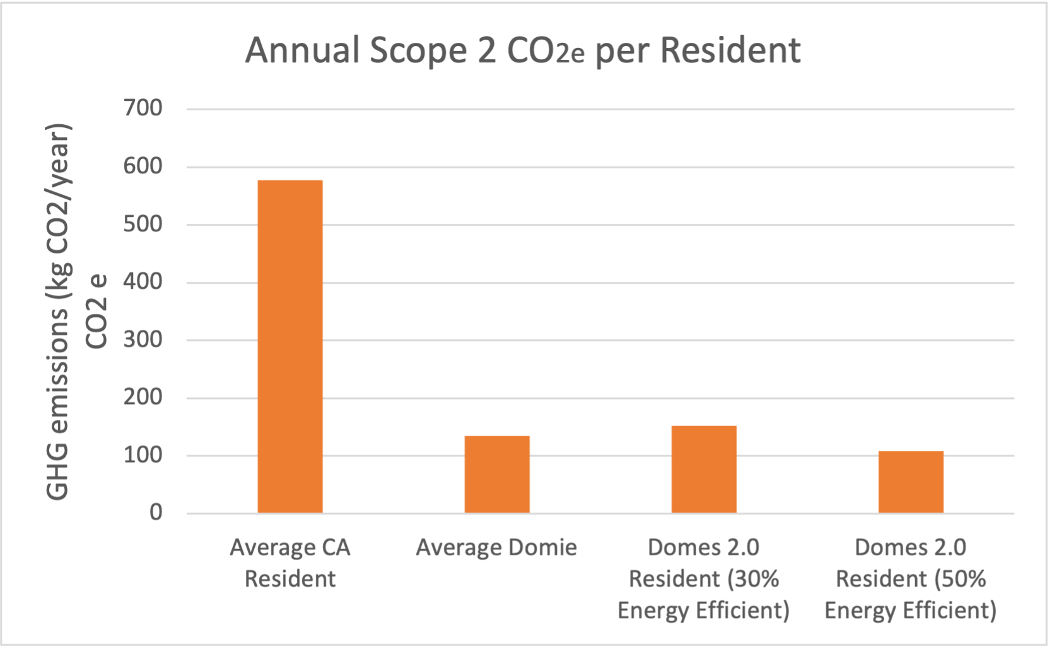
Energy Use Intensity (EUI) and Grid Emissions
Energy Use Intensity (EUI) kBtu/sq ft
 | Average CA single family home | Domes (550sq ft) | Domes 2.0 (30% EE) (650 sq ft) | Domes 2.0 (50% EE) (650 sq ft)
Energy Use Intensity (EUI) kBtu/sq ft | 30 | 22 | 20 | 14.4
EUI % reduction from baseline | 0% | 25% | 33% | 48%
https://zerotool.org/zerotool/
UC Davis Energy Mix
Modeled using CAMX emission factor - 2019
Notes:
To set a benchmark for Domes 2.0 , we looked into Energy use Intensity and Emissions
The EUI of an average CA home is 30kbtu/sq ft
The EUI of Domes in comparison is 25% lower. This is majorly due to some behaviour differences in the residents.
For Domes 2.0 Energy Efficiency measures can reduce consumption from 30-50%, leading to further reductions in EUI
The UCD campus gets electricity from a variety of sources. only 38% of which accounts for grid electricity.
This chart shows the annual electricity consumption
It is evident that an average Domie has a lower Energy footprint
in order to for Domes 2.0 residents to be comparable to it, a minimum of 30% energy effiency is required.
for 50% EE. Domes 2.0 would have significanlty lower electricity consumption than Domes while offering higher quality of life.
The annual scope 2 emissions were modeled using CAMX emission factor, and they also follow the same trend.
CEED residence halls UCD EUI?
Green Energy residual mix emission factors for scope 2 emissions, market based approach (2019)

Slide 8
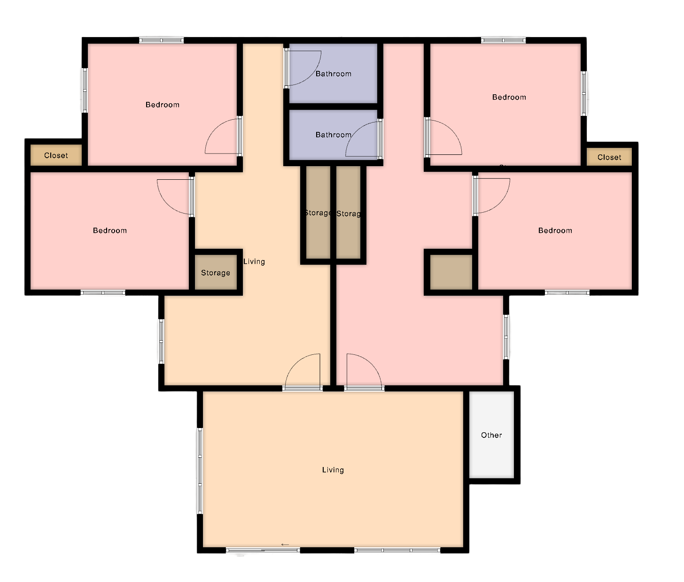
Modeling Zero Net Energy and Low Water Usage (Domes 2.0)
Domes 2.0 (30% Energy Efficient)
Grid-tied (30 residents)
Solar energy system = 44kW
Cost est = $ 120,000
Stand alone (30 residents)
Solar energy system = 129kW
Battery Backup = 12000Ah
Cost est = $570,000
Domes 2.0 (50% Energy Efficient)
Grid-tied (30 residents)
Solar energy system = 31kW
Cost est = $ 91,450
Stand alone (30 residents)
Solar energy system = 91kW
Battery Backup = 8500Ah
Cost est = $436,000
Solar $2.95/W
Solar with battery
$4.84/W
U . S . Solar Photovoltaic System and Energy Storage Cost Benchmarks With Minimum Sustainable Price Analysis : 2022c
Effect of rainwater catchment and greywater system on water demand Domes 2.0 (30 people)
 | Average annual water usage |  |  | Average annual water usage after greywater system (30% savings)
 | 383250 (gal/year) |  |  | 268275 (gal/year)
 | Arc-Commons (5200 sq ft) | Tri-Story (3600 sq ft) | Row-houses (3000 sq ft) | Arc-Commons (5200 sq ft) | Tri-Story (3600 sq ft) | Row-houses (3000 sq ft)
Ave annual rainwater collection (gal/year) | 120,513 | 40,557 | 104,290 | 120,513 | 40,557 | 104,290
Net water demand (gal/year) | 262,737 | 342,693 | 278,960 | 147,762 | 227,718 | 163,985
Arc-commons building layout
Notes:
-Solar system for Domes 2.0 was modeled,
-if the buildings are 30% more energy efficient they would need a 44kW grid-tied or 129 kW off-grid system to achieve Zero net energy.
- 50% more energy efficient buildings would need a 31kW grid tied whereas 91kW off-grid system.
-Based on the different designs proposed, the effect of rainwater catchment and greywater was also calculated. We have three final designs that Isaac will go over. The Arc-commons design, due to its greater rooftop area would lead to a significant decrease in net water demand from rainwater catchment. Additional decrease in demand would be seen if a greywater system offering 30% savings in water use is installed.

Slide 9
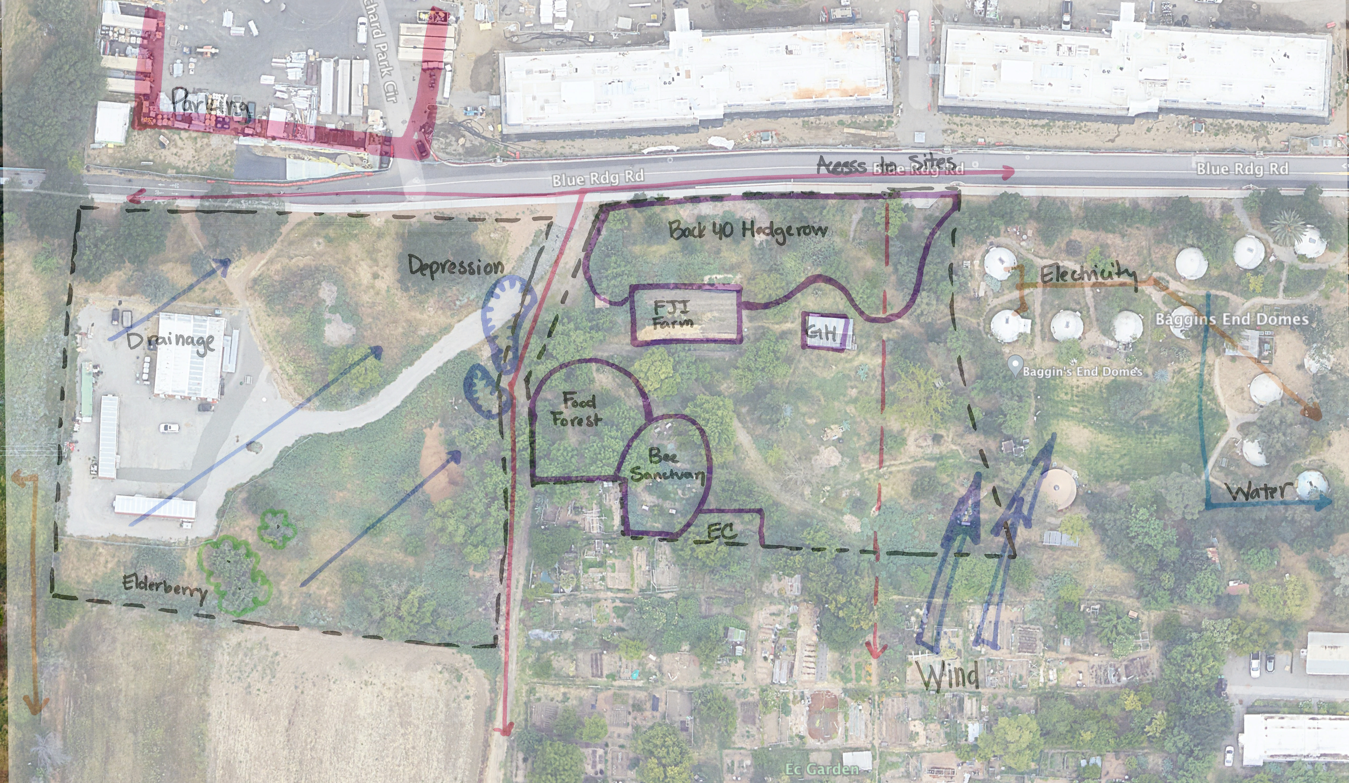
Opportunities & Constraints
Access
Drainage
Sun
Wind
Existing utilities
Existing communities
Existing vegetation

Slide 10
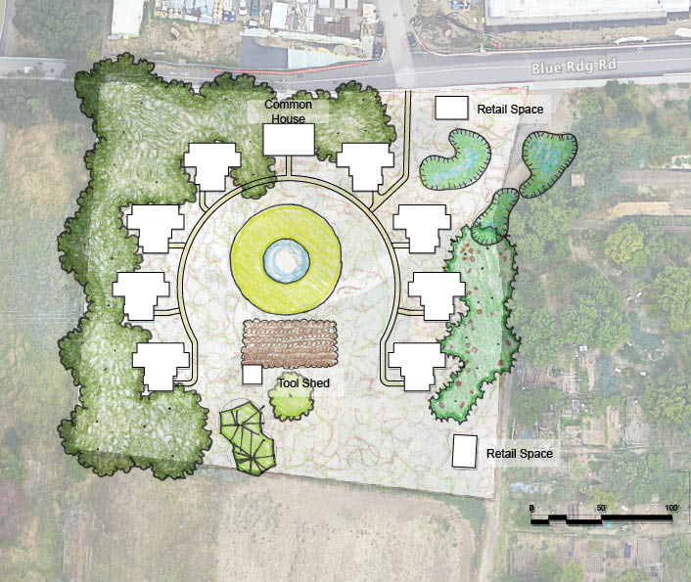
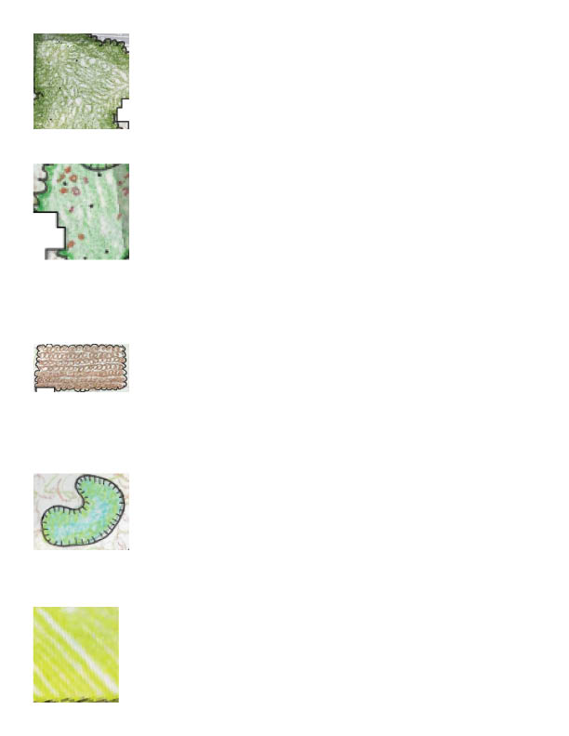
Arc Commons
Best building footprint for solar + rainwater harvesting
Building Footprint: 1200 sqft.
Worst building footprint for solar and rainwater harvesting
Can be phased
Legend
Canopy
Food Forest
Field
Bioretention
Common Space
Notes:
Pros and cons

Slide 11
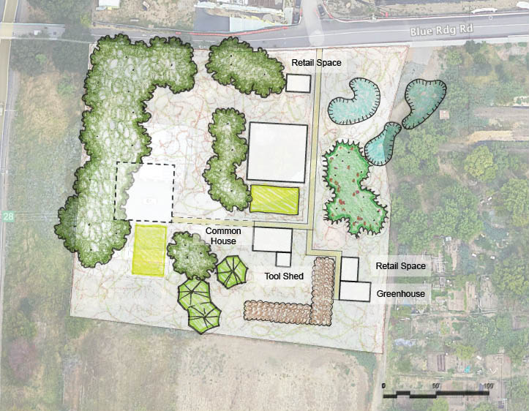
Tri-Story
Building Footprint: 3600 sqft.
Worst building footprint for solar and rainwater harvesting
Can be phased
Legend
Canopy
Food Forest
Field
Bioretention
Common Space
Notes:
Where to access
Pros and cons

Slide 12
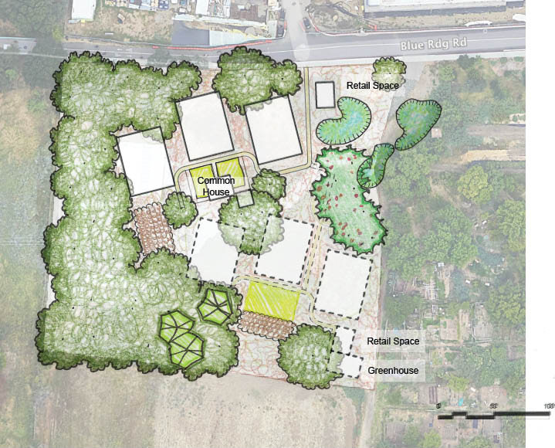
The Rowhouses
Building Footprint: 2700 sqft.
Can be phased
Legend
Canopy
Food Forest
Field
Bioretention
Common Space
Notes:
Pros and cons

Slide 13
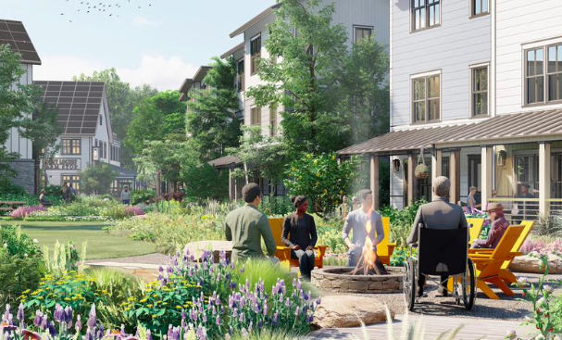
Recommendations and Next Steps
Explore sustainable building materials
Explore connections to neighboring communities
Refine and expand layout
Determine budget and timeline
Notes:
Explore sustainable building materials
Request LCA of proposed building materials (Redhorse)
Types of materials?
Red horse prefab sheets, cob, mycelium, mass timber
Explore connections to neighboring communities
Public facing retail (ag, blue ridge)
Refine and expand layout

Slide 14
References
[1] R. Jussila, “Disaster Risk Reduction: A Cross-cutting Necessity in the SDGs,” Glob. Sustain. Dev. Rep. 2015 Ed., p. 202, 2015, [Online]. Available: https://sustainabledevelopment.un.org/content/documents/1758GSDR 2015 Advance Unedited Version.pdf.
[2] J. Sherry, “The impact of community sustainability: A life cycle assessment of three ecovillages,” J. Clean. Prod., vol. 237, p. 117830, 2019, doi: 10.1016/j.jclepro.2019.117830.
[3] A. Kirby, “Redefining social and environmental relations at the ecovillage at Ithaca: A case study,” J. Environ. Psychol., vol. 23, no. 3, pp. 323–332, 2003, doi: 10.1016/S0272-4944(03)00025-2.
[4] M. Francis, “Village Homes: A Case Study In Community Design,” Landsc. J., vol. 21, no. 1, pp. 23–41, 2002, doi: 10.3368/lj.21.1.23.
[7] Practices, B., & Learned, L. (2012). EcoVillage at Ithaca : Introduction : Overview :
[8] Ramasamy, V., Zuboy, J., Shaughnessy, E. O., Feldman, D., Desai, J., Woodhouse, M., Basore, P., Margolis, R., Ramasamy, V., Zuboy, J., Shaughnessy, E. O., Feldman, D., Desai, J., Woodhouse, M., Basore, P., & Margolis, R. (2022). U . S . Solar Photovoltaic System and Energy Storage Cost Benchmarks , With Minimum Sustainable Price Analysis : Q1 2022 U . S . Solar Photovoltaic System and Energy Storage Cost Benchmarks , With Minimum Sustainable Price Analysis : Q1 2022. September.

Slide 15
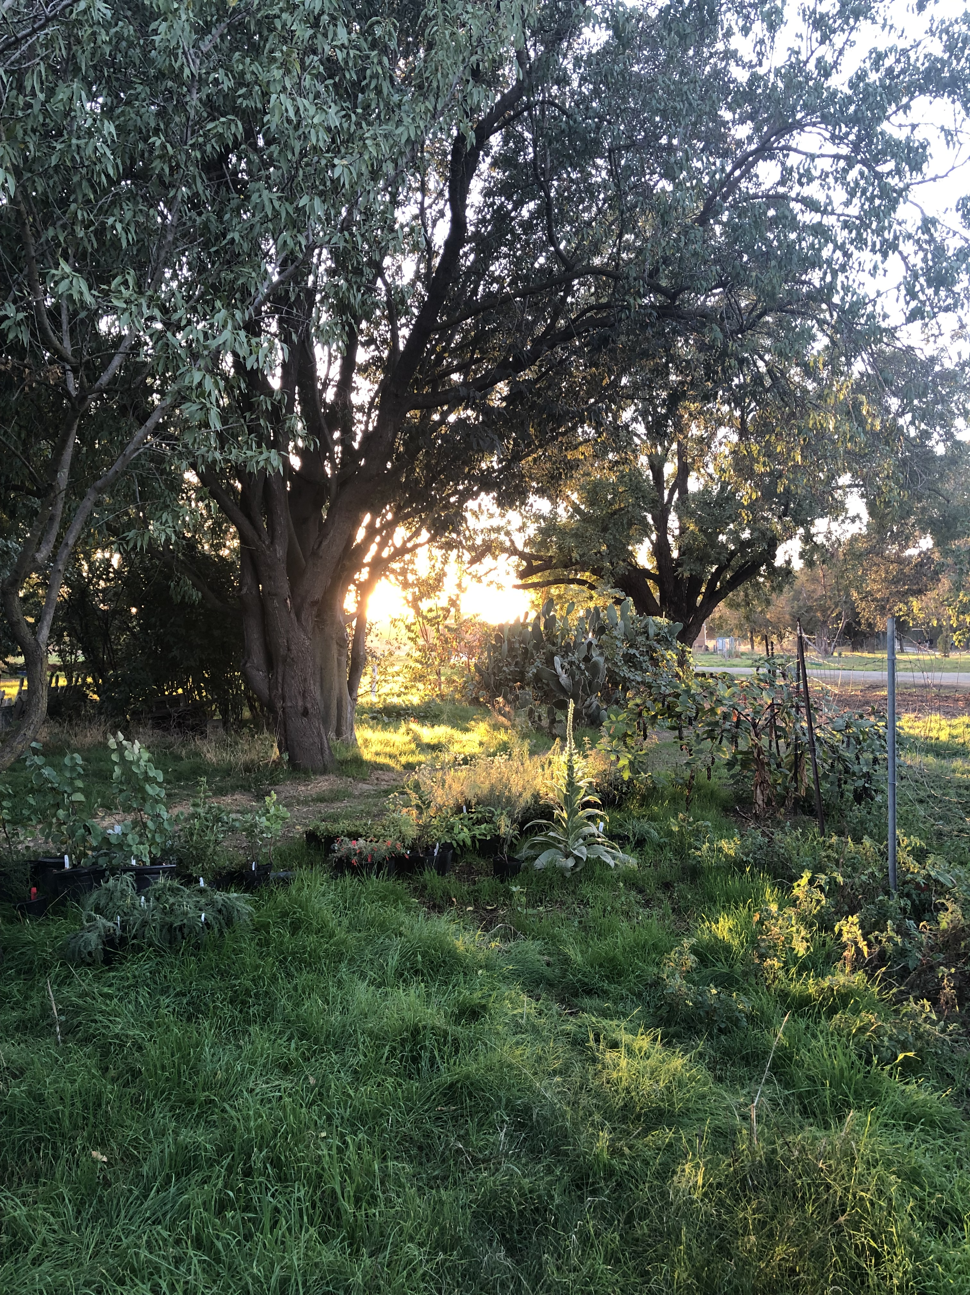
Thank you!

